Slide 1
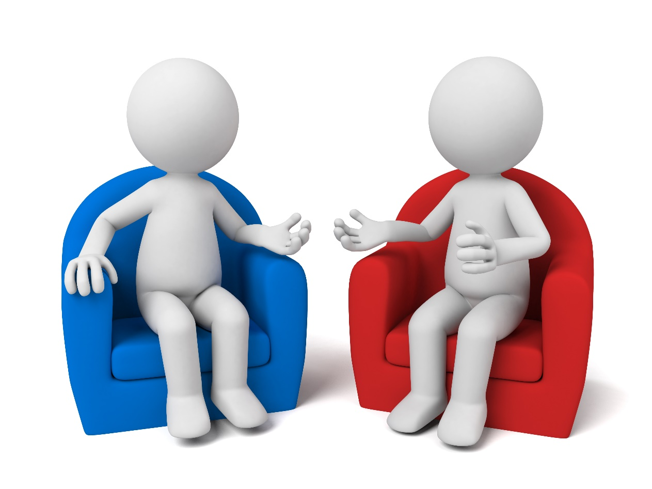
All behaviour is communication
Making sense of behaviour in a neurodiverse world
Part 2
“English is my second language. Autism is my first,”
Dani Bowman
Sarah Barratt
Educational Psychologist, PASDA
sarahs_karma@yahoo.co.uk

Slide 2
Module Outline
Part 2
Neurotypes: Neurological Differences
Communication: Autism and Social Communication
Myth Busting: Behaviour that may appear rude
Autism and Empathy: ‘Shallow’ versus ‘Deep’ Empathy
Theory of Mind: Perspective Taking
Autistic Overload: Burnout, Meltdown and Shutdown
Masking: Mimicking Others
Autistic Overload: Signs of Distress
Neurology of the Stress Response: A Physiological Reaction

Slide 3
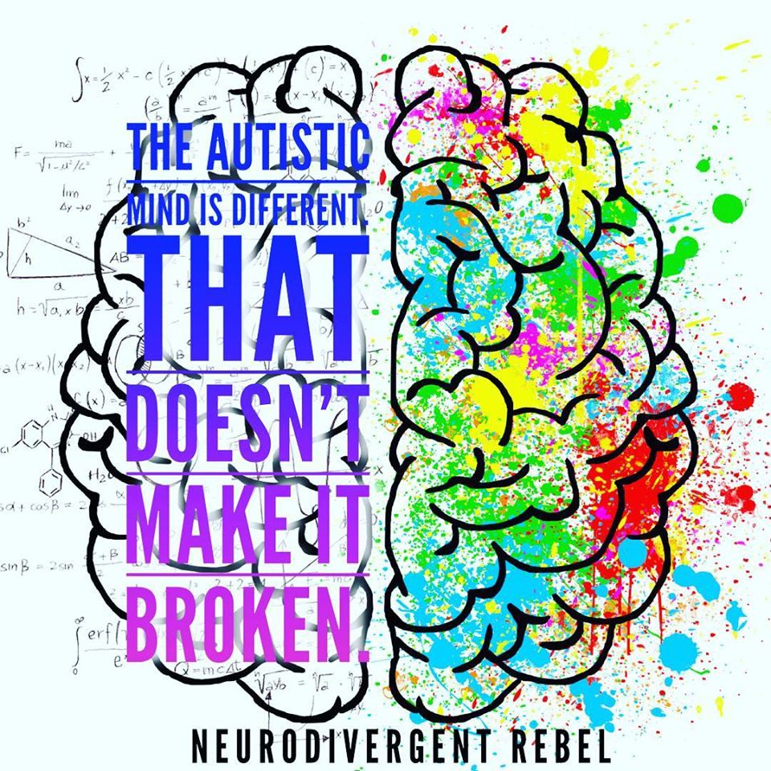
Neurotypes
Autistics and neurotypicals communicate and think differently
Autistic and neurotypical brains process information differently
The Autistic brain is a different; not a deficient neurotype
Neurodiversity is a vital part of humanity
https://blogs.scientificamerican.com/observations/clearing-up-some-misconceptions-about-neurodiversity/

Slide 5
The library is your mind . . .
and books are the sensory, emotional, or cognitive
stimuli that the environment offers
Imagine a very tidy library
Most people pick out one or two books they think is relevant
The rest they ignore; either they are not useful or are about a similar subject
Neurotypicals have a ‘natural stimulus discrimination system’ to choose a single book
Nobody taught them how to do this; this is an innate neurological ability
It's just the way their minds work
The Neurotytpical mind
Taken from what Autistic adults have learnt about how the Autistic mind differs from that of most other people’s
https://neuroclastic.com/wp-content/uploads/2020/04/UNDERSTANDING-THE-AUTISTIC-MIND-11.pdf

Slide 6
The library is your mind . . .
Now imagine a library with no shelves
All books are open
Thousands of red threads interconnect information in one book with that of another; like a detective's corkboard
With all the books open; pasted against the walls, it is difficult to select the one or two you need
This is how Autistic brains work
‘We don't have the same ability to discriminate among stimuli’
Autistic individuals cannot filter stimulus input
They therefore have to process all the stimuli that enters their minds
The Autistic mind
Taken from what Autistic adults have learnt about how the Autistic mind differs from that of most other people’s
https://neuroclastic.com/wp-content/uploads/2020/04/UNDERSTANDING-THE-AUTISTIC-MIND-11.pdf

Slide 7
What is communication?
The three basic levels of communication
Vocabulary
Tone of voice
Non-verbal behaviour
Meaning is conveyed in the following ways:
7% through the words spoken
55% via body language and non-verbal behaviours
38% through paralinguistics i.e. the volume and tone of voice
All the above have a significant impact:
on the messages we share with one another
what understanding we are left with
7%
38%
55%

Slide 8
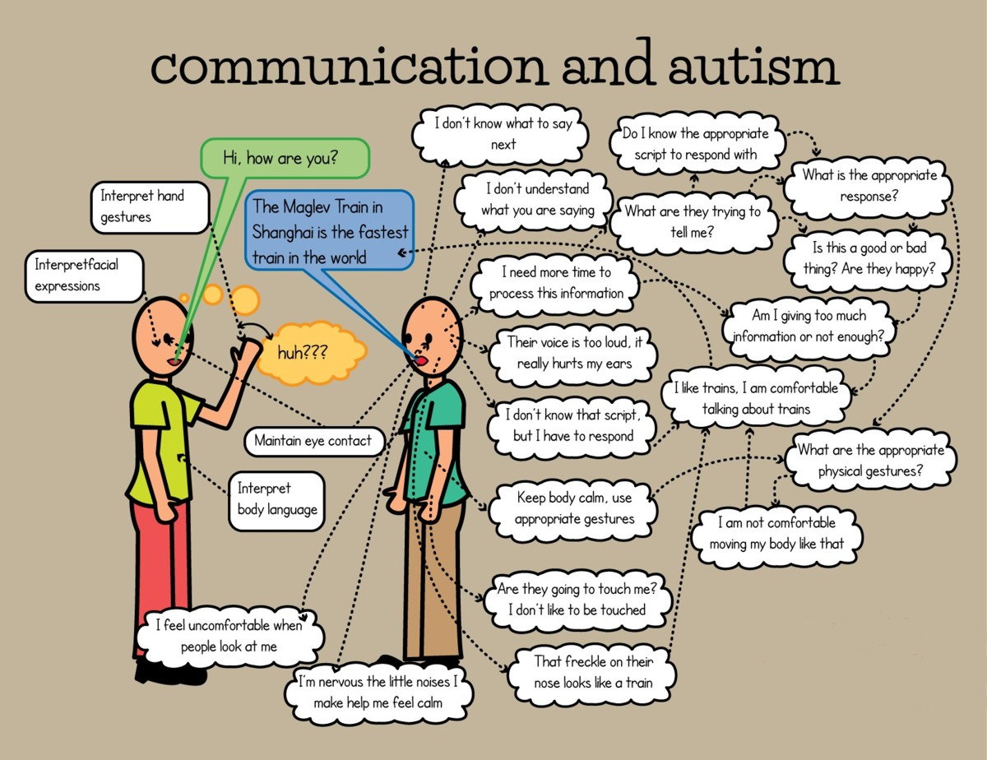
Some of the challenges many Autistic adults may experience during social interaction.

Slide 9
Autism and Social Communication
‘The latest thinking acknowledges that language is an
integral part of social communication, and that social
communication as a whole, is a persistent difficulty for
many Autistic people.’
Lydia Denworth
Science journalist, author and speaker

Slide 10
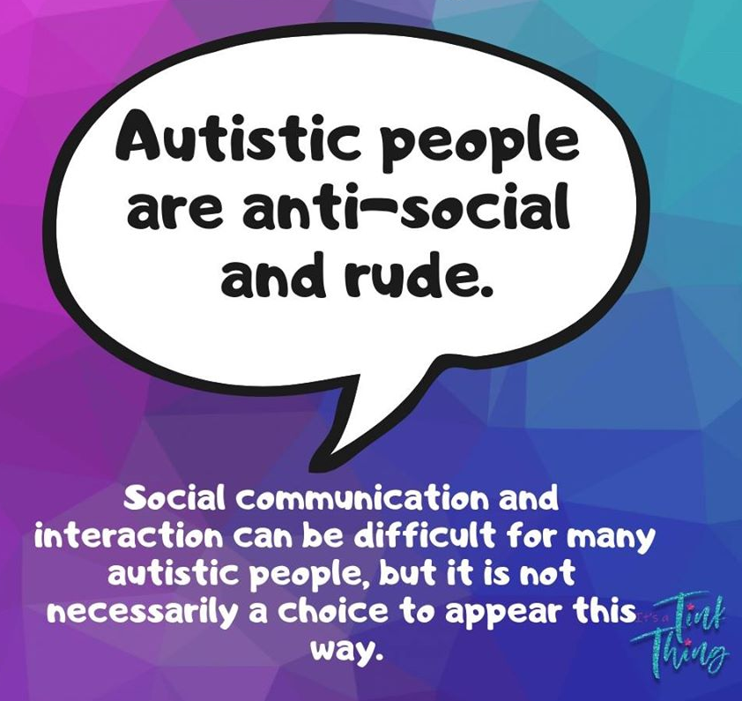
Behaviour that may appear rude . . .
We do not listen
We seem distrustful
We sometimes laugh at inappropriate moments
We invade other’s space
We cancel plans at the last minute
We appear condescending
We are too honest for our own good
We leave conversations abruptly
We are loud
We do not always follow the rules
By James Sinclair,
My journey to find out what makes him (Autis)tic
https://autisticandunapologetic.com/2020/07/11/10-rude-things-autistic-people-do-and-what-they-really-mean/

Slide 11
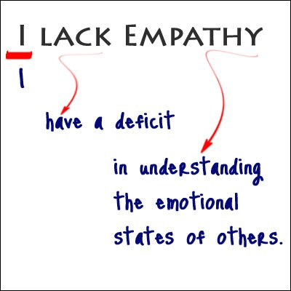
Autism and Empathy
From the ‘Musings of an Aspie’, one woman’s thoughts on life on the spectrum
‘This doesn’t mean I’m unsympathetic.
It doesn’t mean I don’t care for others.
It doesn’t mean I can’t show concern.
It doesn’t mean I have no emotions.
It doesn’t mean I don’t get overwhelmed by other people’s emotional states.
It doesn’t mean I’m any less human than you are.
What does it mean then?
That I may need more information than a typical person to understand a social situation. That my reactions to your emotions may be unconventional. That I have to work harder to grasp what comes naturally to most people.
Simple as that. Nothing more, nothing less.’
https://musingsofanaspie.com/2013/01/17/the-empathy-conundrum/

Slide 12
https://www.youtube.com/watch?v=1Evwgu369Jw

Slide 13
‘We do not lack empathy as people know it. We lack cognitive empathy (shallow empathy). That is, the ability to predict other's thoughts and intentions, including the ability to read between the lines during communication. We have plenty of affective empathy (deep empathy), which is the ability to share another person's feelings with them. We have plenty of compassionate empathy (deep empathy) , which is the desire to help others (though we may not always know how). Many of us have too much affective and compassionate empathy which can be overwhelming for us.’
Is Autism an ‘Empathy Disorder’?
Autism may mean a lack of ‘shallow empathy’, but not ‘deep empathy’.
https://www.psychologytoday.com/us/blog/out-the-darkness/201705/is-autism-really-empathy-disorder

Slide 14
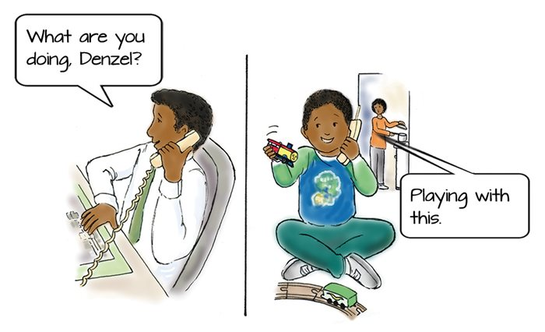
Theory of Mind
The ability to take another's perspective; ‘put yourself in their shoes’

Slide 15
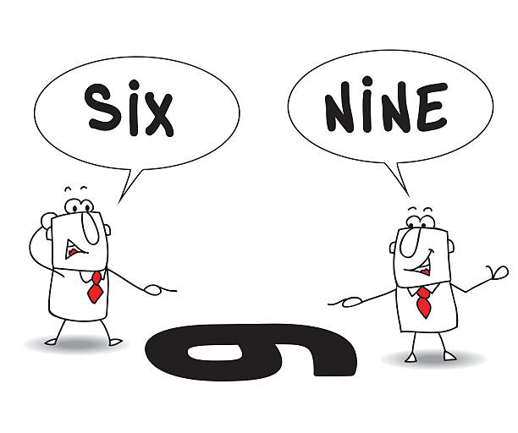
Theory of Mind
Difficulty appreciating another’s perspective, can make it difficult to:
Explain one’s own behaviours
Understand emotions
Predict the behaviour or emotional state of others
Understand perspectives of others
Infer the intentions of others
Understand that behaviour impacts how others think and/or feel
Attend jointly and make sense of other social conventions
Differentiate fiction from fact

Slide 16
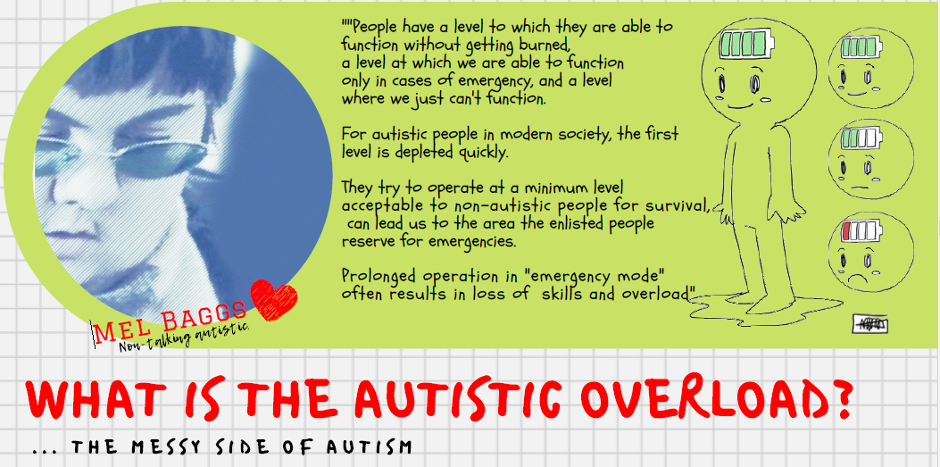
https://www.youtube.com/watch?v=JnylM1hI2jc

Slide 17
Types of Autistic overload
Burnout: a form of silent and prolonged collapse; the mind is busy handling the stimuli that overload it and cannot focus on everyday tasks
Meltdown: an extreme stress reaction; a furious outburst in overwhelming situations, with loss of control in behaviour that is expressed verbally, physically or combination of both
Shutdown: the flip side of a meltdown; it occurs internally; an autistic person may seem disconnected, limited to doing only the minimum to survive; essentially functioning on auto-pilot
These should NOT be considered as behavioural problems!

Slide 18
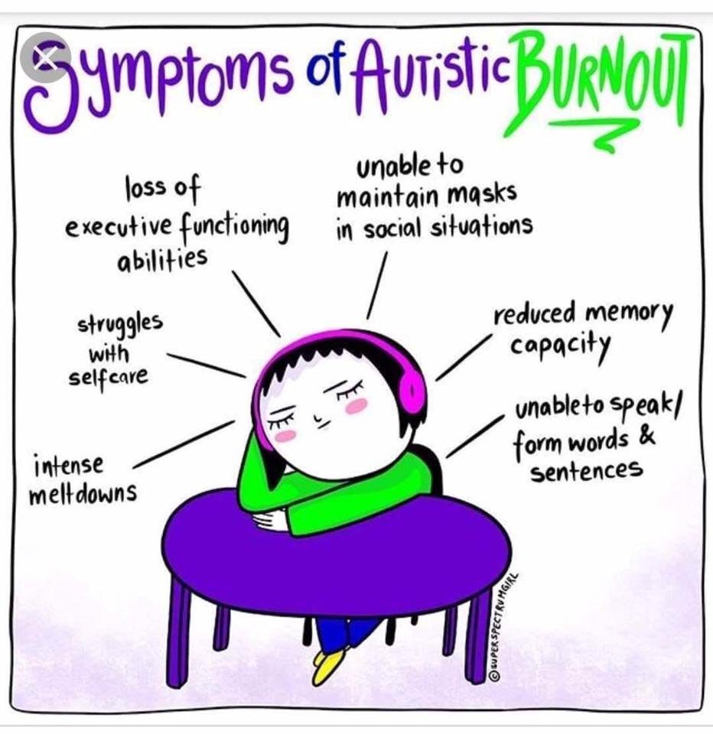
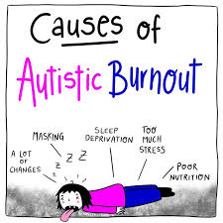

Slide 19
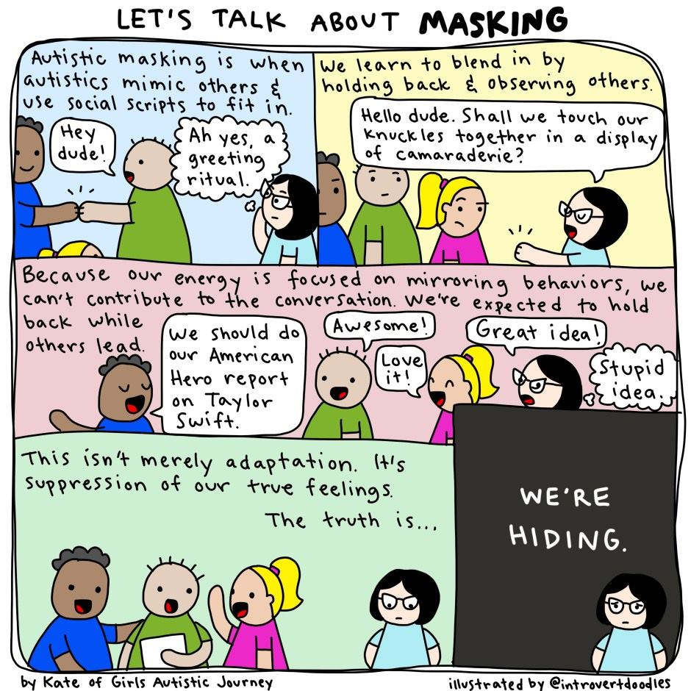

Slide 20
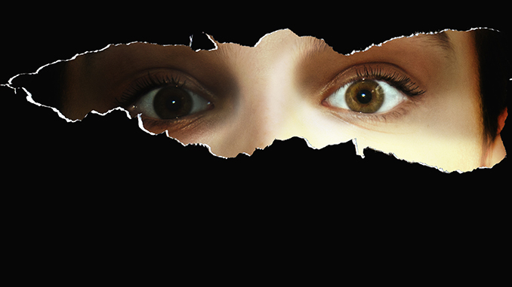
https://www.spectrumwomen.com/opinion-piece/what-masking-is-not/

Slide 22
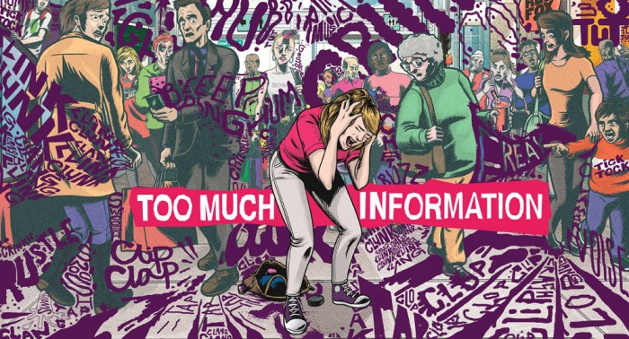
Autistic Meltdowns

Slide 23
Autistic adults describe what a meltdown feels like
https://www.youtube.com/watch?v=WAPAA4lm8M8

Slide 24
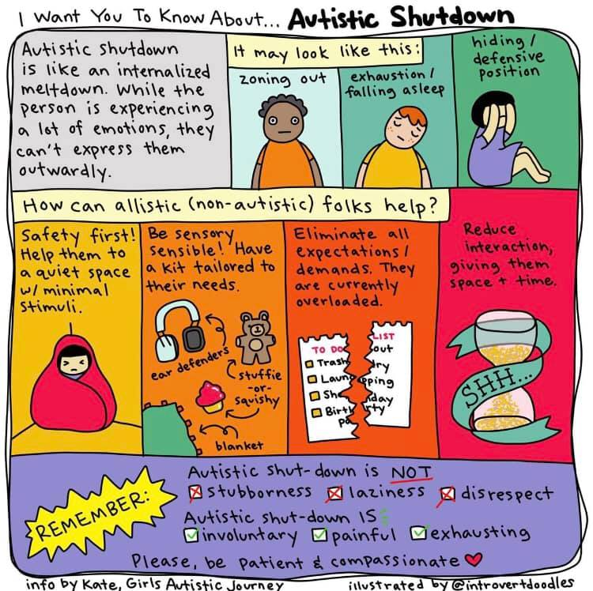

Slide 25
https://www.youtube.com/watch?v=spLOq80e4f0

Slide 26
Autistic overload
versus behaviour problems
Behavioural Problems | Autistic Overloads
Influenced by the attention and reaction of others | Occurs regardless if any one is looking
Manipulative and have a clear and defined goal | A response to distress and/or perceived threat
Careful not to hurt one’s self | Often become unsafe to themselves and others without being aware of it
Generally stops once the desired goal has been achieved | Often long lasting and ends only when the internal chaos is has dissipated
the individual is the one who controls the situation | Nobody is in control of the situation

Slide 27
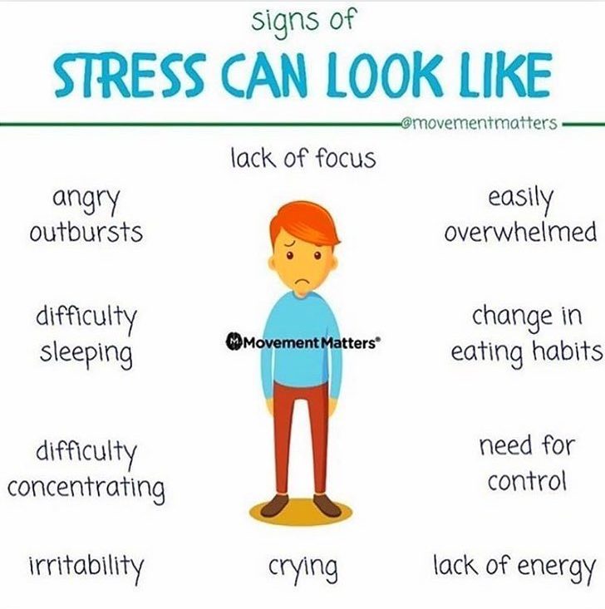
Signs of
DIS

Slide 28
Neurology of the stress response
Peanuts is feeling distressed
He has flipped his lid!

Slide 29
57 Albion Road, Edinburgh EH7 5QY Tel: 0131 475 2416 Email: info@pasda.org.uk Website: www.pasda.org.uk Scottish Charity Number: SC042678
MAKE A DONATION TO SUPPORT Pasda’s WORK
If you have benefitted from this presentation, please consider supporting Pasda's work.
You can do this in one of four ways:
Donate via JustGiving on the Pasda website at: https://www.pasda.org.uk , at the top right of the Home Page.
Donate via JustGiving at: https://www.justgiving.com/pasdauk
Make a bank transfer. To do this, please contact us by phone or email for the account details.
Make out a cheque payable to Pasda, and mail it to our office at the address above.
Thank you very much.

