Slide 1
Pathological
Demand
Avoidance
A misunderstood profile of Autism
PART 2
Sarah Barratt
Educational Psychologist, PASDA
Sarahs_karma@yahoo.co.uk

Slide 2
Extreme Demand Avoidance Questionnaire (EDA-Q)
A screening tool
Score 1
Score 2
Score 3
Score 4
Designed by Liz O’Nions
http://www.pdasociety.org.uk/resources/extreme-demand-avoidance-questionnaire

Slide 3
The stages of Demand Avoidance
STAGE 1: LIGHT AVOIDANCE | STAGE 2: STRONG AVOIDANCE | STAGE 3: MELT- OR SHUTDOWN
Distraction
Procrastination
Negotiation
Excusing themselves
Ignoring
STAGE 1: LIGHT AVOIDANCE | STAGE 2: STRONG AVOIDANCE | STAGE 3: MELT- OR SHUTDOWN
Distraction | Retreating into fantasy or role play
Procrastination | Outrageous social behaviour
Negotiation | Incapacitating themselves
Excusing themselves | Making excuses that seem ridiculous
Ignoring
STAGE 1: LIGHT AVOIDANCE | STAGE 2: STRONG AVOIDANCE | STAGE 3: MELT- OR SHUTDOWN
Distraction | Retreating into fantasy or role play | Self harm (physical and/or emotional)
Procrastination | Outrageous social behaviour | Verbal or physical abuse of others
Negotiation | Incapacitating themselves | Destruction of property
Excusing themselves | Making excuses that seem ridiculous | Extreme exhaustion & inability to function
Ignoring
‘Stage 3’ type behaviours are essentially survival responses to what are perceived as threatening situations!
Notes:
You may remember from the video shared earlier, some of the strategies employed by PDAers to avoid demands.

Slide 4
The Anxiety bucket Analogy
Explaining accumulation of anxiety
‘My anxiety bucket doesn’t empty naturally (or if it does it’s very, very slow).
I never want to get to the point where it’s full as then my cognitive ability becomes too impaired and I can’t cope.’
Julia Daunt, Adult PDAer
A Neurotypical’s anxiety bucket
A PDAer’s anxiety bucket
https://www.pdasociety.org.uk/resources/julias-story/

Slide 5
Harry Thompson on Demand Avoidance
https://www.youtube.com/watch?v=9exqlS1gsS4

Slide 6
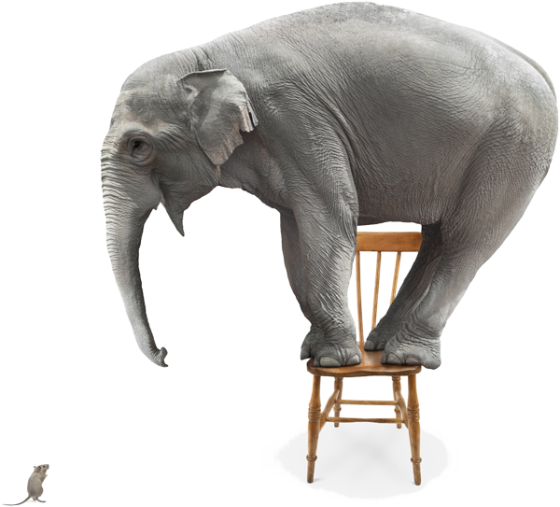
Highly sensitive neuroception
at the heart of PDA based on Dr Stephen Porges’ theory of Neuroception
https://pathologicaldemandavoidanceaprofileofautism.com/2019/06/25/pda-neuroception-the-five-fs/
Neuroception is our neural (brain) circuits’ capacity to determine the level of threat posed by a situation and/or person
A perceived threat triggers a defensive bodily response
In the case of PDA, threat is perceived within ‘demands’
A survival response is unconsciously triggered
The more extreme responses a PDAer has in relation to
demands can be viewed as similar to that of a
trauma response
It may then be helpful to view PDA through a trauma informed
lens
Raelene Dundon, 2018 Clinical Psychologist
http://www.raelenedundon.com/supporting-children-with-pda-using-play-and-trauma-informed-practice/
Notes:
Viewing PDA in this way, does not mean that PDA is caused by trauma, PDA is a profile of behaviour that presents as part of an ASD.
What it does mean however, is that we are then able to respond with the essential calm and gentleness that is required to hold a safe space for the individual with PDA to return to rather than join them in their triggered space; their neuroception of threat.

Slide 7
Family experiences of PDA
Parents labelled as permissive and advised to attend parenting courses
Family PDAer believed to be a victim of fabricated or induced illness prompting Social Work involvement
Parents as well as adult PDAer left feeling incompetent, hopeless, unsupported and misunderstood
An ever increasing sense of social isolation
Decreasing emotional & mental wellbeing
Significant breakdown in family dynamics
Life long financial implications and concerns for the future
Geographical variation in terms of diagnosis and access to appropriate services
https://www.pdasociety.org.uk/wp-content/uploads/2019/08/BeingMisunderstood.pdf

Slide 8
Parent/carer’s voices
HEAR OUR
‘Reprogramming yourself to parent in a completely counter-intuitive way.
The biggest challenge for us now is having no one recognise it or know how to help.’
VOICES!
‘My whole life has changed. I am stressed constantly and no longer have any patience or tolerance for anybody other than my children. My marriage has broken down and I have no friends. I don’t even get any support from my family.’
From ‘Being Misunderstood: Experiences of the PDA Profile of ASD’

Slide 9
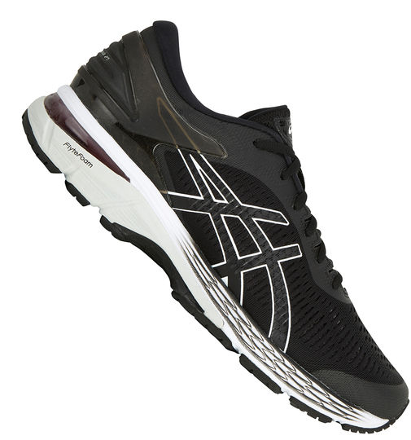
How to respond in a PDA way
The scenario:
You surprise your adult PDAer with brand new pair of Asics trainers; trainers he had indicated he had wanted
You open the box and present them to him
to demand avoidance of a PDA kind
His response:
‘I thought I was going to go with you to buy these?
They look way too big?
Are you sure they are the right size?
This white bit here is going to get very dirty!
My old ones don’t have this white bit here.’
He takes the trainer from you and places it back into the box and continues to play X-box.

Slide 10
How to respond in a PDA way
to demand avoidance of a PDA kind
What is your ‘gut’ response to this situation?
What do you think is the demand that is being avoided?
How could you respond in a way that demonstrates your understanding of the demand avoidance at play?

Slide 11
Some Adult PDAer’s experience
‘In some cases parents, or the individual themselves, may have only recently discovered PDA while searching for answers to help them understand the difficulties that they may have experienced, either personally or in raising their child.
In such cases it is not uncommon for these adults to have never been identified as having an ASD. Because of this, it is not uncommon for these adults to have gone through life misunderstood and misdiagnosed.
This may sometimes have led to a variety of diagnoses, including mental health disorders and/or conduct or personality disorders.
Some have spent periods in mental health wards and in a few cases some adults may have been sectioned under the mental health act.
Self-medication in the form of substance or alcohol abuse may also be a factor, as are brushes with the criminal justice system.’
https://www.pdasociety.org.uk/life-with-pda-menu/adult-life-landing/adult-life-by-pdaers-landing/

Slide 12
“If I’d been diagnosed aged 5 I might have a job now. There are a lot of ‘what ifs’. Although I’ve accepted that I won’t work, I haven’t accepted why. Demand avoidance is everything. Work is a demand too far. After a day of social interaction I might need a week of recovery. I can’t work one day a week, or have a TA at work or have an office all to myself. I’d need too many accommodations. I’m too disabled. It’s not like putting in a wheelchair ramp.
For me self-awareness is the key. If you don’t have self- awareness how can you modify or avoid things that cause anxiety? Society continually tells us we need to act in a certain way, we’re forced to learn how to fit in. If you don’t know why you feel anxious out there how can you deal with it? When you understand what’s hard for you and why, you can make suitable adjustments. I have continuous pings or lightbulb moments when I look back and can see how certain things happened or why I felt in a certain way. All of a sudden once you have self-awareness your life makes sense.”
Julia Daunt; age 36
Diagnosed with PDA (12½) & comorbid ADHD
https://memyselfandpda.com/

Slide 13
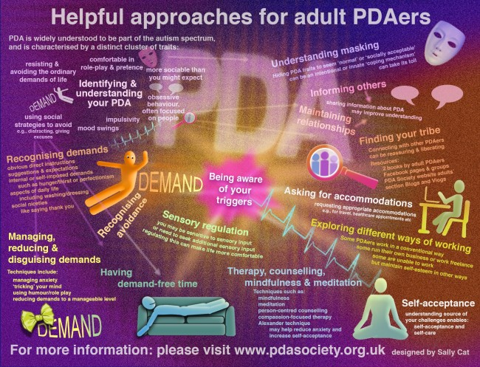
- Recognise demands
- Recognise avoidance
- Identify & understand your PDA
- Self-acceptance
- Understand masking
- Find your tribe
- Manage, reduce & disguise
demands
- Be aware of your triggers
- Sensory regulation
- Have demand-free time
- Explore different ways of
working
- Inform others & ask for
accommodations
- Maintain relationships
- Therapy, counselling,
mindfulness & meditation
https://www.pdasociety.org.uk/life-with-pda-menu/adult-life-landing/self-help-coping-strategies-and-therapies-for-adult-pdaers/

Slide 14
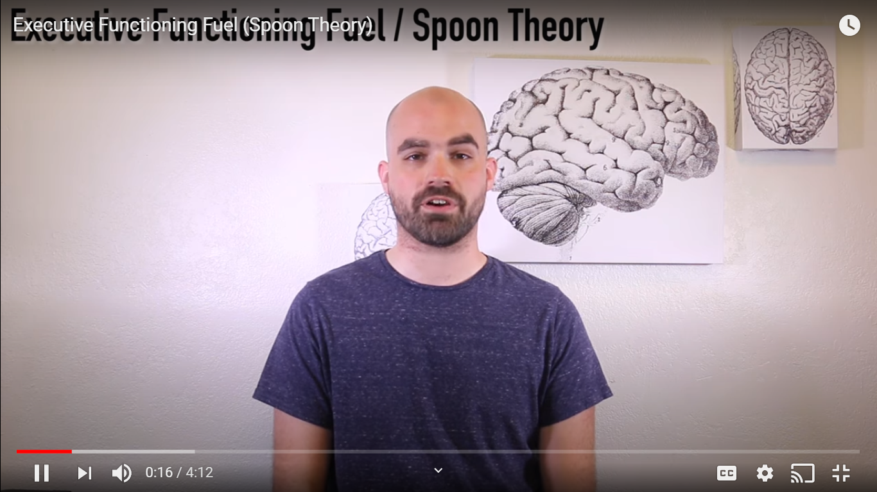
https://www.youtube.com/watch?v=7Dt7QgfQYOE

Slide 15
Building family resilience
What typically works to support autistic individuals DOES NOT work for PDAers
Through relationship create the sense of feeling safe
All behaviour is communication
It is not personal
Balance tolerance and demands
Pick your battles
Decide on and how to, enforce
non-negotiable boundaries
Make use of natural rewards and
consequences
Plan ahead
Adopt an appropriate communication style
Identify and address sensory differences
Notes:
A relationship based on collaboration and respect, is more likely to build trust and reduce less desirable behaviours
Remember the iceberg analogy, the behaviour you see (the tip of the iceberg) is underpinned by a culmination of difficulties hidden beneath the surface. All behaviour is communication. Therefore ask yourself: ‘What is my adult PDAer saying through his behaviour?

Slide 16
Building family resilience
Continued . . .
Develop and promote self-awareness
Use humour
Be open to doing things alongside your PDAer
family member
Manage challenging behaviour
Make use of visuals and/or non-verbal cues
Make use of a ‘noticing wall’
If in doubt stay silent
Be prepared to be adaptable and flexible
Support emotional wellbeing, while remembering to safeguard your own
https://notesonpda.wordpress.com/2019/05/16/a-z-of-pda-strategies/

Slide 17
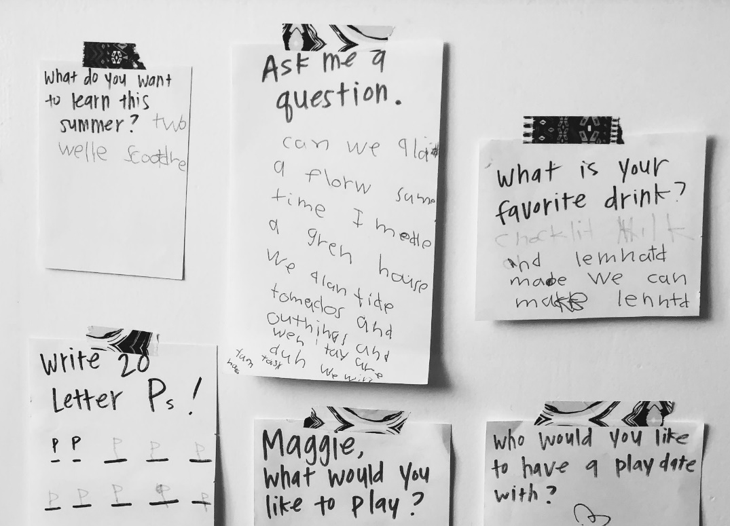
A noticing Wall
A note of encouragement from my son, who has been diagnosed with the PDA profile of Autism, on our noticing wall.
https://offspring.lifehacker.com/create-a-noticing-wall-for-your-kid-1834930062#:~:text=If%20you're%20creating%20a,And%20sometimes%2C%20poems%20about%20farts.

Slide 19
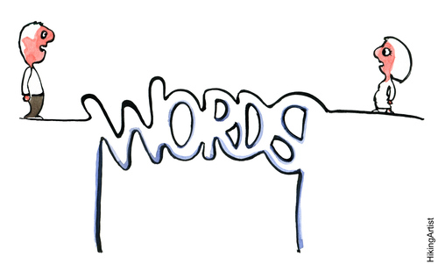
Adopt an appropriate communication style
Use indirect commands to disguise demands and make them fun
Try to make them feel useful which also helps to maintain emotional wellbeing
Pretend you don’t know/get it wrong and ask them to teach you
Offer limited choices to give the PDAer
a sense of control
Use role play and props
Model desirable behaviour
Voice control: use a calm, even tone
Indirect praise

Slide 20
PDA friendly language
https://pathologicaldemandavoidanceaprofileofautism.com/2020/04/24/pda-and-language/

Slide 21
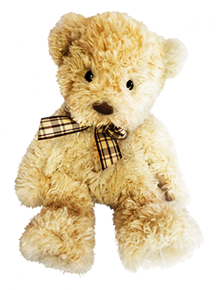
Meet Tyke, the French Bulldog puppy
Your PDAer / the PDAer in your care recently decided to get a puppy.
This wasn’t a snap decision it was two years in the planning, we both thought about it, did a massive amount of research and made sure we were really ready.
Your PDAer / the PDAer in your care was delighted with his puppy when he got him three weeks ago.
He named him Tyke and was getting up early to take him out, feed him and walk him round the block.
He loved to watch Tyke pounce on the soft teddy bear we had chosen for him and shake the ‘life’ out of it.

Slide 22
One morning however, I came downstairs / arrived at the house to find he was already up.
He told me he had seen to Tyke, so I asked him if he wanted to take him to the park later, but instead of answering, he stormed out the room, the slammed door reverberating in my ears.

Slide 23
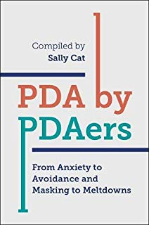
https://www.pdasociety.org.uk/adult-life
Resources
Books:
https://www.autism.org.uk/about/what-is/pda.aspx
Blog:
http://www.sallycatpda.co.uk/
PDA Support Groups:
https://www.facebook.com/groups/416598812283015/
Facebook pages:
https://www.facebook.com/JuliaDauntPDA/
https://www.facebook.com/PDAsupportPage/
https://www.facebook.com/groups/AdultPDASupportNetwork/

Slide 24
57 Albion Road, Edinburgh EH7 5QY Tel: 0131 475 2416 Email: info@pasda.org.uk Website: www.pasda.org.uk Scottish Charity Number: SC042678
MAKE A DONATION TO SUPPORT Pasda’s WORK
If you have benefitted from this presentation, please consider supporting Pasda's work.
You can do this in one of four ways:
Donate via JustGiving on the Pasda website at: https://www.pasda.org.uk , at the top right of the Home Page.
Donate via JustGiving at: https://www.justgiving.com/pasdauk
Make a bank transfer. To do this, please contact us by phone or email for the account details.
Make out a cheque payable to Pasda, and mail it to our office at the address above.
Thank you very much.

