Slide 1
All behaviour is communication
Making sense of behaviour in a neurodiverse world
Part 1
“English is my second language. Autism is my first,”
Dani Bowman
Sarah Barratt
Educational Psychologist, PASDA
sarahs_karma@yahoo.co.uk

Slide 2
Are your eyes listening?
“Are your eyes listening?
That’s what needs to happen to hear my writing voice.
Because of Autism, the thief of politeness and friendship, I have no sounding voice.
By typing words I can play with my life and stretch from my world to yours.
I become a real person when my words try to reach out to you without my weird body scaring you away.
Then I am alive.”
Excerpt from ’Are your eyes listening?
Collected Works’
by Sarah Stup,
a critically acclaimed Autistic author who types to speak

Slide 3
Module Outline
Part 1
The Iceberg Analogy: All Behaviour is Communication
The Social Discipline Window: Maintaining Social Norms & Behaviour Boundaries
Become a Stress Detective: Reframe Distressed Behaviour
Make Sense of Behaviour: A Functional Behaviour Analysis
Reframe Behaviour: Can’t instead of won’t
Behaviour through a Neurodiverse Lens: Autism from the inside-out

Slide 4
today
your

Slide 5
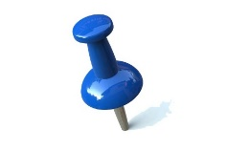
Take home
All behaviour is communication.
All behaviour serves a function.
A particular behaviour, for an individual, is the SOLUTION, not the PROBLEM!

Slide 6
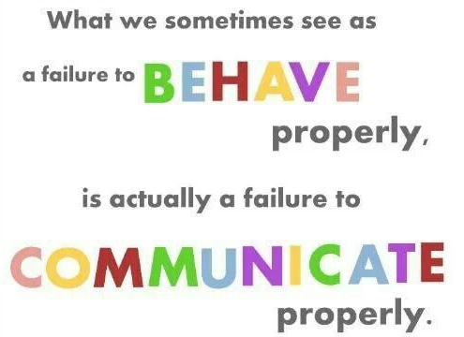
as expected.
difficulty to
adequately how we feel; what we want or need.

Slide 7
Dd Distressed Behaviour
What is your usual response to your adult Autistic child’s distressed behaviour?

Slide 8
Common interpretations of observable behaviours; the tip of the iceberg
Behaviour | Interpretation
Oppositional/ non-compliant | Wilful, attention seeking, stubborn, defiant, disrespectful
Verbally and/or physically aggressive | Bully, manipulative, immature
Self-harming and/or threatening suicide | Manipulative, attention seeking
Repeatedly making the same mistakes | Wilful, careless, lack of motivation, manipulative, inattentive
Disruptive and hyperactive | Disobedient, attention seeking, deliberately annoying, trouble maker
Unable to secure and/or maintain a job | Lazy, slow, dependent, immature, lacks motivation and/or ambition
Often late | Disrespectful, poor parenting
Anti-social behaviour e.g. spitting, swearing, destruction of property and/or lashing out at others | Bad parenting, absence of positive role models growing up, anti-social personality
Socially inappropriate | Bossy, controlling, demanding, self-centred, lacking in empathy, selfish, rude
Poor social judgment | Wilful, absence of positive role models, abused as a child
Common misinterpretations of observable behaviours; the tip of the iceberg

Slide 9
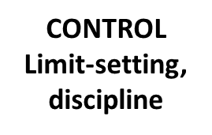
The Social Discipline Window
Approaches to maintaining social norms and behaviour boundaries
“Human beings are happier, more cooperative and productive, and more likely to make positive changes in their behaviour when those in positions of authority do things with them, rather than to them or for them.”
– Ted Wachtel
Social Discipline Window
TO
Punitive
WITH
Restorative
NOT
Neglectful
FOR
Permissive

Slide 10
The Social Discipline Window
Which window best describes your parenting/carer style?
HIGH
Authoritarian
Punitive
Power Struggles
Confrontation
Win-Lose
Retribution
Stigmatizing
Consistent
Responsive
Flexible
Accountable
Responsible
Cooperation
Negotiation
TO
WITH
Passive
Indifferent
Tired
Lazy
Burnt Out
Given Up
NOT
FOR
Protective
Chaotic
Inconsistent
Excusing
Giving In
Blurred Boundaries
Rescuing
LOW
HIGH

Slide 11
Activity
Making sense of behaviour

Slide 12
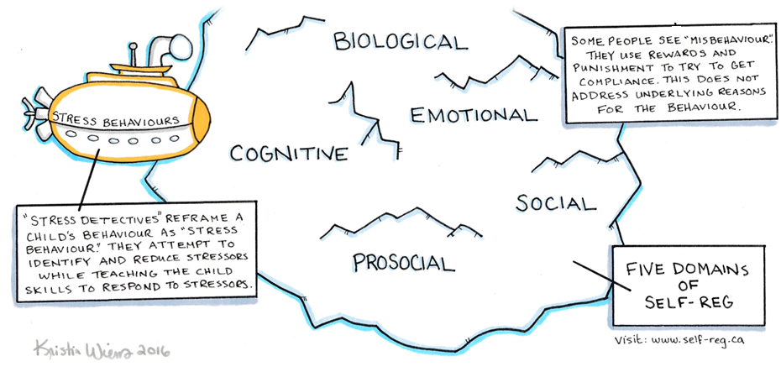
The Iceberg Analogy
Let us explore below the surface.

Slide 13
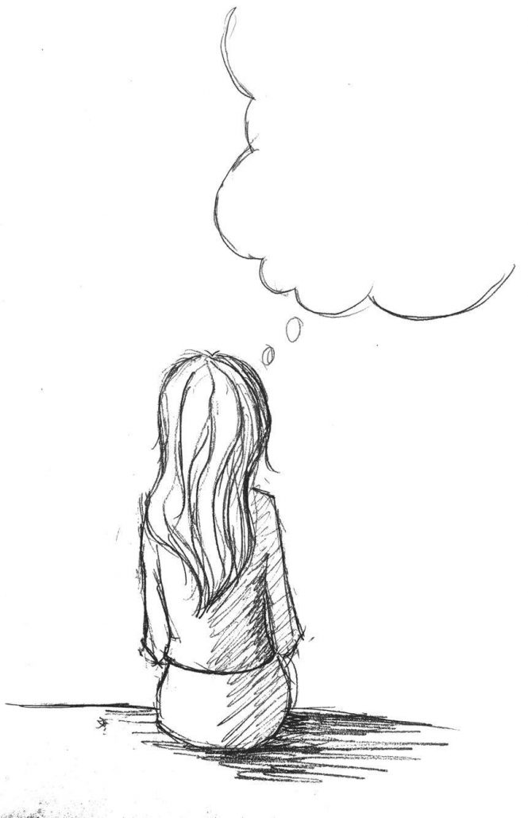
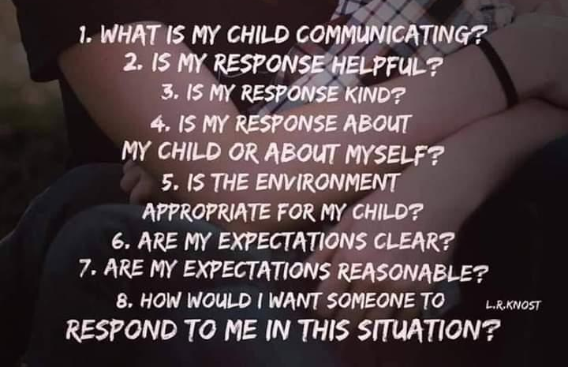
Ask yourself . . .
Reflect further

Slide 14
Become a stress detective
Reframe distressed behaviour as a stress behaviour
Your child may be trying to communicate one or more of the following:
frustration: they can’t do something or can’t tell you what they want
fear: they are frightened
strong feelings: they are unhappy or angry about something
anxiety: they are feeling confused, worried, stressed, unable to think well
hyperactivity: they have excess energy
discomfort: they are in pain and can’t tell you
attention: they are making attempts to meet their need for connection and interaction
difficulty with understanding: they may need time to work out what you mean and so don’t initially respond to an instruction
difficulty processing or making sense of sensory experiences in the environment: for example, may be hyper or hypo-sensitive to certain touch, noise and lights
Seeking sensory input and/or experiences: a requirement of their nervous system

Slide 15
Unmet needs
We all have the following needs at some point in our lives, to a lesser or greater degree.

Slide 16
Likely interpretations of observable behaviours; the tip of the iceberg
Behaviour | Interpretation
Oppositional/ non-compliant | Fearful, anxious, struggles to transition, difficulty processing verbal information, difficulty dealing with the demands of others
Verbally and/or physically aggressive | Distressed due to sensory overload, frustrated, difficulty regulating emotions
Self-harming and/or threatening suicide | Overwhelmed, depressed, highly anxious, aware of difference
Repeatedly making the same mistakes | Executive functioning difficulties i.e. difficulty generalising from one context to another
Disruptive and hyperactive | Sensory overload; neurological need to move
Unable to secure and/or maintain a job | Anxious, social communication difficulties, difficulties managing and dealing with the demands of others
Often late | Time blindness i.e. difficulty appreciating the passing of time
Anti-social behaviour e.g. spitting, swearing, destruction of property and/or lashing out at others | Potential underdeveloped coping skillsi.e. does not possess an alternative repertoire in terms of responding when frustrated and/or stressed
Socially inappropriate | Anxious, difficulty reading, making sense of and responding appropriately to social cues, context blindness
Poor social judgment | Lonely, difficulty reading social cues, context blindness

Slide 17
Recognize distress triggers
As a parent-carer ask yourself whether your adult Autistic child:
Has difficulty processing information?
Has difficulty anticipating what will happen?
Is unable to meet his/her sensory needs or experiences particular sensory stimuli as overwhelming e.g. noise can be overwhelming?
Has pain or other health problems?
Has difficulty concentrating?
If there’s been difficulty for other people to connect socially with him/her?
If he/she wants to tell you something, but is unable to articulate this clearly?

Slide 18
Understand
the functions of behaviour
As a parent-carer consider what function your adult Autistic child’s behaviour serves
Trying to communicate the desire to receive or avoid attention
Attempting to obtain or avoid tangible objects
An effort to show that they would like to take part in or avoid an activity
Trying to receive or avoid certain sensory experiences

Slide 19
Consider . . .

Slide 20
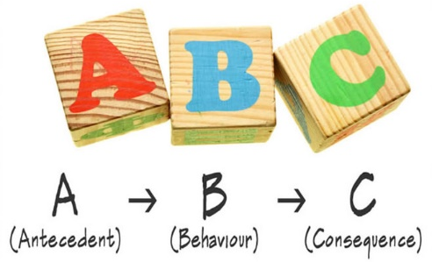
Making sense of behaviour
A Functional Behaviour Analysis
What was happening before the observed behaviour occurred?
What happened immediately following the observed behaviour?
What function could the observed behaviour be serving?
Date Time Antecedent Behaviour Consequence Function
https://blogs.nottingham.ac.uk/cffp/2018/11/05/functional-analysis-a-simple-worked-example-of-a-fictional-case/

Slide 21
Reframing behaviour

Slide 22
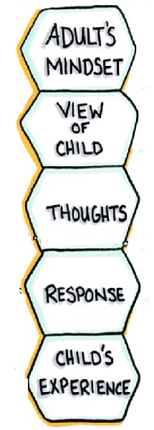
https://centerforparentingeducation.org/library-of-articles/child-development/the-skill-of-re-framing/

Slide 23
‘When we view behaviour through the lens of neurodiversity, we come to understand that any particular behaviour in one person can, in fact, mean something completely different in another person.’
Kristy Forbes,
an autistic support specialist for neurodivergent people and their families and professionals

Slide 24
Autism from the inside-out
understanding how Autistic individuals think, feel, and perceive the world
Autism is essentially perceptual, processing, and thinking differences
A different way of perceiving and experiencing the world
It is a human condition, not a behaviour disorder

Slide 25
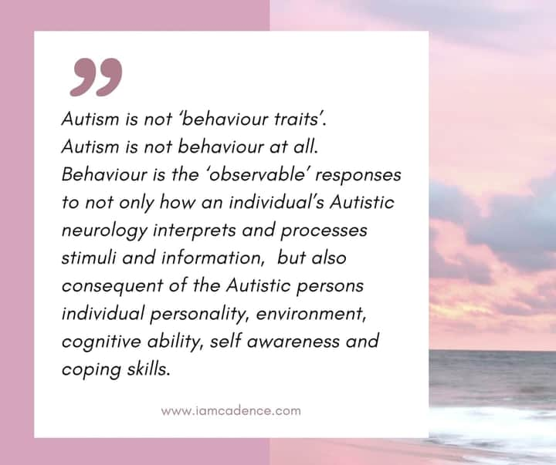
‘

Slide 26
57 Albion Road, Edinburgh EH7 5QY Tel: 0131 475 2416 Email: info@pasda.org.uk Website: www.pasda.org.uk Scottish Charity Number: SC042678
MAKE A DONATION TO SUPPORT Pasda’s WORK
If you have benefitted from this presentation, please consider supporting Pasda's work.
You can do this in one of four ways:
Donate via JustGiving on the Pasda website at: https://www.pasda.org.uk , at the top right of the Home Page.
Donate via JustGiving at: https://www.justgiving.com/pasdauk
Make a bank transfer. To do this, please contact us by phone or email for the account details.
Make out a cheque payable to Pasda, and mail it to our office at the address above.
Thank you very much.

