Slide 1
All behaviour is communication
Making sense of behaviour in a neurodiverse world
Part 3
“English is my second language. Autism is my first,”
Dani Bowman
Sarah Barratt
Educational Psychologist, PASDA
sarahs_karma@yahoo.co.uk

Slide 2
Module Outline
Part 3
Neurology of the Stress Response: Hand Model of the Brain
Autistic Meltdown: Fight, Flight, Freeze or Fawn Response
The Arousal Cycle: Making Sense of Distressed Behaviour
Cause of Autistic Overload: Too much Emotional, Cognitive and Sensory Information
Autistic Tools: Coping with Overload
Self-Care: Parent-Carers; Me Too
Escalating Behaviour: Responding Appropriately
Co-Regulation: First step towards Self-Regulation

Slide 3
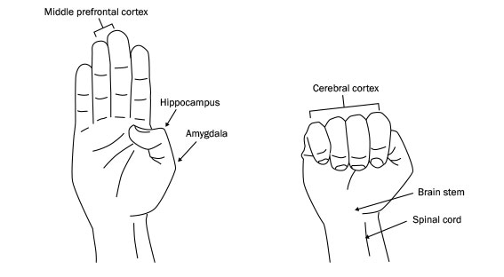
Fight/Flight/Freeze response
Dan Segal’s Hand Model of the brain: an explanation of what happens when we become distressed
Neocortex
gives us our ability to reason & communicate ideas via language
https://www.youtube.com/watch?v=f-m2YcdMdFw
Limbic Brain
Processes emotions & stores memories
Reptilian Brain
Survival & safety
Feeling calm
- The Neocortex is offline
Behaviour is now being controlled by the Limbic Brain’s interpretation of our emotions
Fight/Flight/Freeze mode has been automatically
activated by the Reptilian Brain
The Neocortex mediates our responses to emotional
triggers
It helps us to put a pause between a trigger and a response and allows us to think through options and possible consequences

Slide 4
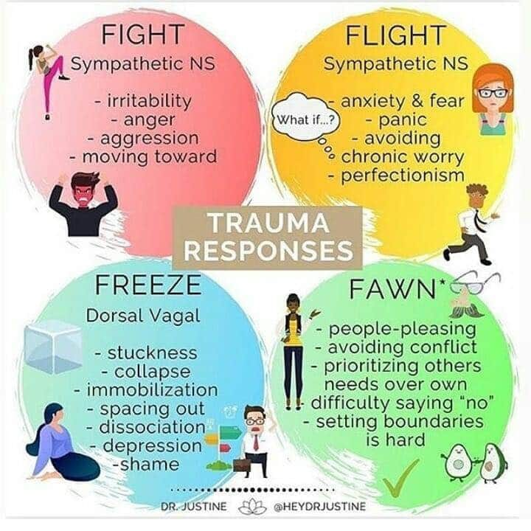
When distressed and we have ‘flipped our lids’ i.e. the thinking brain is offline and the feeling brain is now in charge.
We will respond in one of the following four ways
Responses to Autistic Meltdown
https://www.youtube.com/watch?v=oTGeqnbQp_Q

Slide 5
The arousal cycle
of distressed behaviour
Trigger
Phase
Escalation
Phase
Crisis
Phase
Recovery
Phase
Post Crisis
Phase
Learning
Phase
Crisis
Additional assaults
Assault
AROUSAL
Aggression
Anger
DANGER
Anxiety
PERCEIVED THREAT
Baseline Behaviour
Exhaustion
TIME

Slide 6
Emotion | Behaviour | Message | Response
Anxiety (Trigger Phase) | Withdrawal or agitation | I’m worried I’m frustrated | Active Listening, explore feelings, Problem Solve, Involve, redirect, relaxation strategies, anxiety management
Anger (Escalation Phase) | Loud / Disruptive Critical, Swearing, Generalised Abuse | Listen to me Help Me | As above + divert, refocus, reassure, set limits, remove others
Aggression (Escalation Phase) | Personalised Abuse Threats , Gesticulation, Space Invasion, Eye contact | I’m losing control Help me regain control | Set limits, unambiguous language, don’t question, divert, offer exit, seek help
Crisis (Crisis Phase) | Destructive behaviour Towards people/ property / self | Can you control me? | Escape, Protect self and others, Seek Assistance,
Exhaustion (Recovery Phase) | Tearful, Expressions of remorse / anger, regret, apologetic | I feel bad | Support, Monitor Secure the area
Post Incident (Learning Phase) | Return to baseline behaviour |  | Post incident review(s)

Slide 7
What causes Autistic Overload
Emotional Overload
Cognitive Overload
Sensory Overload
https://www.youtube.com/watch?v=vloYhuxiD-0

Slide 8
A psychologist walked around a room while teaching stress management to an audience. She asked . . .
https://www.youtube.com/watch?v=01BBbRgHcq8

Slide 9
Emotional Overload
Baseline coping capacities
INDIVIDUAL
INDIVIDUAL
INDIVIDUAL

Slide 10
s. . .
are the mental processes that enable us to. . .
Plan
Focus Attention
Remember Instructions
Juggle Multiple Tasks
All 3 are interlinked & influence each other
2. Inhibitory Control
1. Working Memory
3. Cognitive Flexibility
Executive function distinguishes three components. . .

Slide 11
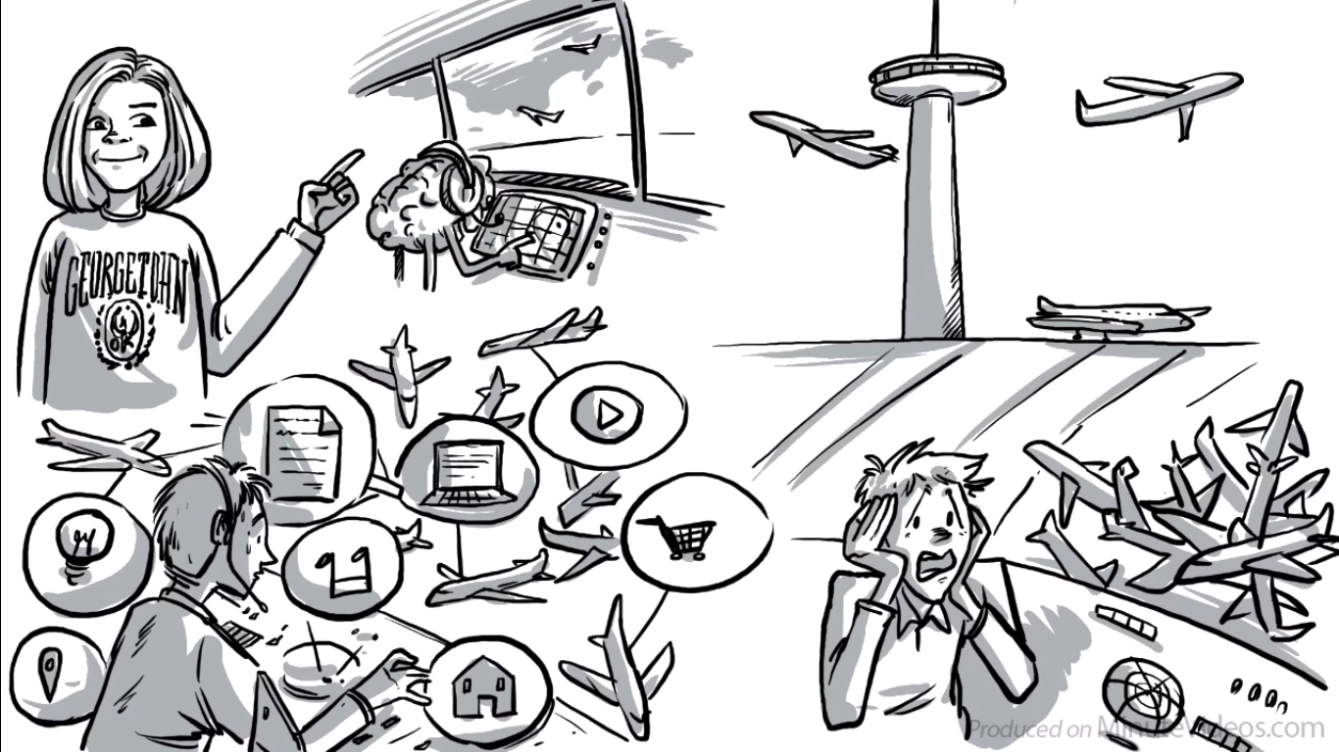
Psychologist
Deborah Phillips
Managing lots of information and distractions simultaneously
Air Traffic Control System of the Brain
Executive Dysfunction can result in chaos
Executive Function: The Brain’s Control Centre
https://www.youtube.com/watch?v=sZmElSGKBG8

Slide 12
Executive Functioning & Autism
https://www.youtube.com/watch?v=229Xb50_o8M

Slide 13
Cognitive Overload
LOT OF
INFORMATION
LOT OF
INFORMATION
The Autistic Brain

Slide 14
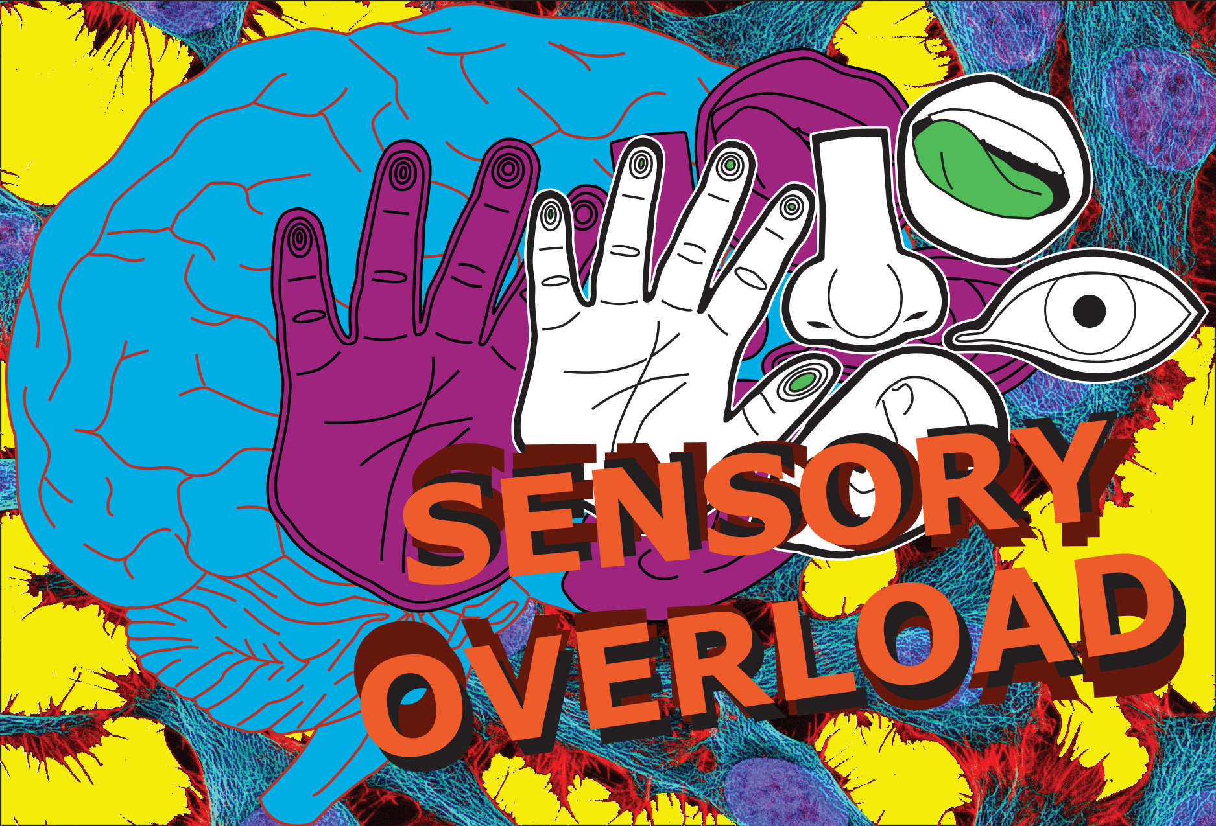
Our experience of life is woven from the information delivered by our senses.

Slide 15
Sensory Overload
Each autistic person has a unique sensory profile that fluctuates between:
Hypersensitivity and hyposensitivity
The avoidance profile and the seeker profile
The level of variation in how one experiences a certain sensory system
All hypersensitivities can contribute to overloading the autistic mind
https://www.youtube.com/watch?v=K2P4Ed6G3gw

Slide 16
Autistic tools
Ways of coping with Autistic Overload
Creating and maintaining routines can become a way to build
a structure for the day, allowing some reassurance; the
form of planning that best fits the detailed and intense Autistic neurology
Hyperfocus limited to a particular field of interest; the Autistic mind experiences the joy of a space of peace and mental wellbeing
Retreating to a safe space allows the timeous closing of the doors to the Autistic mind, potentially preventing burnout and avoiding overload
Engaging in self-soothing sensory activity e.g. listening to music, mindfulness breathing exercises or going for a walk, improves emotional regulation and prevents overload in stressful situations
http://www.thinkclinicalpsychologists.com.au/2017/09/04/using-your-5-senses-to-self-soothe/

Slide 17
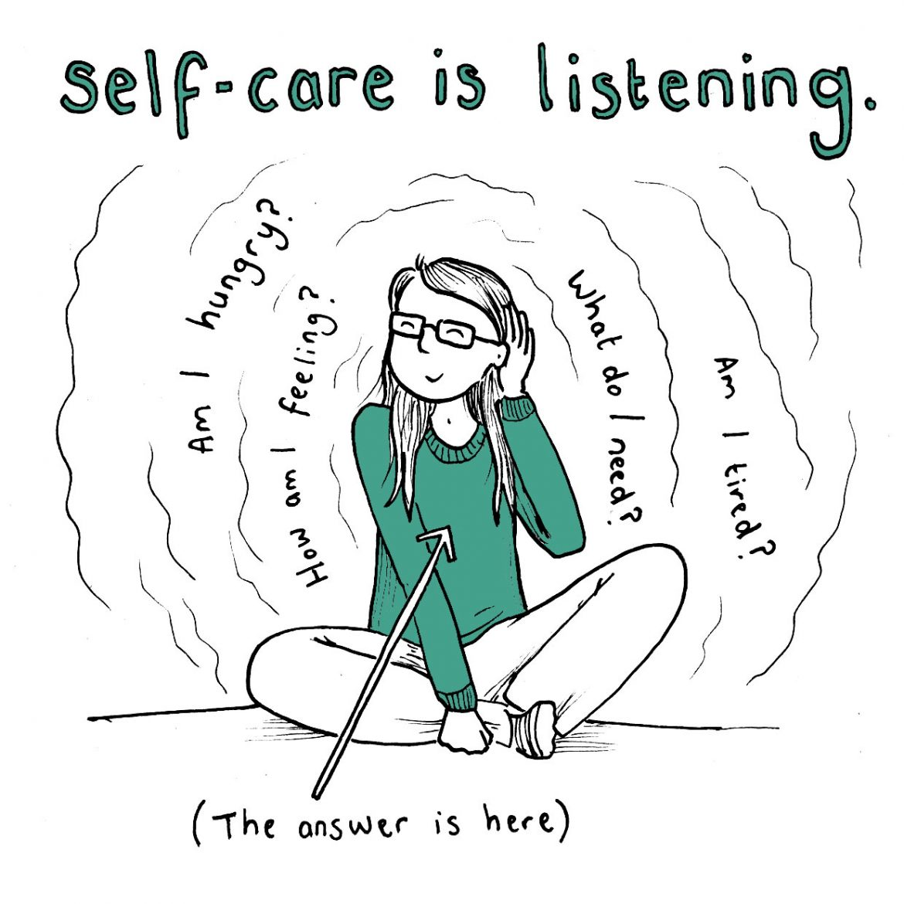
Taking care of yourself (parent-carer) is a priority
It does not mean ‘Me first’
It just means ‘Me, too’
Only then . . .
Can we experience the true power of relationship
And communicate so that we listen to understand
Rather than focusing on how we could reply

Slide 18
Understand your contribution
in escalating distressed behaviour . . .
You are emotionally and/or physically exhausted
You become emotionally hooked
You unintentionally bring additional stressors into
the situation
You are unable to identify what is driving the
observable behaviour:
- a particular stressor
- an unmet need
- a lack of skill
The behaviour you observe has been translated through the lens of your own experience

Slide 19
The Arousal Cycle of distress
Autistic adult and Parent-carer
Trigger
Phase
Escalation
Phase
Crisis
Phase
Recovery
Phase
Post Crisis
Phase
Learning
Phase
Crisis
Assault
Parent/Carer
AROUSAL
Aggression
Autistic adult
Anger
Anxiety
Baseline Behaviour
TIME
Exhaustion

Slide 20
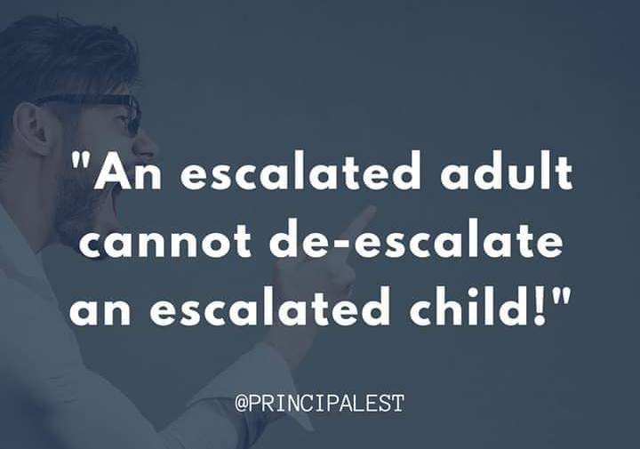

Slide 21
Responding appropriately
Focus on the emotions driving the behaviour rather than the behaviour itself
The goal is to de-escalate, not to punish or teach a lesson
It requires recognition and safe management of one’s own counter-aggressive impulses
https://www.livingwellessex.org/health-and-well-being/all-ages-autism-hub/helping-people-with-autism-in-a-crisis/
https://hes-extraordinary.com/de-escalation-techniques

Slide 22
Count slowly to 10
Take several slow, deep breathes
Walk away if you need to
What could be driving this behaviour?
What are other possible ways I could respond?
What could I consider doing differently?
Create a sense of safety first
Listen more; speak less if at all
Empathise, creating the sense your are now reconnected
When appropriate, consider possible solutions together

Slide 23
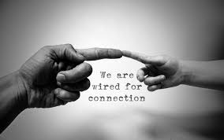
All humans are attention needing, not attention seeking!
attachment
However following any TRAUMA (real or perceived), the brain becomes wired for PROTECTION!

Slide 24
The art of co-regulation
the first step on the pathway to self-regulation
‘How we experience the world, relate to others, and find meaning in life is dependent on how we have come to regulate our emotions.’
Dan Siegel, 1999

Slide 25
‘

Slide 26
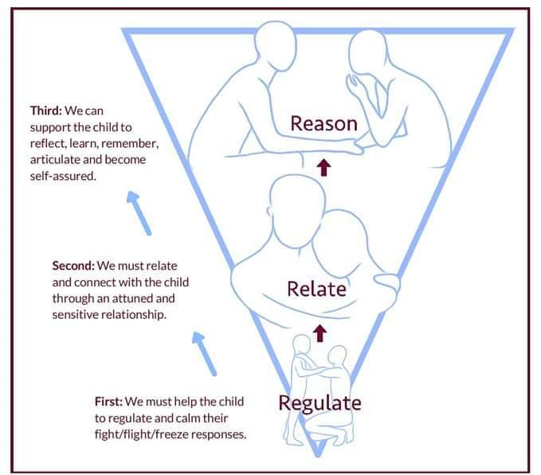
Connecting with the thinking brain
How to help your Autistic adult child who is exhibiting challenging and distressed behaviour:
- Learn
- Think
- Reflect
You need to intervene in the following sequence
3.
2.
Until your child is regulated, he/she is not likely to be able to relate to you
Until your child is related, he/she is unlikely to have the mental capacity to relate to you
1.

Slide 27
Co-regulation typically involves:
Warmth
a soothing tone of voice
communication that acknowledges the Autistic individual's distress
supportive silence
an invitation to engage in reflective problem-solving
https://genmindful.com/blogs/mindful-moments/what-co-regulation-looks-like

Slide 28
Further considerations . . .
in response to distressed behaviour
Co-regulation alone is not always enough
Autistic adults may also need:
- to be actively coached in ways to manage their
emotions and impulses
- support recognizing their and other’s body
cues; translating this into a verbal description
of how they feel before deciding on an
appropriate response

Slide 29
S
WORTH CONSIDERING
Generally helpful to . . . | Less helpful to . . .
take time, stay calm and neutral give reassurance in ways that are understood be supportive, caring and listen keep your language simple and give clear, concise messages Model more appropriate behaviour Remove other people from the situation if necessary look and sound confident – even if you are feeling anxious yourself intervene quickly, but noninvasively; try diversion or distraction | look angry or upset lose your temper Intimidate talk a lot, quickly or shout confuse your child with too much information have other people chip in re-ignite the situation by blaming be negative; making unkind, angry comments threaten punishment and/or removal of privileges

Slide 30
57 Albion Road, Edinburgh EH7 5QY Tel: 0131 475 2416 Email: info@pasda.org.uk Website: www.pasda.org.uk Scottish Charity Number: SC042678
MAKE A DONATION TO SUPPORT Pasda’s WORK
If you have benefitted from this presentation, please consider supporting Pasda's work.
You can do this in one of four ways:
Donate via JustGiving on the Pasda website at: https://www.pasda.org.uk , at the top right of the Home Page.
Donate via JustGiving at: https://www.justgiving.com/pasdauk
Make a bank transfer. To do this, please contact us by phone or email for the account details.
Make out a cheque payable to Pasda, and mail it to our office at the address above.
Thank you very much.

