Slide 1
Autism Spectrum Condition
PART 1
Sarah Barratt
Educational Psychologist, PASDA
sarahs_karma@yahoo.co.uk

Slide 2
Introduction: My true colours
Making sense of autism
It is a spectrum
The challenge of high functioning autism
Social communication
Executive functioning
Interoception
Girls and autism
Anxiety
All behaviour is communication
Co-regulation: managing distressed behaviour
Module
outline

Slide 3
Introduction
Developing your self-awareness
An Activity: True colours questionnaire

Slide 4
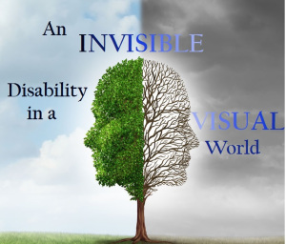
Autism

Slide 5
Autism
What do you see?

Slide 6
The Disability
or the Individual?

Slide 7
Imagine that your mind got stuck ...
NO I don’t want to ... NO, NO, NO!
This word replays in your mind over and over, getting louder and louder …
You don’t want to feel controlled – you just have to say NO, it comes from nowhere, it makes NO sense
It feels like a flood of anger which takes over your whole body...
No-one understands, your parents they expect too much, they expect you to be perfect!
With the anger comes anxiety…
When you feel anxious, it feels like you are in danger. Anxiety is a feeling that tells you to respond, react, protect yourself, DO SOMETHING! SAY NO! FIGHT! ARGUE! SHOUT! SCREAM!
You don’t want to be like this, feel like this ...
Your Mom is sad, she cries a lot, especially when she thinks you are asleep
And Dad, he gets angry and shouts a lot ...
You want new skin, new bones ... You just want to be different ... Someone else
You might recognize that none of this makes sense, or even seems reasonable, yet it still feels real, intense, and true …
Why would your brain lie?
Why would you feel this way if it weren’t true?
Feelings don’t lie… Do they?

Slide 8
This is my story,
I am not going to be ashamed;
Autism
OCD
Anxious all the time
Hard to get the words from my brain out of my mouth
Terrible eyesight
Allergic to bees
Heart palpitations
Unhealthy levels of procrastination.
This is me,
I have AUTISM!

Slide 9
Parenting is the easiest thing in the world to have an opinion about, but the hardest thing in the world to do!
- Matt Walsh

Slide 10
It is important to remember . . .
All parents have dreams for their children
Raising an autistic child in a neurotypical world, can be extraordinarily hard

Slide 11
Crossing the Bridge
over into the world of autism

Slide 12
Neurodiversity
It is a neurodevelopmental condition that affects the way the brain functions
WIRING!
The fundamental difference between those with autism and those without . . .
Neurodiverse
DIFFERENT, NOT LESS
It is a different style of processing information
Which impacts the way an individual see and respond to the world

Slide 13
Forcing a square peg into a round hole!

Slide 14
Making sense of Autism
Also sometimes referred to as a social communication condition; affects four major areas of development:
- Language and communication
- Social interaction
- Thinking and behaviour
- Sensory processing
https://www.youtube.com/watch?v=S0w6carvS8k

Slide 15
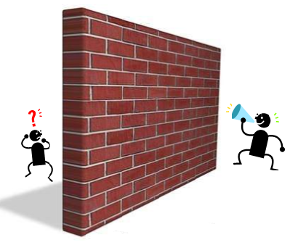
Communication and Autism
Potential barriers to communication
It’s a Spectrum: It doesn’t mean what you think
“If you’ve met one person with autism, you’ve met one person
with autism.”
Dr Stephen Shore
An autistic professor of special education at Adelphi University

Slide 16
It is a spectrum:
Doesn’t mean what you think . . .
“My son is on the severe end of the autism spectrum.”
“We’re all a little autistic – it’s a spectrum.”
“I’m not autistic, but I’m definitely on the spectrum.”
A child cannot be ‘a little autistic’ or ‘extremely autistic,’ the way a colour could be a little red or extremely red
Autism is not a set of defined characteristics; collectively increasing in intensity moving ‘up along’ the spectrum

Slide 17
Like the visual spectrum:
The Autism Spectrum . . .
The various parts of the spectrum are noticeably different
Blue looks very different from red; they are both on the visible light spectrum
Red is not ‘more blue’ than blue is
Red is not ‘more spectrum’ than blue is

Slide 18
All autistic people are affected in one way or another in most or all of these boxes – a rainbow of traits
If you only check one or two boxes, then it is not autism – it is something else
The Autism Spectrum
Pragmatic Language
Social Awareness
Monotropic Mindset
Information Processing
Sensory Processing
Repetitive Behaviours
Neuro-Motor Differences
Social communication including body language, eye contact, small talk and turn taking in conversation.
Ability to pick up on etiquette, social norms, taboos. Ability to form and maintain relationships.
Narrow, but intense ability to focus, resulting in ‘obsessive’ interests and difficulty task switching.
Ability to assimilate and apply new information quickly or to adapt to new environments or situations.
Challenges interpreting sensory information, hypersensitivity to stimuli.
Tendency to self-soothe in response to varying emotions. Can be helpful or harmful in nature.
Ability to control body movements. Ranges from clumsiness to complete loss of ability to move with intention.

Slide 19
Communication and Autism
Potential barriers to communication
What is your Function: High vs low functioning autism
“Maintaining only a narrow definition of what it means to
‘function’ serves only to ignore and silence valid disability, and
dismiss and marginalize real potential.”
Laura Tisoncik
Elder in the Autistic and Neurodiverse communities

Slide 20
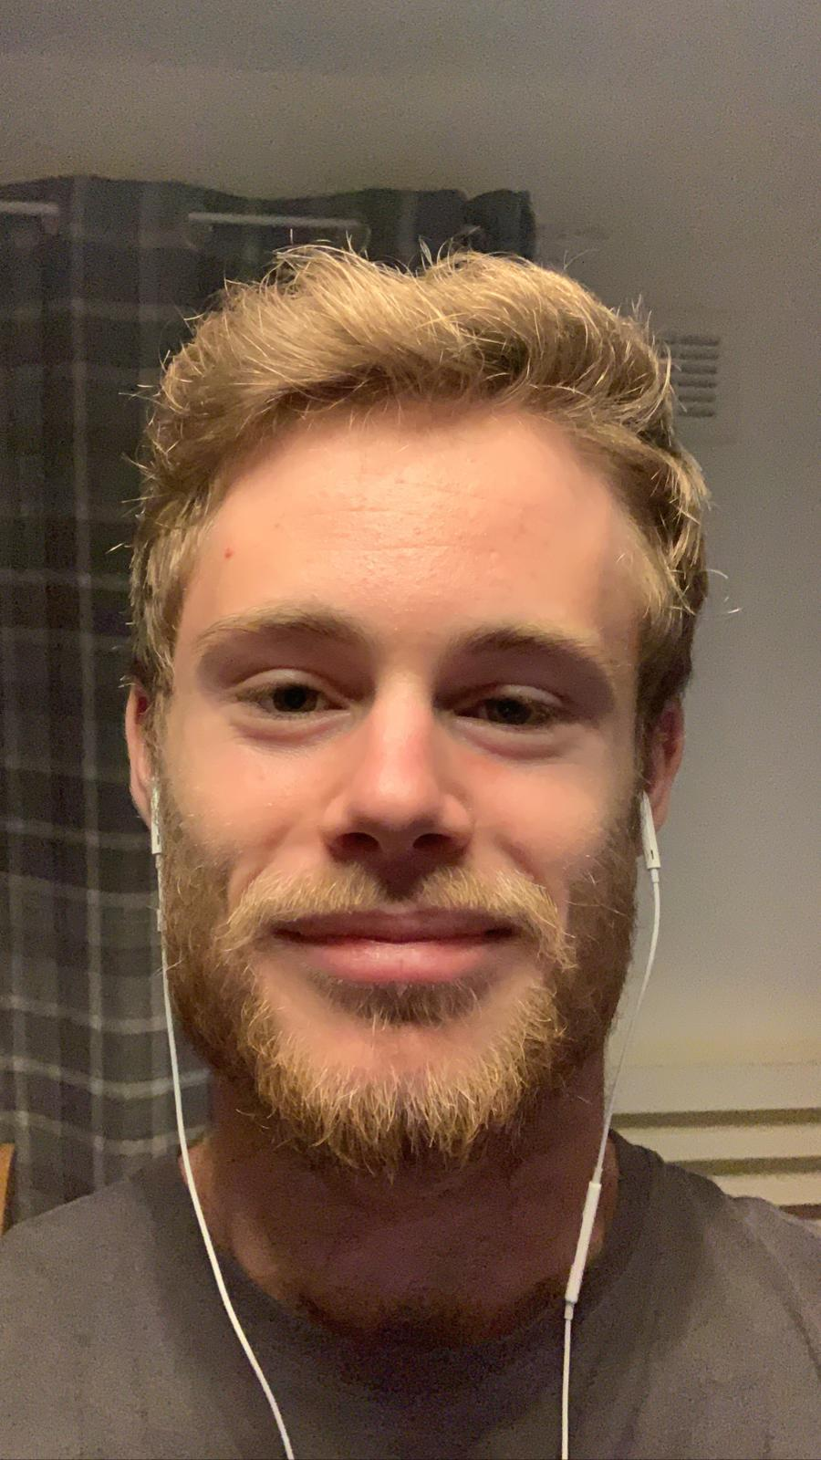
The challenge of high functioning Autism
https://www.verywellhealth.com/why-high-functioning-autism-is-so-challenging-259951

Slide 21
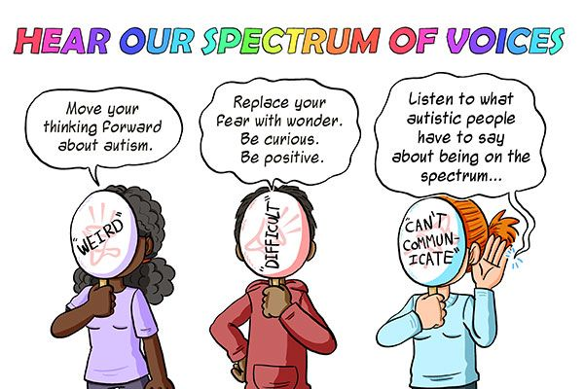
The myth of high functioning Autism
https://www.youtube.com/watch?v=K2P4Ed6G3gw
High functioning is not synonymous with ‘mild’
Myth: People with high functioning Autism are unusually intelligent and successful
Fact: High functioning Autism can make daily life very challenging
These challenges may include some/all of the following:
- Sensory processing
- Executive planning skills
- Transitions and change
- Processing of verbal information
- Anxiety and depression
- Emotional regulation

Slide 22
Communication and Autism
Potential barriers to communication
Social communication
“The latest thinking acknowledges that language is an
integral part of social communication, and that social
communication as a whole, is a persistent difficulty for
many autistic people.”
Lydia Denworth
Science journalist and author

Slide 23
https://www.youtube.com/watch?v=8Ox5LhIJSBE

Slide 24
What is communication?
From the Latin word ‘Communicare’ which means to share
The three basic levels of communication
7%
Vocabulary
Tone of voice
Non-verbal behaviour
38%
55%

Slide 25
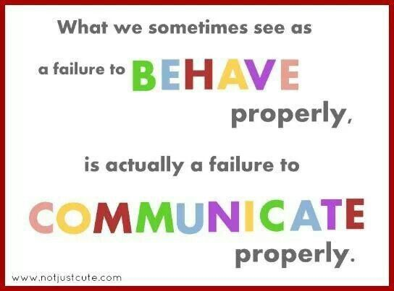
difficulty to

Slide 26
Communication and Autism
Potential barriers to communication
Executive functioning
“Living in a ‘five minute bubble’ - the impact of poor
executive functioning.”
https://help4psychology.co.uk/blog/living-in-a-five-minute-bubble-the-impact-of-poor-executive-functioning/
Dr Judy Eaton
Consultant Clinical Psychologist specialising in Autism and Pathological Demand Avoidance (PDA)

Slide 27
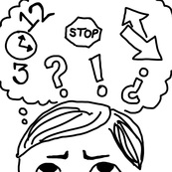
Executive functioning
The Chief Executive Officer (CEO) of the brain
https://www.theottoolbox.com/executive-functioning-skills/
Refers to a set of mental skills that are key to learning and managing behaviour
Problems with executive function can result in difficulties with:
- working memory
- flexible thinking
- self-control
Executive functioning has been identified as a particular area of difficulty for Autistic individuals

Slide 28
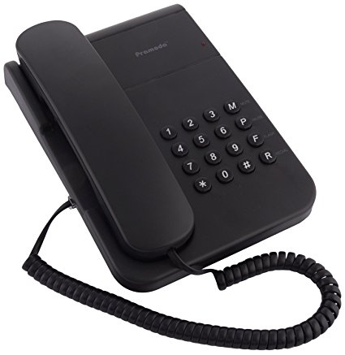
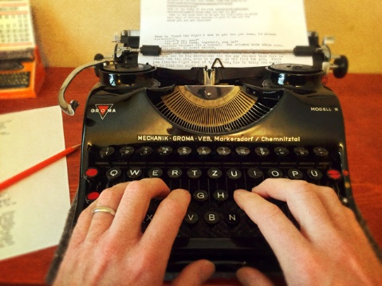
Working memory
How many of these pictures can you remember?
Give yourself 60 seconds to memorise the images on this slide.
Jot down as many of the items you can remember.

Slide 29
Working memory
How many of these pictures did you manage to remember?
.

Slide 30
Information Processing
As you see each word, say aloud the colour in which it has been written
YELLOW
GREEN
BLACK
OLIVE
PINK
ORANGE
PURPLE
WHITE
GREY
LILAC
SCARLETT
RED

Slide 31
57 Albion Road, Edinburgh EH7 5QY Tel: 0131 475 2416 Email: info@pasda.org.uk Website: www.pasda.org.uk Scottish Charity Number: SC042678
MAKE A DONATION TO SUPPORT Pasda’s WORK
If you have benefitted from this presentation, please consider supporting Pasda's work.
You can do this in one of four ways:
Donate via JustGiving on the Pasda website at: https://www.pasda.org.uk , at the top right of the Home Page.
Donate via JustGiving at: https://www.justgiving.com/pasdauk
Make a bank transfer. To do this, please contact us by phone or email for the account details.
Make out a cheque payable to Pasda, and mail it to our office at the address above.
Thank you very much.

