Slide 1
Autism Spectrum Condition
PART 2
Sarah Barratt
Educational Psychologist, PASDA
sarahs_karma@yahoo.co.uk

Slide 2
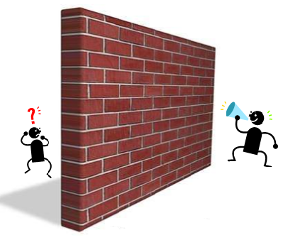
Communication and Autism
Potential barriers to communication
Interoception: the eighth sensory system
“Could interoception be a missing link in the field of autism?”
Kelley Mahler
Occupational therapist and autism consultant
https://autismawarenesscentre.com/what-is-interoception-and-how-does-it-impact-autism/

Slide 3
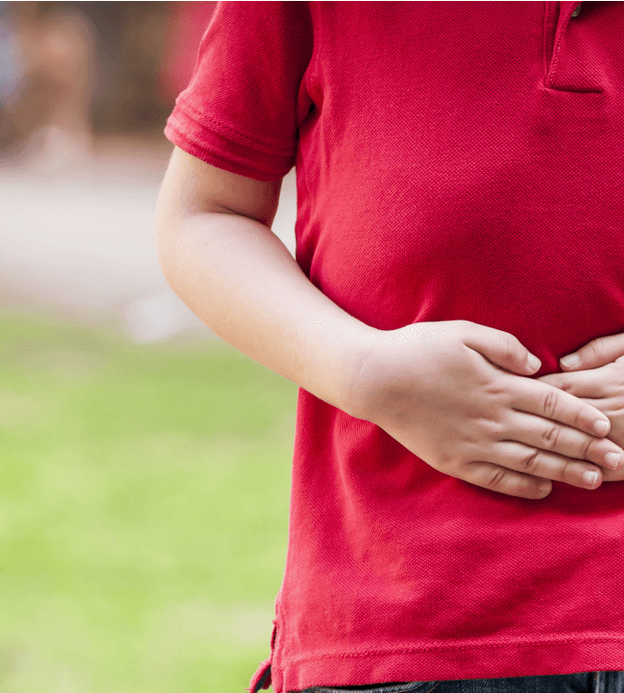
Our eighth sensory system
https://www.youtube.com/watch?v=A0zbCiakjaA

Slide 4
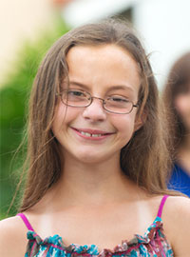
Autism and Girls
Hiding in plain sight
Girls often go undiagnosed or are diagnosed much later in life than boys
Girls tend not fit autism stereotypes
Girls are generally able mask their difficulties in ways boys can’t
https://childmind.org/article/autistic-girls-overlooked-undiagnosed-autism/

Slide 5
The costs of camouflaging
Often motivated by the desire to fit in and increase connection with others
Comprises a combination of masking and compensation techniques
Camouflaging may impact diagnosis, quality of life and long-term outcomes
https://www.spectrumnews.org/features/deep-dive/costs-camouflaging-autism/

Slide 6
Autism and Anxiety
The nervous system
MELTDOWN – the brain’s ‘panic’ button has been set off!
is fragile; vulnerable to stress and overload
Point of no return
SHUTDOWN - brains attempt to minimize stimulation in order to avoid overload!
Critical point
Sensory receptors give inadequate feedback. Individual unaware of the rapid build up of stress chemicals.
Easily overwhelmed!
Nervous system running on high idle, anxious and insecure
https://blog.autismtreatmentcenter.org/2016/11/understanding-the-difference-between-meltdowns-tantrums.html

Slide 7
https://www.youtube.com/watch?v=F18FsiPMFhc

Slide 8
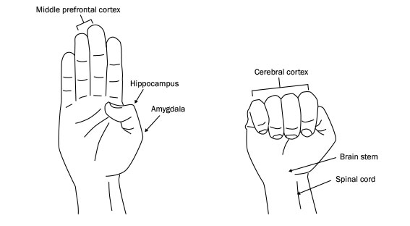
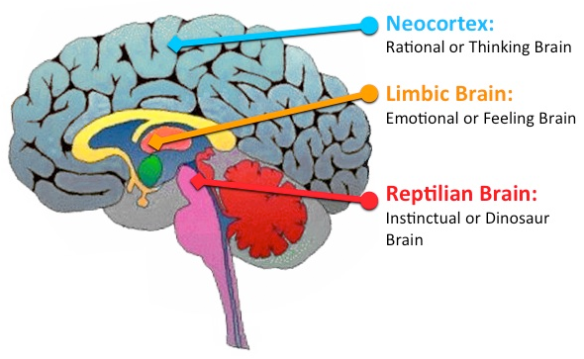
The Hand Model of the Brain
Dan Segal’s Hand Model of the brain: an explanation of what happens when we become distressed
https://www.youtube.com/watch?v=gm9CIJ74Oxw
Neocortex
gives us our ability to reason & communicate ideas via language
Limbic Brain
Processes emotions & stores memories
Feeling distressed
The Neocortex is offline
Behaviour is now being controlled by the Limbic Brain
Fight/Flight/Freeze mode has been activated
Feeling calm
The prefrontal cortex is monitoring & regulating impulses coming from the Reptilian & Limbic Brains
Reptilian Brain
Survival & safety

Slide 9
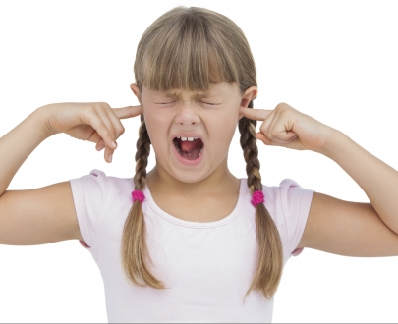
Now we look at what happens when…
We get distressed and flip our lid!
Our Thinking Brain is now ‘offline’
Behaviour is now being controlled by the Reptilian and Limbic Brains
Our Fight/Flight/Freeze mode has been activated
https://www.heysigmund.com/how-to-teach-kids-about-the-brain-laying-strong-foundations-for-emotional-intelligence-by-dr-hazel-harrison/

Slide 10
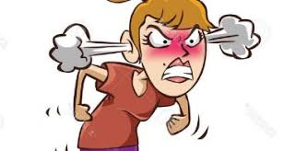
If we flip our lid…
- behaviours
Aggression
Safety through dominance, lashing out
Absence
Safety through concealment
Running away
Appeasement
Safety through ‘manipulation’
… SURVIVING not thriving!
… the Reptilian Brain and the Limbic Brain
- instantaneous, automatic response
Fight
Remove the threat
Flight
Remove self!
Freeze
Infantilise to attract adult help
Immobility, big eyes, smiles,
perhaps incontinence

Slide 11
https://www.youtube.com/watch?v=mtRrxNTnyh8

Slide 12
The arousal cycle
of distressed behaviour
Y Axis: Arousal State
X Axis: Time

Slide 13
Common interpretations of observable behaviours; the tip of the iceberg
Behaviour | Interpretation
Oppositional/ non-compliant | Wilful, attention seeking, stubborn, defiant, disrespectful
Verbally and/or physically aggressive | Bully, manipulative, immature
Self-harming and/or threatening suicide | Manipulative, attention seeking
Repeatedly making the same mistakes | Wilful, careless, lack of motivation, manipulative, inattentive
Disruptive and hyperactive | Disobedient, attention seeking, deliberately annoying, trouble maker
Unable to secure and/or maintain a job | Lazy, slow, dependent, immature, lacks motivation and/or ambition
Often late | Disrespectful, poor parenting
Anti-social behaviour e.g. spitting, swearing, destruction of property and/or lashing out at others | Bad parenting, absence of positive role models growing up, anti-social personality
Socially inappropriate | Bossy, controlling, demanding, self-centred, lacking in empathy, selfish, rude
Poor social judgment | Wilful, absence of positive role models, abused as a child
Common misinterpretations of observable behaviours; the tip of the iceberg

Slide 14
The Iceberg Analogy

Slide 15
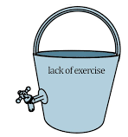
Becoming a stress detective
Reframe distressed behaviour as a stress behaviour
Fight or flight response
Stress & difficulties coping
Additional Support Needs
Developmental Stage
Reinforcement
Trauma
A primary physiological need
To get needs met
To gain control
Stress Bucket
Vulnerability = size of the bucket
Functionality of the tap = capacity to cope
https://www.youtube.com/watch?v=1KYC5SsJjx8

Slide 16
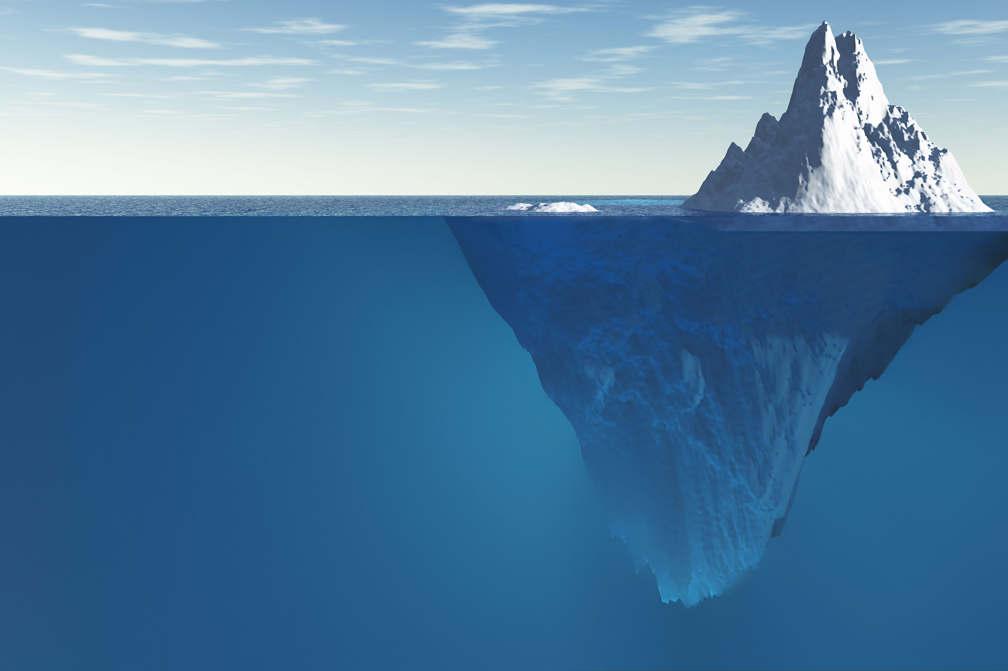
All behaviour is Communication
Always ask yourself:
- What need does this behavior meet for this individual?
- Will my intervention/ response make things better or worse?
- Am I in control of myself?
The correct answers enable you to:
- respond in a firm, but understanding way
- support your child to the link his/her external and internal worlds

Slide 17
Likely interpretations of observable behaviours; the tip of the iceberg
Behaviour | Interpretation
Oppositional/ non-compliant | Fearful, anxious, struggles to transition, difficulty processing verbal information, difficulty dealing with the demands of others
Verbally and/or physically aggressive | Distressed due to sensory overload, frustrated, difficulty regulating emotions
Self-harming and/or threatening suicide | Overwhelmed, depressed, highly anxious, aware of difference
Repeatedly making the same mistakes | Executive functioning difficulties i.e. difficulty generalising from one context to another
Disruptive and hyperactive | Sensory overload; neurological need to move
Unable to secure and/or maintain a job | Anxious, social communication difficulties, difficulties managing and dealing with the demands of others
Often late | Time blindness i.e. difficulty appreciating the passing of time
Anti-social behaviour e.g. spitting, swearing, destruction of property and/or lashing out at others | Potential skills deficit i.e. does not possess an alternative repertoire in terms of responding when frustrated and/or stressed
Socially inappropriate | Anxious, difficulty reading, making sense of and responding appropriately to social cues, context blindness
Poor social judgment | Lonely, difficulty reading social cues, context blindness

Slide 18
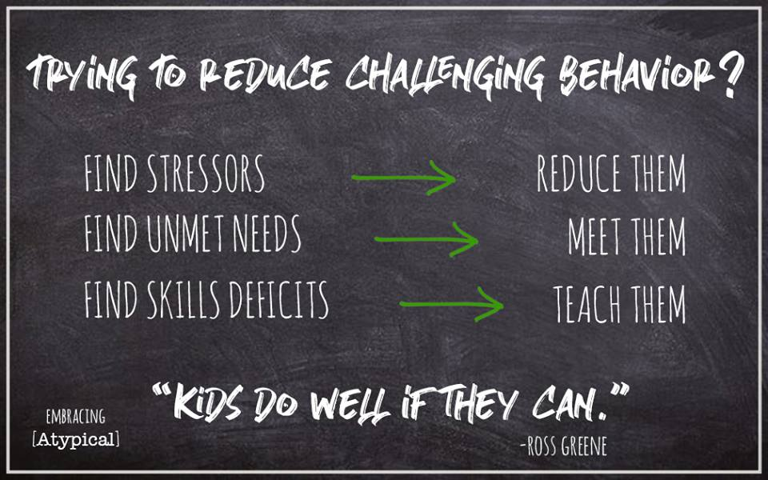
AND DISTRESSED
FIND SKILLS THAT NEED DEVELOPING

Slide 19
Reframing behaviour
YET
“Kids do well if they can.”
https://www.informationchildren.com/kids-do-well-if-they-can/
Dr. Ross Greene

Slide 20
“See a chid differently; you see a
different child.”
Dr Stuart Shanker

Slide 21
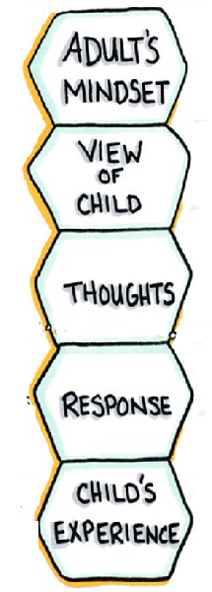
REFRAME
BEHAVIOUR

Slide 22
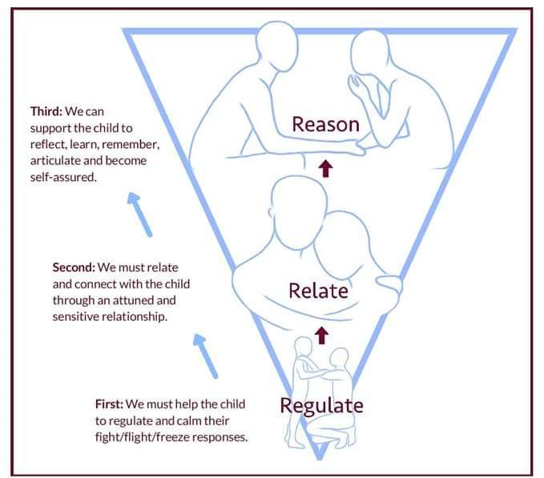
The 3 R’s of how to respond
Appropriately to children who exhibit distressed and challenging behaviour so that they can be supported to:
- Learn
- Think
- Reflect
You need to intervene in the following sequence
Until a child is regulated, they are not likely to be able to relate to you
Until a child is related, they are unlikely to have the mental capacity to relate to you

Slide 23
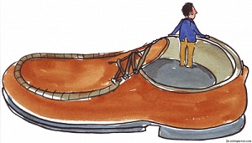
https://www.cdd.unm.edu/ecln/PSN/common/pdfs/The%20Importance%20of%20Attunement.pdf

Slide 24
The art of co-regulation
Use a warm soothing tone of voice
Acknowledge the child’s feelings
Make use of supportive silence
Extend an invitation to problem solve
Ask the question: what would be helpful right now?
https://www.cyc-net.org/cyc-online/cyconline-mar2010-bath.html

Slide 25
Power of connection
Every time you connect and empathise with a child,
His/her brain floods with feel-good hormones,
Building and strengthening millions of neuropathways, making it easier for him/her to:
- regulate
- empathise
- create & make good decisions

Slide 26
The importance of self-care
“Rest and self-care are so important. When you take time to replenish your spirit, it allows you to serve others from the overflow.”
- Eleanor Brown
You cannot pour from an empty cup!

Slide 27
57 Albion Road, Edinburgh EH7 5QY Tel: 0131 475 2416 Email: info@pasda.org.uk Website: www.pasda.org.uk Scottish Charity Number: SC042678
MAKE A DONATION TO SUPPORT Pasda’s WORK
If you have benefitted from this presentation, please consider supporting Pasda's work.
You can do this in one of four ways:
Donate via JustGiving on the Pasda website at: https://www.pasda.org.uk , at the top right of the Home Page.
Donate via JustGiving at: https://www.justgiving.com/pasdauk
Make a bank transfer. To do this, please contact us by phone or email for the account details.
Make out a cheque payable to Pasda, and mail it to our office at the address above.
Thank you very much.

