Slide 1

Pathological
Demand
Avoidance
A misunderstood profile of Autism
PART 1
Sarah Barratt
Educational Psychologist, PASDA
Sarahs_karma@yahoo.co.uk

Slide 2
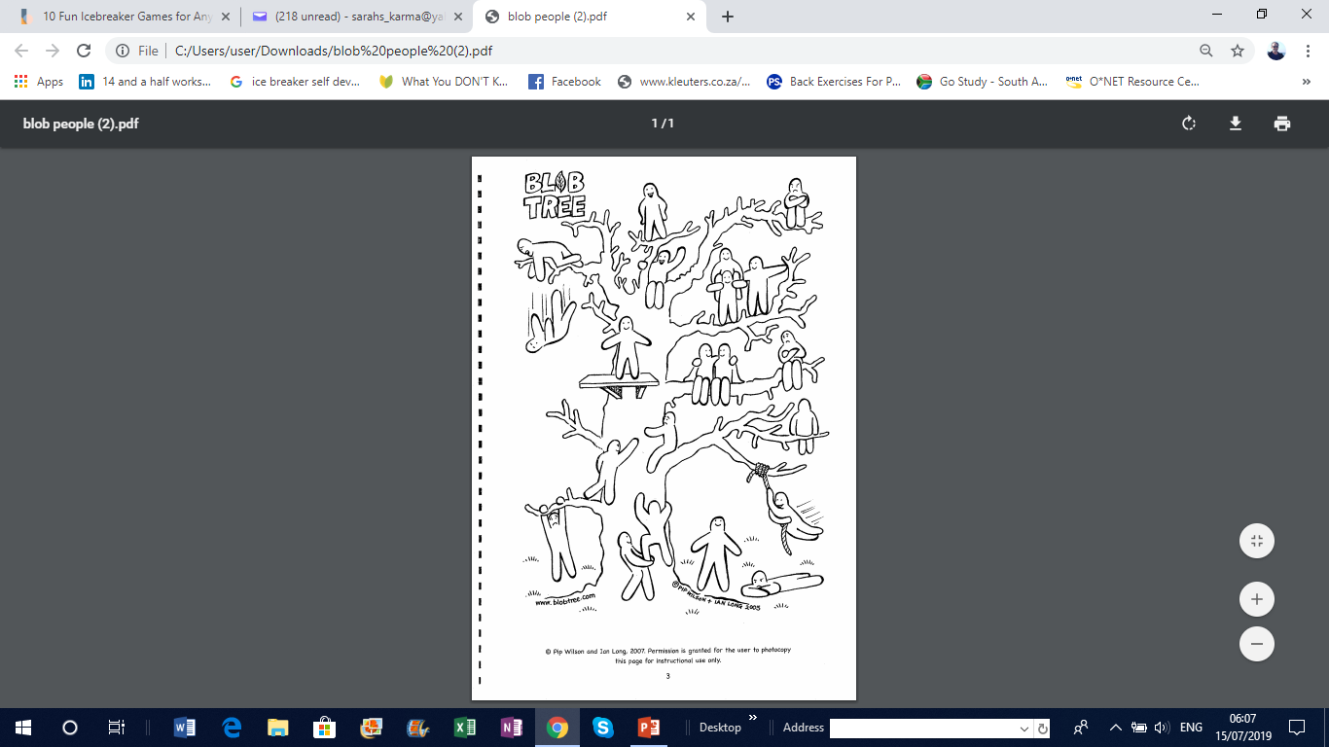
Meet the Blobs
Which Blob best describes how you are feeling at this moment?
Reflect on what may have contributed to how you are currently feeling.

Slide 3
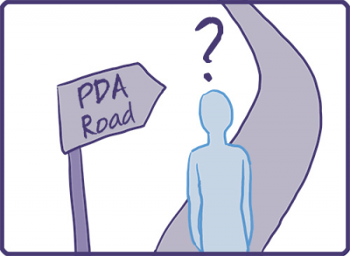
Module outline
What is Pathological Demand Avoidance (PDA)?
The origins of PDA
The current situation
Autism and PDA
The main features of PDA
Highly sensitive neuroception
Family experiences of PDA
Life as an adult ‘PDAer’
Coping strategies for adult ‘PDAers’
Towards family resilience
Resources

Slide 4
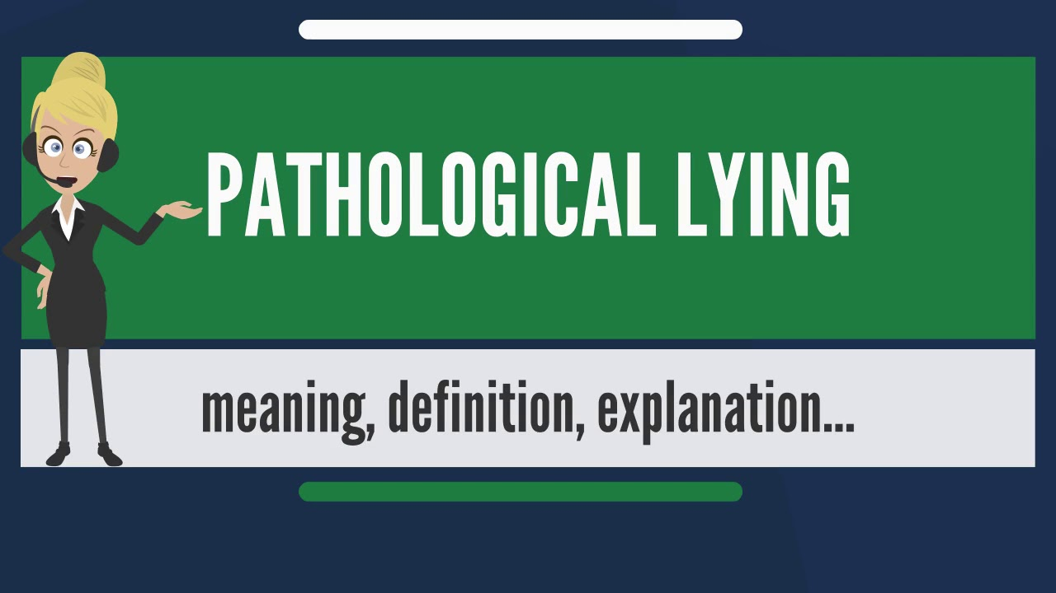

Jot down on a piece of paper, the very first thing that comes to mind when you hear this word

Slide 5
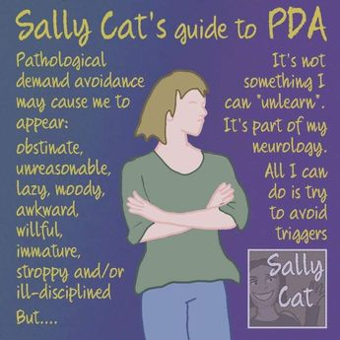
Synonyms for ‘pathological’
Chronic
Compulsive
Confirmed
Morbid
Illogical
Unreasonable
Hardwired
Persistent
Diseased
Obsessive
Irrational
Hardened
http://www.sallycatpda.co.uk/

Slide 6

pathological
an adjective
Pathological comes from a Greek word, pathologikos
This means ‘treating of diseases’ — pathos means ‘suffering’
of or relating to pathology: pathological research; A pathological examination led to the diagnosis
altered or caused by disease: pathological changes in the body; also indicative of disease: pathological symptoms
being such to a degree that is extreme, excessive, or markedly abnormal: A pathological liar; pathological fear
https://www.merriam-webster.com

Slide 7
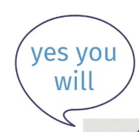
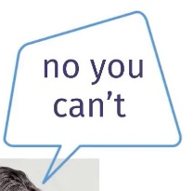

Pathological Demand Avoidance?
Pathological
Excessive, extreme; it is not won’t, but instead is I can’t help it
Request to act as well as any internal thought or feeling that ‘I ought to’
Response to avoid negates giving in, which equals staying in control and reducing anxiety
Demand
Avoidance

Slide 8

Pathological Demand Avoidance
The central difficulty for people with PDA is their “anxiety-driven need to be in control and avoid other people’s demands and expectations”
(Christie, Duncan, Fidler & Healy, 2011)
This often also includes the demands and expectations they place upon themselves

Slide 9
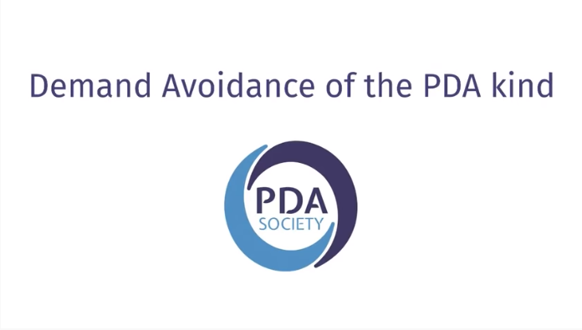

What is Demand Avoidance?
https://www.youtube.com/watch?v=CCsfKxyuH1I

Slide 10


Meet Harry Thompson
https://www.youtube.com/watch?v=9exqlS1gsS4

Slide 11

Demand: this or that
A. 1. Maintaining friendships or 2. Being generally sociable
B. 1. Brushing your teeth or 2. Taking a shower
C. 1. Looking good or 2. Being viewed by others as good
D. 1. Being punctual or 2. Being reliable
E. 1. Housework or 2. Keeping the house tidy
F. 1. Walking the dog or 2. Going to the gym
G. 1. Debating your point of view or 2. Acceptance of the majority view
H. 1. Supporting a family or 2. Earning a living
I. 1. Preparing to leave the house or 2. Left alone with your thoughts

Slide 12

What is a
?
Consider your life currently:
Jot down all the things you experience as a demand
What is it about these things/situations that make them feel ‘demanding’?
https://www.stephstwogirls.co.uk/2018/06/ten-things-you-need-to-know-about.html
DEMAND (noun)
to ask for something forcefully, in a way that shows that you do not expect to be refused

Slide 13

https://memyselfandpda.com/2017/05/09/its-been-a-long-time-coming-aka-discombobulated/

Slide 14
The PDAers’ experience of demands
https://www.youtube.com/watch?v=CCsfKxyuH1I

Slide 15
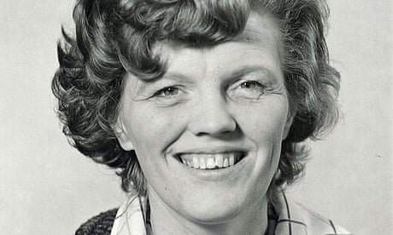
The Origins of PDA
Originally called PDA Syndrome by Professor Elizabeth Newson in the 1980’s
April 1929 – February 2014
A developmental psychologist
Viewed at the time as a separate condition
Described individuals suspected of being Autistic, but whose presentation differed in fundamental ways from those with ‘typical’ Autism
https://www.bexleyvoice.org.uk/uploads/3/9/0/4/3904704/pda-awareness-matters.pdf

Slide 16
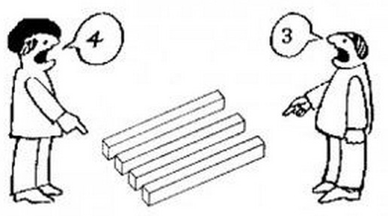
The current situation
https://help4psychology.co.uk/blog/our-current-thinking-on-pda/
Now widely recognised as a distinct profile of autism
However: the recognition of PDA as a valid diagnosis remains contentious amongst professionals in the health, education and care sectors
It is not currently included in either
of the diagnostic manuals: the DSM V
or the ICD 10
The recognition of PDA and the skill
to assess and make a diagnosis varies regionally across the UK

Slide 17

The current situation
https://www.pdasociety.org.uk/resources/pda-society-statement-about-diagnostic-terminology/
When PDA is recognised and a diagnosis given, there is great variability in the wording used:
- ASD with Extreme Demand Avoidance
- PDA: A profile of Autism
- PDA Syndrome
PDA continues to gain interest
Ongoing research is increasing awareness and understanding of PDA

Slide 18


and
PDA is distinct profile of autism
Individuals with a PDA profile share traits similar to Autistic individuals
These traits encompass the following differences:
- Social Communication
- Social Interaction
- Restrictive and Repetitive patterns of behaviour
- Demand Avoidance

Slide 19
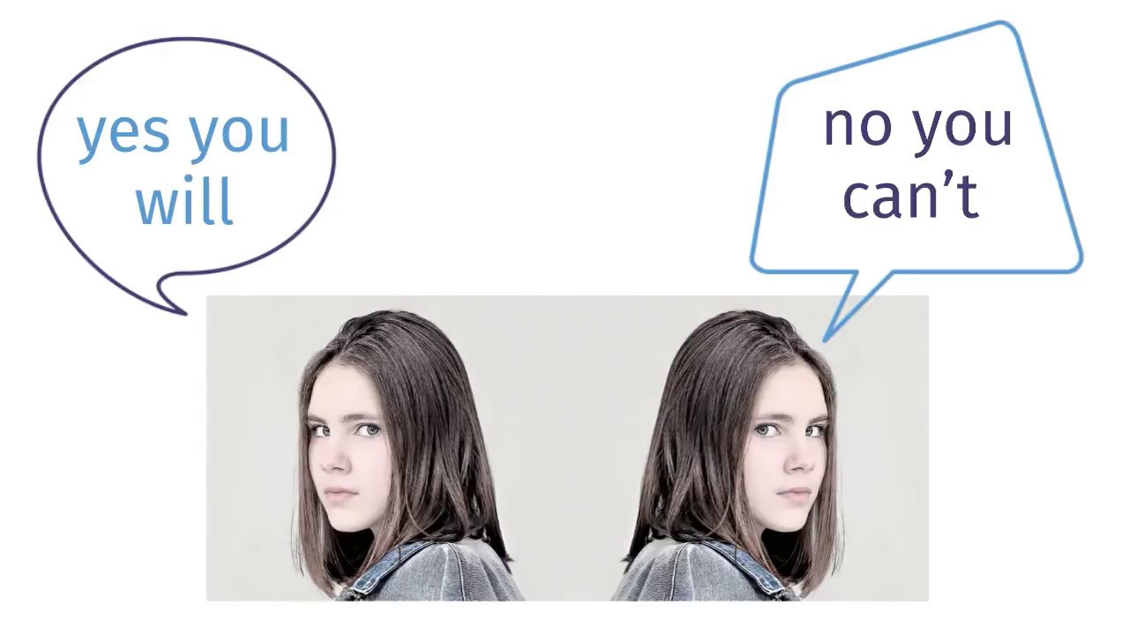
Autism and the PDA
Profile of Autism
However, the demand avoidance of PDA differs in its:
- extreme nature
- and obsessive quality
This demand avoidance extends to the most basic
demands of everyday living
It also includes difficulty complying with:
- self-imposed expectations
- doing things that one would really like to do
Notes:
The demand avoidance for those with a PDA profile differs from that which others on the autism spectrum experience

Slide 20
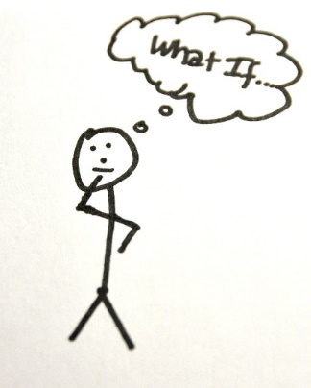
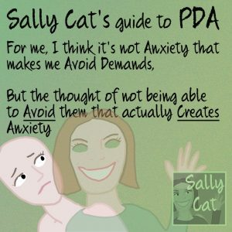
Reframing PDA
“Pathological Demand Avoidance (PDA) is an Autism Spectrum neurotype characterized by an intense need for freedom and self-determination, such that, ANY demands which may impede this need, provoke significant anxiety and so are pathologically avoided.
You don’t have to agree with a neurodiverse approach. It’s the perspective I prefer.”
Sarah Stogryn, an adult with PDA, 2019
https://hedgecraftherbals.ca/blogs/hedgecraft-herbals/reframing-pda
Notes:
Whether PDA is viewed as a particular neurotype where the overriding feature is the intense and pervasive need for personal freedom and self-determination, any demand that interferes with this need provokes anxiety and subsequent pathological demand avoidance or as an anxiety-driven need to be in control and therefore pathologically avoid other people’s demands and expectations is still an ongoing debate.
Many adult PDAers disagree with professionals who describe anxiety as the driving force of PDA. These adults feel that what presents as the need for control is essentially the fundamental neurology of PDA; the intense need for freedom
Essentially though individuals with the PDA profile of Autism exhibit various behaviours distinct from individuals with ASD.

Slide 21
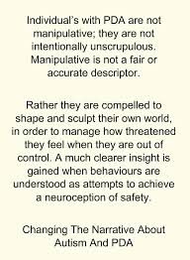

https://www.facebook.com/ChangingTheNarrativeAboutAutismAndPDA/

Slide 22

The main features of PDA
Resists and avoids the demands of everyday life
Uses social strategies to avoid demands
Appears sociable on the surface, but lacks depth in understanding
Excessive mood lability and impulsivity
Comfortable to role play and pretend; sometimes to an extreme extent
Obsessive behaviour that is often focused on other people
https://www.autism.org.uk/about/what-is/pda.aspx

Slide 23

57 Albion Road, Edinburgh EH7 5QY
Tel: 0131 475 2416
Email: info@pasda.org.uk
Website: www.pasda.org.uk Scottish Charity Number: SC042678
MAKE A DONATION TO SUPPORT Pasda’s WORK
If you have benefitted from this presentation, please consider supporting Pasda's work.
You can do this in one of four ways:
Donate via JustGiving on the Pasda website at: https://www.pasda.org.uk , at the top right of the Home Page.
Donate via JustGiving at: https://www.justgiving.com/pasdauk
Make a bank transfer. To do this, please contact us by phone or email for the account details.
Make out a cheque payable to Pasda, and mail it to our office at the address above.
Thank you very much.

