Slide 1
Adaptive self-regulation: the building blocks of a quality life
Self-regulation
and Autism
Sarah Barratt
Educational Psychologist: PASDA
sarahs_karma@yahoo.co.uk

Slide 2
Self-Regulation and Autism
Develop and Promote Self-Awareness
Understanding Self-Regulation
The 5 Domains of Self-Regulation
Self-Regulation: Element of Emotional Intelligence
Self-Regulation in Context
The Thinking Brain versus the Survival Brain
Self-Regulation and Autism
Dysregulation
Suggestions for Parent-Carers
MODULE
outline

Slide 3
‘Awareness is like the sun.
When it shines on things,
they are transformed.’
Thich Nhat Hanh

Slide 4
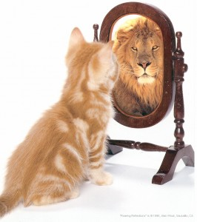
Self-Awareness
Activity
Two adjectives that describe your favourite animal
Two adjectives that describe your second most favourite animal
Two adjectives to describe the ocean

Slide 5
Self-Awareness
Reflections on your responses
Answer to question 1: Reflects how you see yourself
Answer to question 2: Reflects how others see yourself
Answer to question 3: Reflects how you view life

Slide 6
“For me self-awareness is the key. If you don’t have self-awareness how can you modify or avoid things that cause anxiety? If you don’t know why you feel anxious out there, how can you deal with it?
When you understand what’s hard for you and why, you can make suitable adjustments. All of a sudden once you have self-awareness your life makes sense.”
Julia Daunt; age 36
Diagnosed with PDA; a profile of Autism
https://memyselfandpda.com/

Slide 7
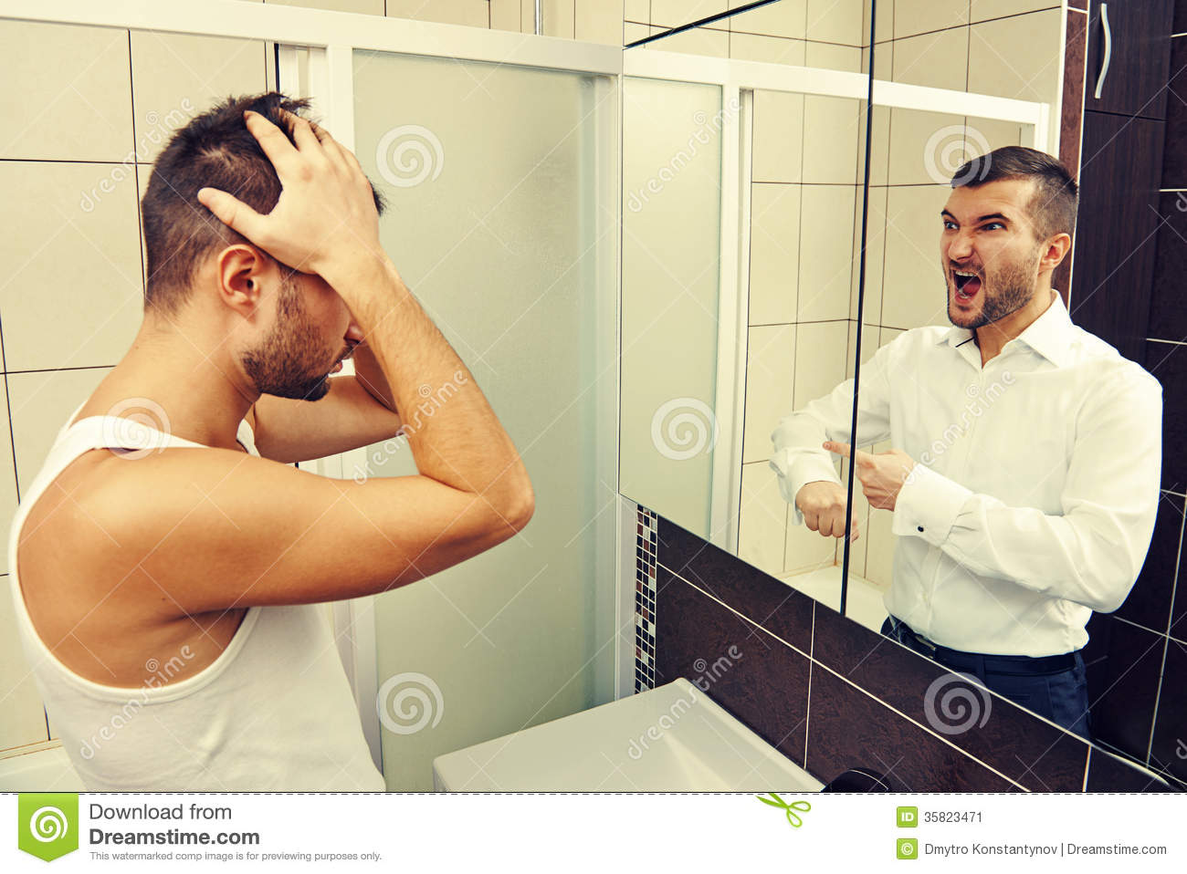
Self-Awareness . . .
the conscious knowledge of one’s own character, feelings, motives and desires.

Slide 8
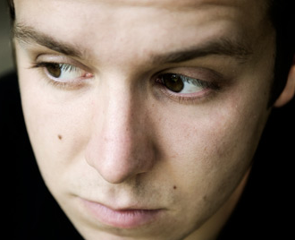
Self-Awareness
Activity
Luis is having relationship problems with his girlfriend, Monique.
He thinks she takes him for granted and she doesn’t tell him, she loves him or show him much affection.
They fight about this frequently.
Suddenly, he realizes that he may be contributing to the problem.

Slide 9
Self-Awareness
Activity continued . . .
He reflects; looking inward and realises that he doesn’t show Monique appreciation very often; that he tends to overlook the nice things she does around the house for him and the little physical touches that show her affection.
Luis considers his thought processes when Monique misses an opportunity to make him feel loved and notes that he often automatically assumes that she purposely avoids doing things that he likes.
Luis spends time thinking and talking with Monique about how they each want to show and receive love, and they decide to begin working together on their relationship.

Slide 10
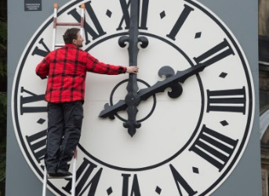
Cultivate your Self-Awareness

Slide 11
Meet Harley and Loa
https://youtu.be/88XQcpU5Vuk

Slide 12
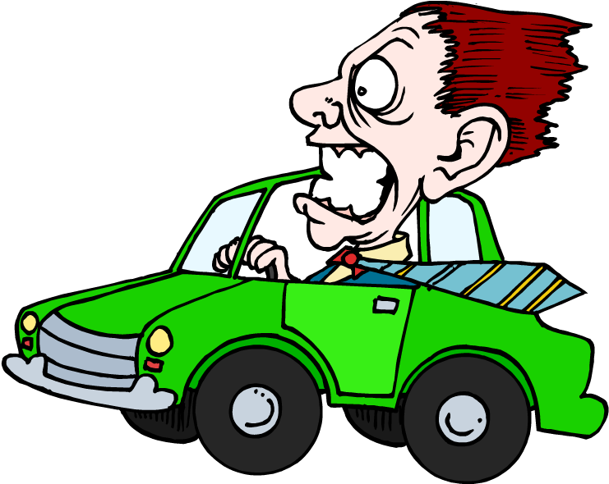
Self-Regulation?
An analogy to help understand self-regulation. . .
We can visualise the ability to self-regulate a bit like how we experience driving a car.
Dr Stewart Shanker

Slide 13
What is Self-Regulation?
It is the ability to control our thoughts, feelings and actions. . .
‘in ways that are socially acceptable and help achieve positive goals, such as maintaining good relationships, learning and maintaining wellbeing’.
Stuart Shanker

Slide 14
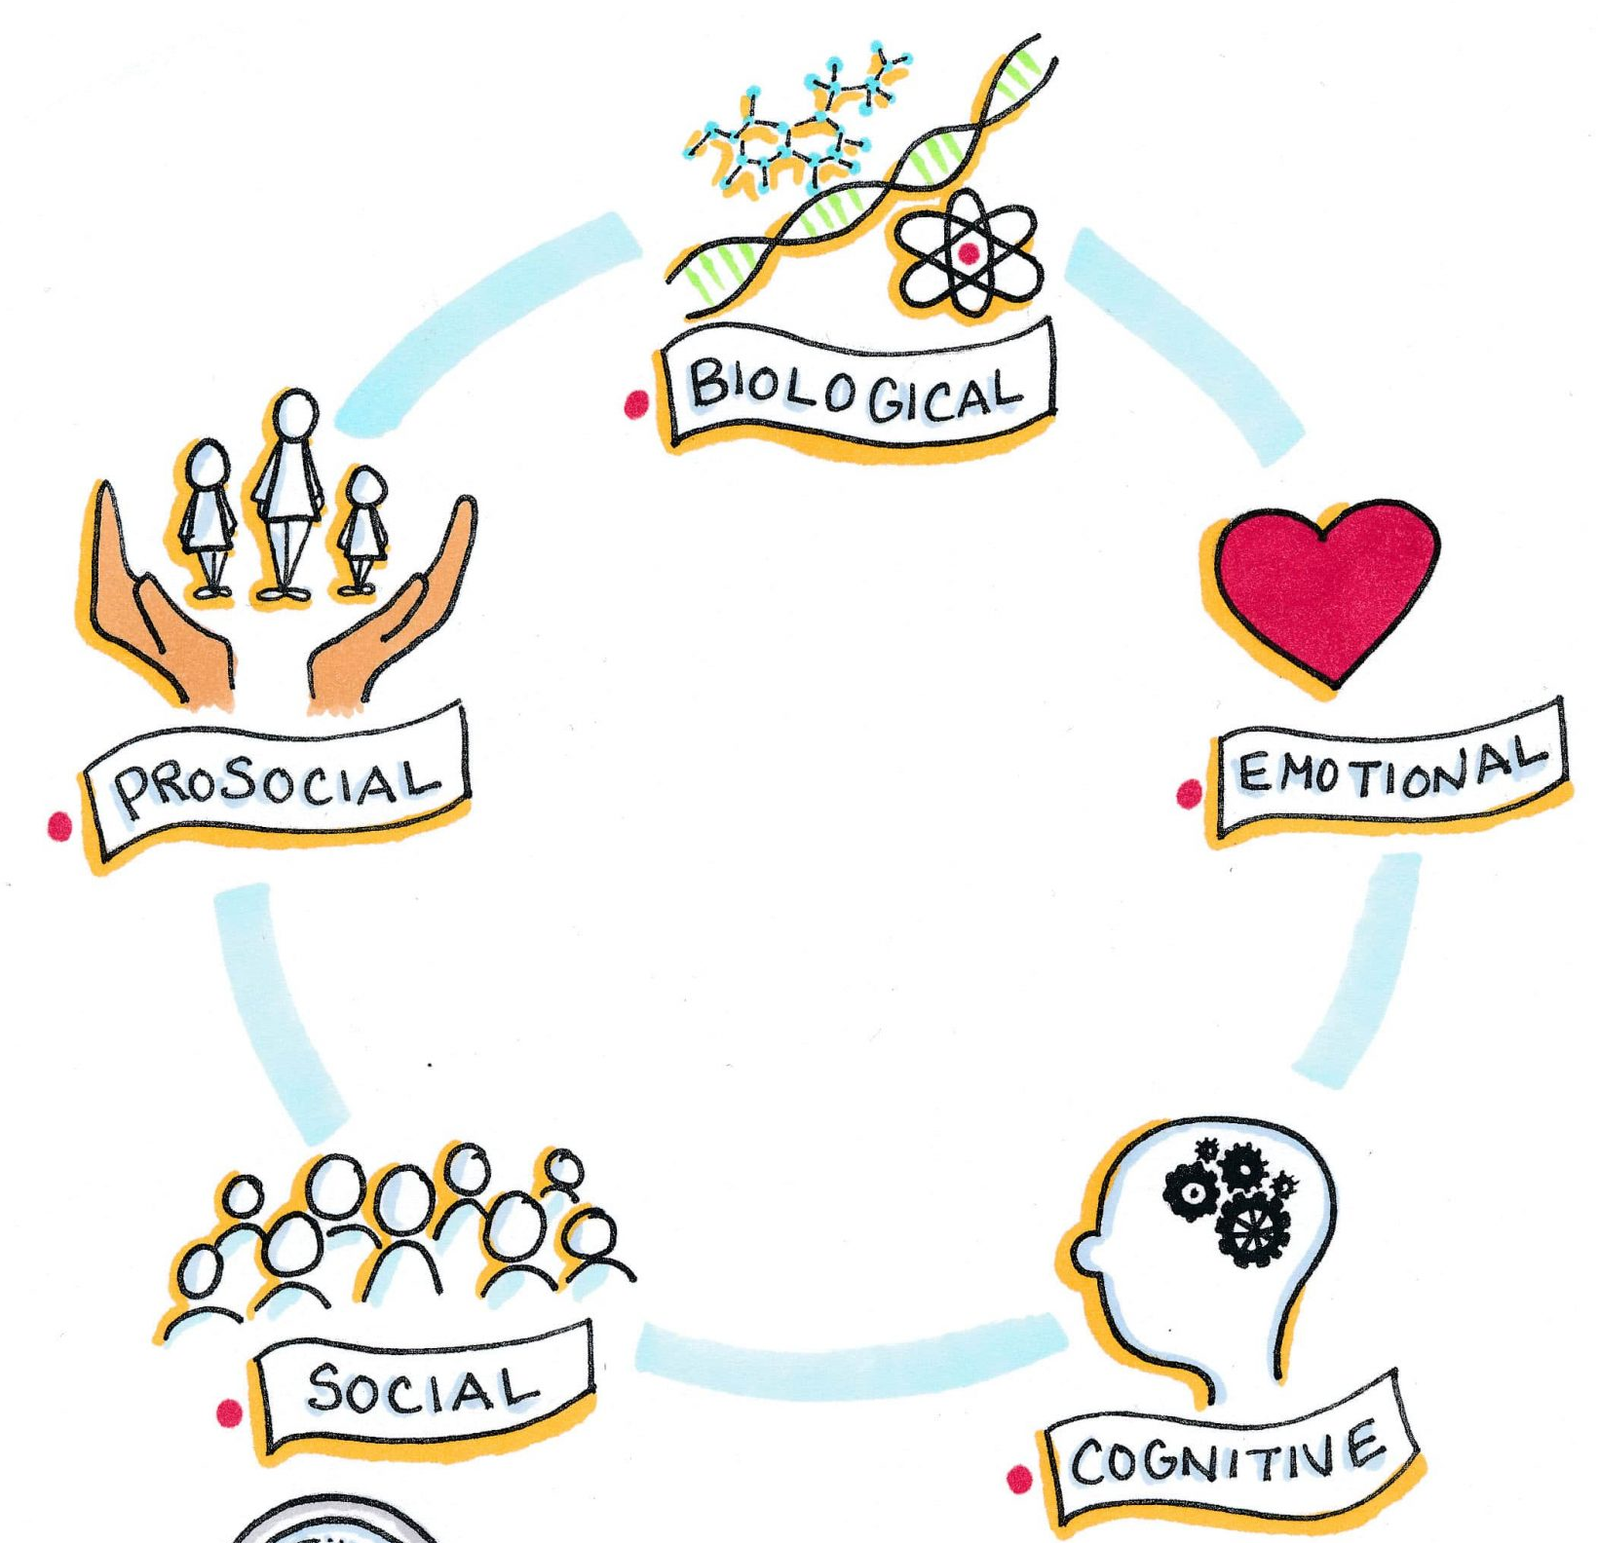
Domains of Self-Regulation
Biological: Environmental stressors e.g. visual, auditory
2. Emotional: Modulate negative
and positive emotions
3. Cognitive: Sustain and switch
attention
4. Social: Master the skills of co-
regulation
5. Prosocial: Development of
empathy

Slide 15
Self-Regulation & the Arousal Continuum
best able to modulate emotions
pay attention
ignore distractions
inhibit impulses
assess the consequences of an action
understand what others are thinking and feeling
appreciate effects of own behaviours
feel empathy for others
Arousal Regulation underpins the other 4 domains of Self-Regulation
Self-Regulation: how smoothly an individual is able to move up and down, along the arousal continuum
Hypo arousal
Hyper arousal

Slide 16
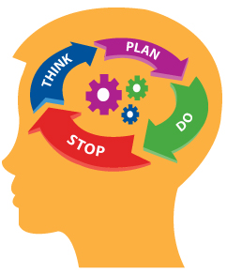
Self-Regulation & Cognitive Components
The key cognitive components related to self-regulation are the executive functions of:
- Inhibition
- Working Memory
- Cognitive Flexibility

Slide 17
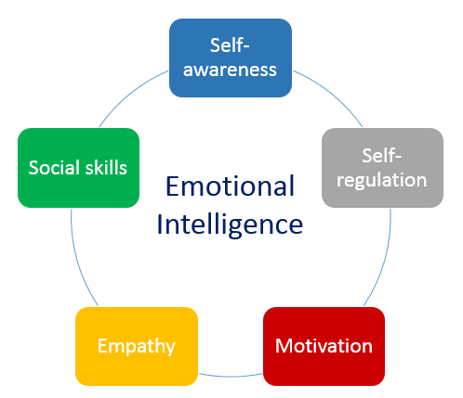
Self-regulation: element of Emotional Intelligence
Emotional intelligence: the ability to analyse and manage your own emotions and having empathy for the emotions of others
It also involves naming specific emotions and being able to respond appropriately
Developing emotional intelligence improves relationships and better enables the accomplishment of shared goals

Slide 18
Self-Regulation in Context
The range of factors that influence whether and how well an individual may self-regulate in any given situation
Each of these factors may interact with and influence one another
The environment may influence an individual’s biology by shaping brain circuitry, and biology or temperament may influence how a parent-carer interacts with their adult child

Slide 19
“Anybody can become angry, that is easy;
But to be angry with the right person,
And to the right degree,
And at the right time,
And for the right purpose,
And in the right way,
That is not within everybody’s power; that is not easy.”
Aristotle

Slide 20
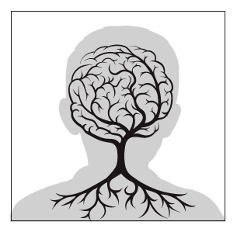
The nervous system and its connection to our capacity to self-regulate

Slide 21
The Truine Brain
Self-regulation is based primarily on brain development and connection between the thinking and survival brain
Hence the need to understand basic neurology

Slide 22
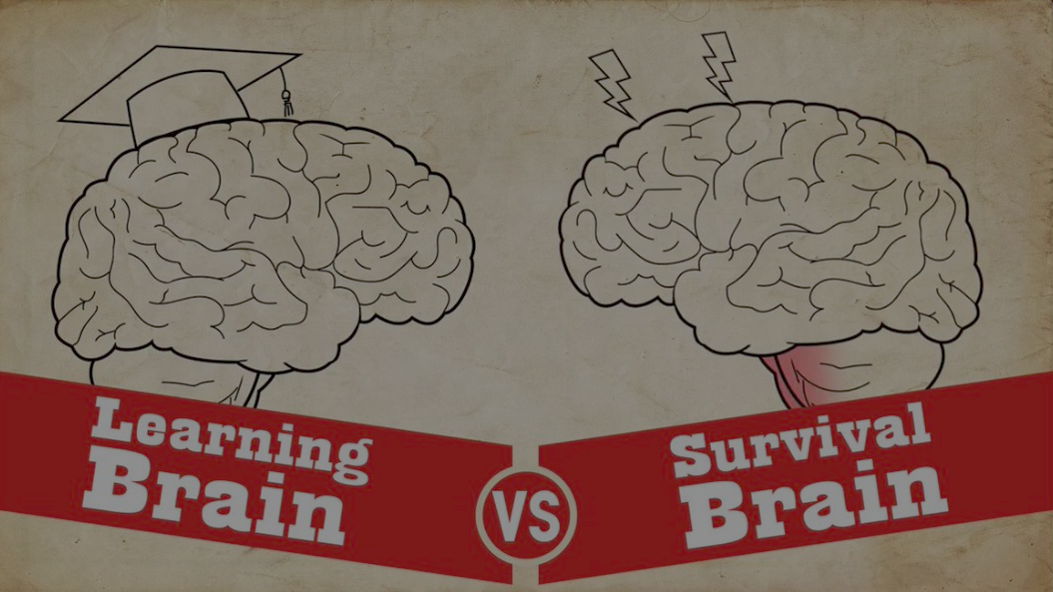
Neuroception i.e. threat assessment
Implicit Memory
Survival Functions
Rest/Recovery
Executive Functioning
Decision Making
Will Power
Explicit Memory

Slide 23
Hand Model of the Brain
The ‘wrap around’ cortex
mediates our responses to emotional triggers
helps us to put a pause between a trigger and a response
allows us to think through options and consequences and consider impacts for ourselves and others
Thinking brain is offline
‘Lid has flipped’
When we are calm: the thinking brain, the neocortex is monitoring and regulating the impulses coming from our reptilian and midbrain
https://www.youtube.com/watch?v=f-m2YcdMdFw

Slide 24
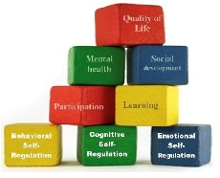
The Importance of Self-Regulation
Quality of Life
Self regulation is as a key factor in wellbeing, learning and development.
Mental Health
Social Participation
Participation
Learning
Behavioural Self-regulation
Cognitive Self-regulation
Emotional Self-regulation

Slide 25
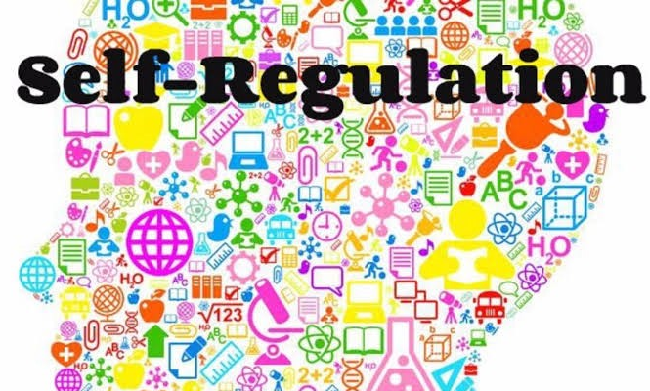
Optimal
Someone who has good self-regulation has/can:
the ability to keep their emotions in check
resist impulsive behaviours that might worsen a situation
cheer themselves up when they are feeling down
a flexible range of emotional & behavioural responses; well matched to the demands of their environment
Andrea Bell

Slide 26
Understanding Self-Regulation Development
Self-regulation serves as the foundation for lifelong functioning
Self-regulation is the act of managing cognition and emotion
A combination of individual and external factors influence self-regulation
Parent-carers can teach and strengthen self-regulation
Self-regulation is dependent on co-regulation provided by parent-carers or other caregiving adults
Prolonged or pronounced stress and adversity can disrupt self-regulation
Self-regulation develops over an extended period from birth through adulthood
It is directly related to brain maturation; specifically the prefrontal cortex
This is the last part of the brain to develop; only fully matured in early adulthood

Slide 27
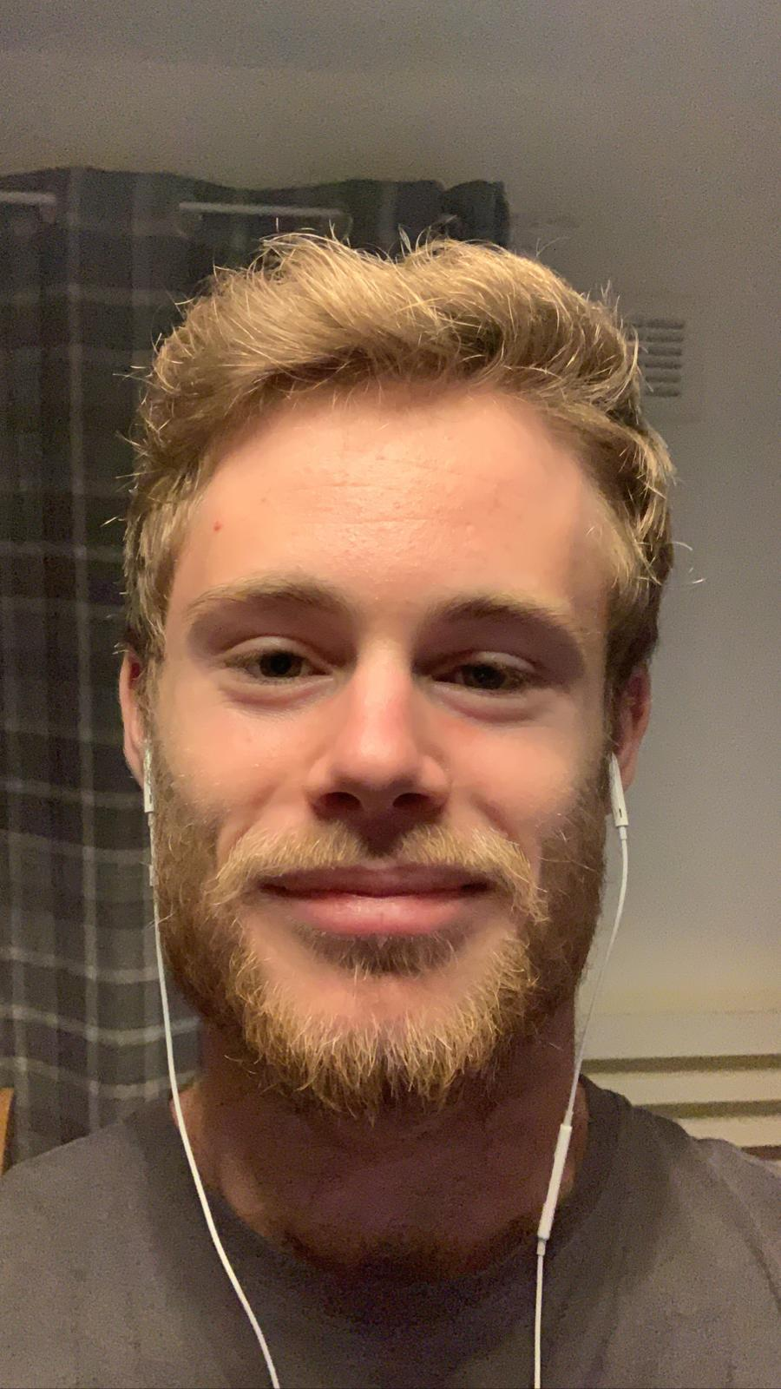
Self-Regulation and Autism
Factors that may impact the development of Self-Regulation:
Neurodevelopment
Neuroception
Social Communication
Executive Functioning Skills
Sensory Processing Sensitivities

Slide 28
What needs to be considered
in our efforts to foster the development of self-regulation
A positive, nurturing relationship
All behaviour is communication
All learning is developmental
Dependence → Co-dependence → Independence
Mind-minded co-regulation
A trauma informed lens

Slide 29
‘As a parent-carer, I have come to the frightening conclusion that I am the decisive element at home.
It is my personal approach that creates the climate.
It is my daily mood that makes the weather.
As a parent-carer, I possess tremendous power to make my child’s life miserable or joyous.
I can be a tool of torture or an instrument of inspiration.
I can humiliate or humour, hurt or heal.
In all situations, it is my response that decides whether a crisis will be escalated or de-escalated, my child humanized or dehumanized.’
Haim Ginott, Philosopher (1971)

Slide 30
Emotional regulation – A social process
https://www.autism.org/emotional-regulation-in-asd/

Slide 31
Dysregulation
.
Self-regulation takes energy; executive functioning fuel
Some individuals have to work that much harder to perform the same tasks as others
It is this expenditure that so seriously depletes the capacity to meet any subsequent challenges
Shutdowns and meltdowns are often the response to the depletion of executive functioning fuel
As carers, it is important to notice what stresses, as well as what soothes your Autistic adult

Slide 33
Spoon Theory
a metaphor in regards to fatigue; used to describe the amount of mental and physical energy a person has available for activities of living
The average person wakes up with 12 units of energy to 'spend' daily
Each spoon represents a 'unit' of energy
‘Each day, I have to plan how to use that energy
As an Autistic person I live in a world that is not designed for me’
Anne Memmott, Autistic Autism Professional
https://annsautism.blogspot.com/2018/02/autism-and-spoon-theory.html?fbclid=IwAR1tIO5_pd19Txm4oT1NvJowF1WiqxRjoYl9xquzNMwgrp43iaEoFkZEfoM&m=1

Slide 34
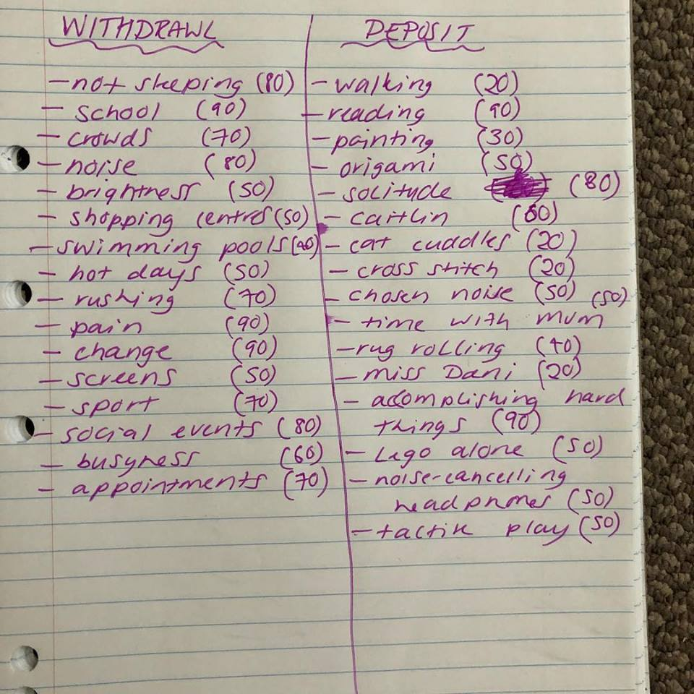
Creating an Energy
Bank Account
Develops awareness of:
Where energy withdrawals and deposits come from
Potential triggers
What can be done to improve recovery from distress
https://medium.com/age-of-awareness/the-energy-accounting-activity-for-autism-3a245e34bdfb

Slide 35
57 Albion Road, Edinburgh EH7 5QY Tel: 0131 475 2416 Email: info@pasda.org.uk Website: www.pasda.org.uk Scottish Charity Number: SC042678
MAKE A DONATION TO SUPPORT Pasda’s WORK
If you have benefitted from this presentation, please consider supporting Pasda's work.
You can do this in one of four ways:
Donate via JustGiving on the Pasda website at: https://www.pasda.org.uk , at the top right of the Home Page.
Donate via JustGiving at: https://www.justgiving.com/pasdauk
Make a bank transfer. To do this, please contact us by phone or email for the account details.
Make out a cheque payable to Pasda, and mail it to our office at the address above.
Thank you very much.

