Slide 1
Adaptive self-regulation: the building blocks of a quality life
Self-regulation
and Autism
Sarah Barratt
Educational Psychologist: PASDA
sarahs_karma@yahoo.co.uk

Slide 2
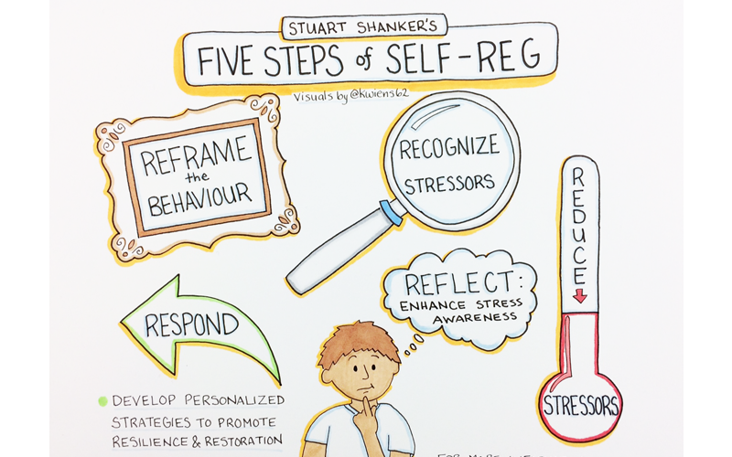
2.
1
3.
5.
4.

Slide 3
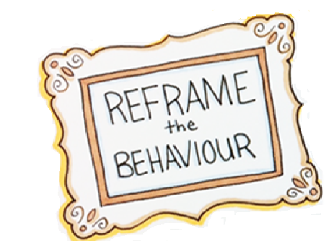
“What is involved in reframing behaviour?”
It’s the idea of reassessing behaviour.
The idea is that we see the individual differently.
We want to insert a pause and consider why we’re seeing this behaviour and why now. Typically we shift from seeing an individual’s behaviour as misbehaviour to seeing it as stress behaviour.
Reframe the Behaviour

Slide 4
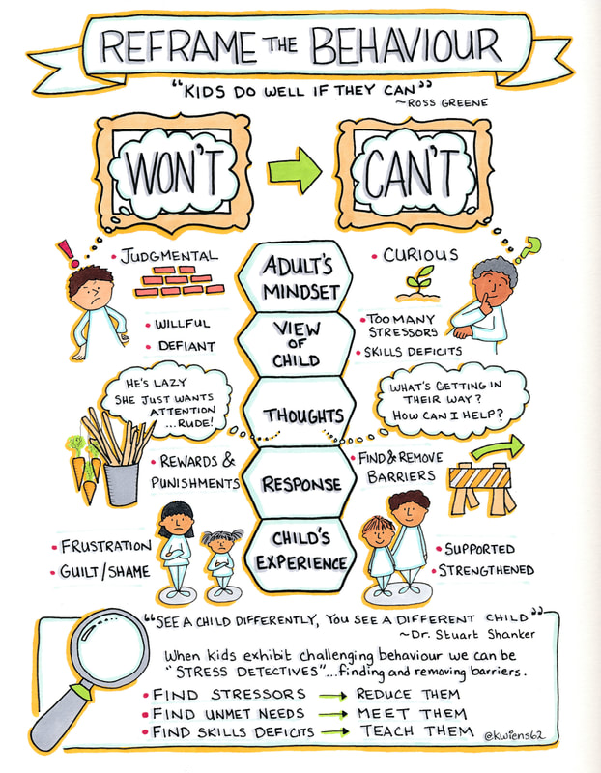
YET!
Carer’s Mindset
We all do well if we can!
View of the Autistic adult
Autistic adult’s experience

Slide 5
“See an individual differently; you see a
different individual.”
Dr Stuart Shanker
When a person exhibits challenging behaviour we need to become “STRESS DETECTIVES” . . . Finding and removing the barriers.

Slide 6
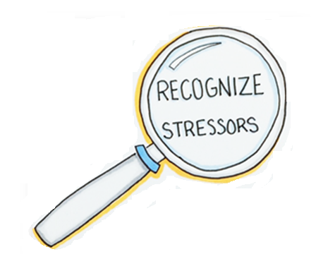
“How do we identify stressors?”
We become stress detectives
We look with all of our senses, including our internal senses, to figure out what the stressors are; not just the obvious ones, but also the very subtle, hidden stressors

Slide 7
The Stress Equation

Slide 8
The Iceberg Analogy

Slide 9
The Domains of Self-Regulation
Self-regulation refers to the manner in which an individual recovers from the expenditure of energy required to deal with stressors
Stressors come from each of these domains
https://self-reg.ca/wp-content/uploads/2020/06/1_4_Domain_Stress_Examples_V2.pdf

Slide 10
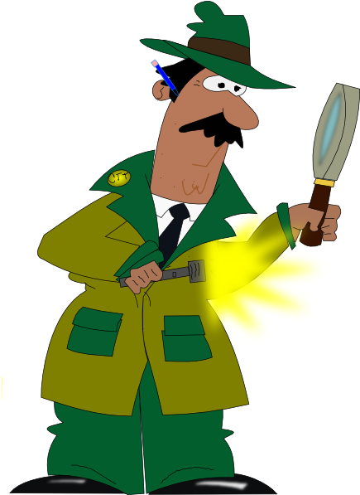
The Domains of Self-Regulation
Continued
https://self-reg.ca/wp-content/uploads/2020/06/5_Step_Profile.pdf

Slide 11
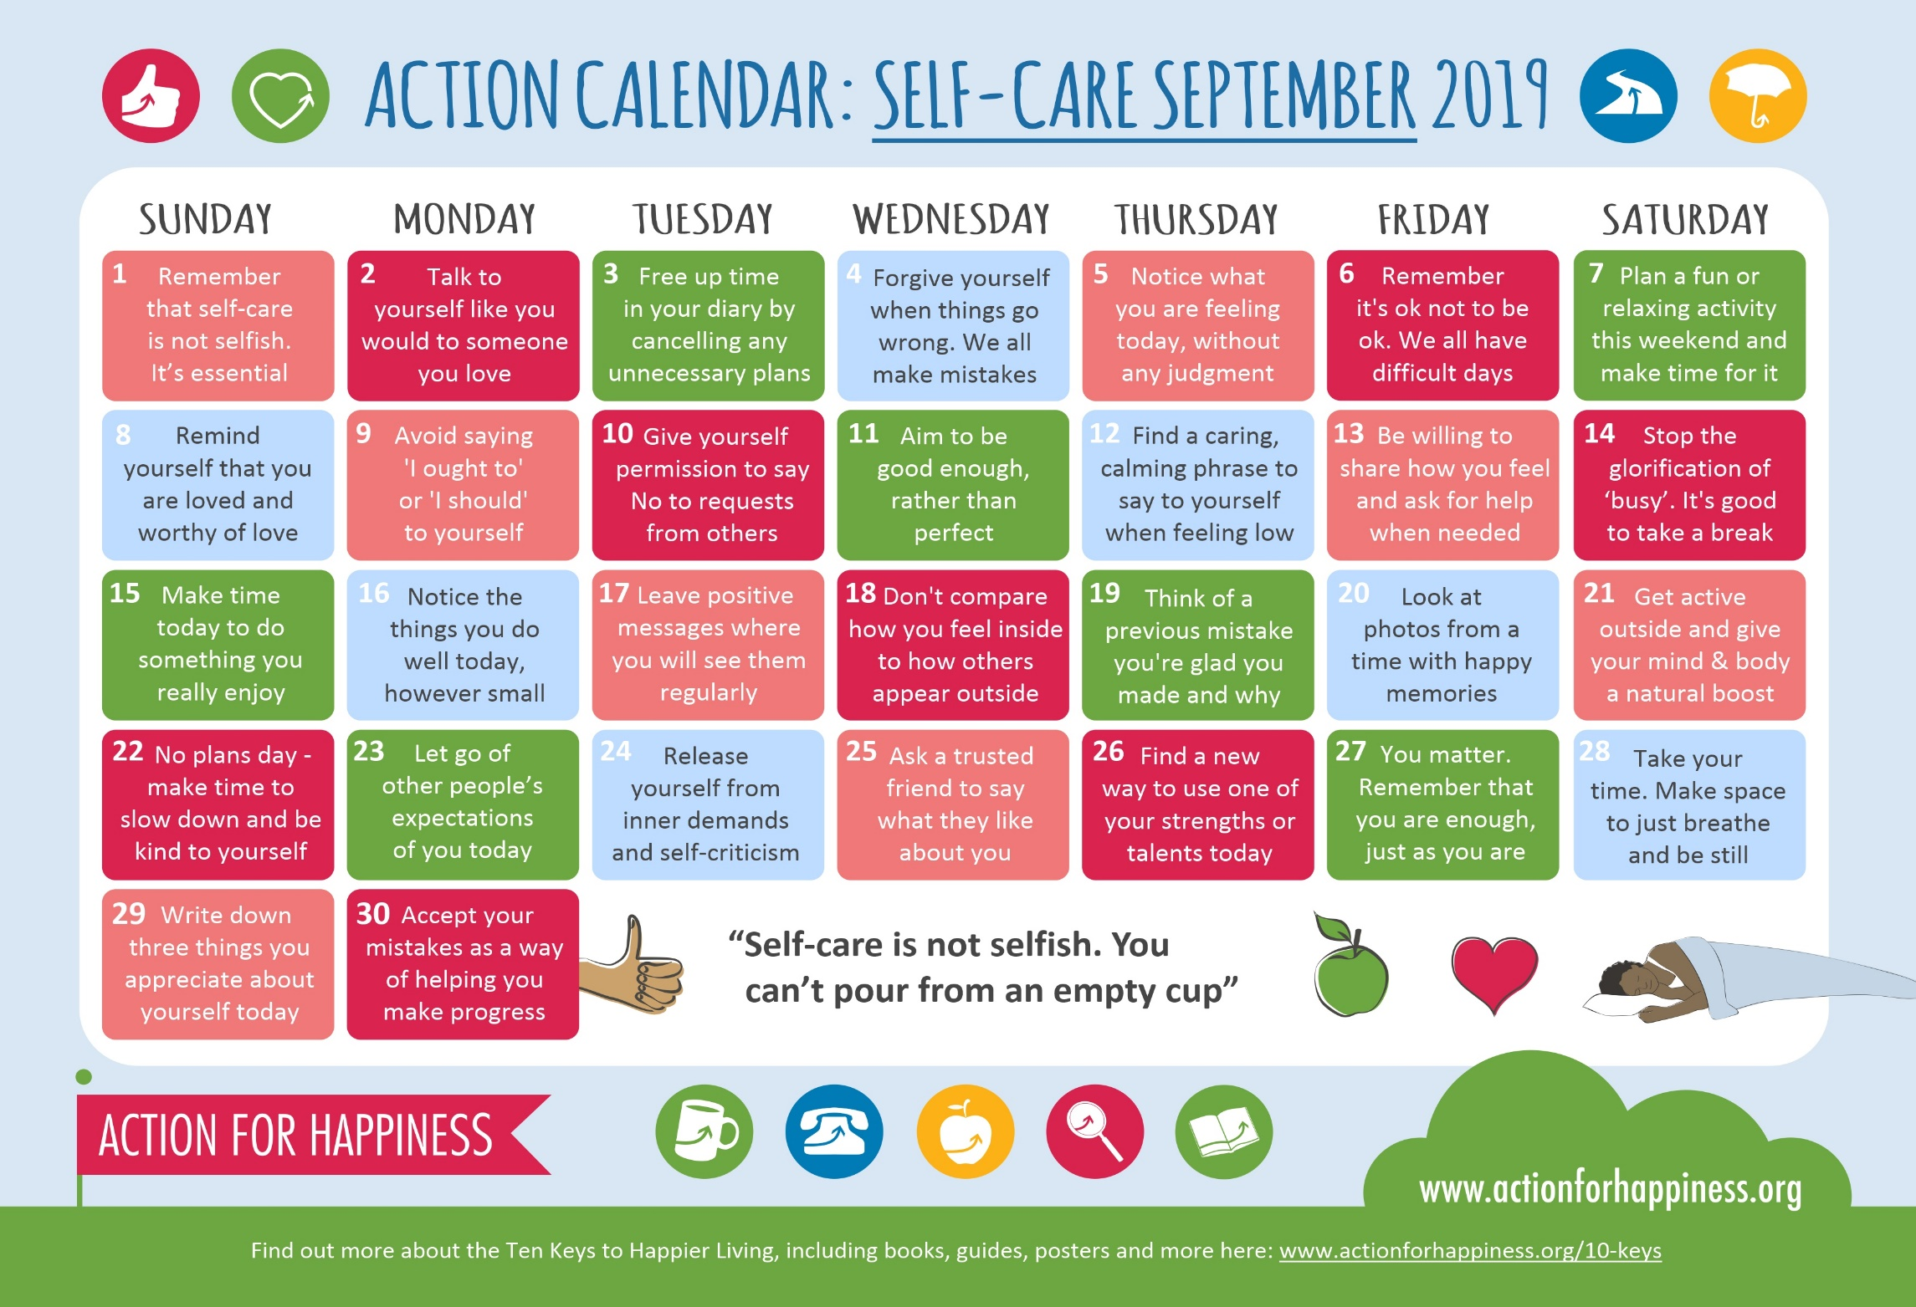
2020
https://www.actionforhappiness.org/media/803824/september_2019.jpg

Slide 12
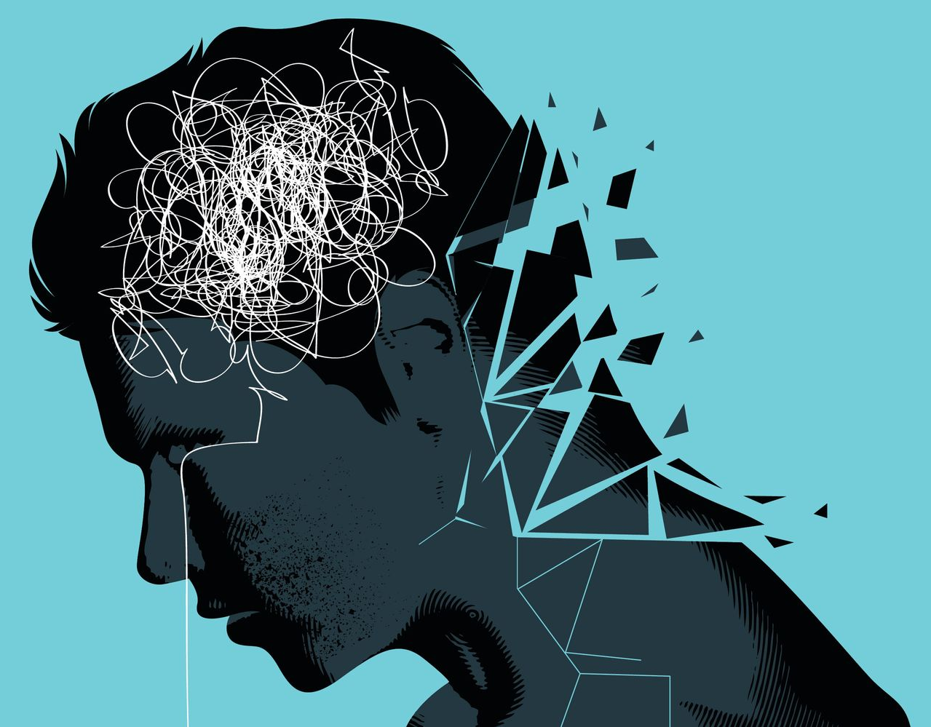
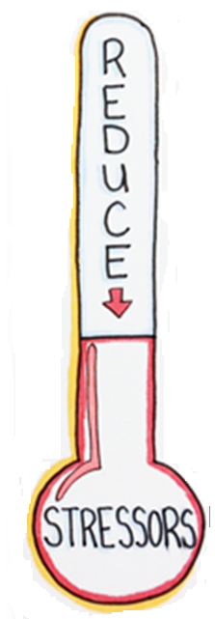
“How do we reduce the stressors?”

Slide 13
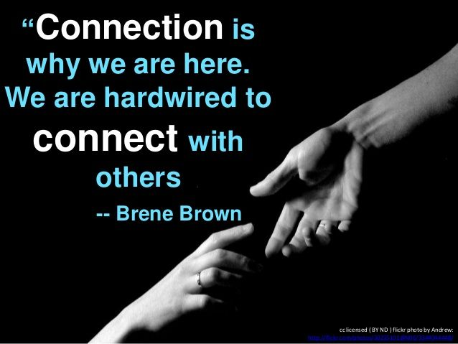
Build relationships that are:
Positive
Warm
Safe
As a parent-carer be:
Available
Patient
Constructive
Self-regulation develops in connection with others.

Slide 14
Self-Regulation & Co-Regulation
Successful self-regulation is:
Dependent on co-regulation
Provided by parents and/or other caregiving
adults
Warm and responsive interactions
Supportive; provides coaching and
modelling
A means of facilitating an individual’s ability to understand, express and modulate their thoughts, feelings and behaviour
is the first step on the pathway towards
https://www.youtube.com/watch?v=l6kvf_BzKwY

Slide 15
Calming together
‘How we experience the world,
relate to others,
and find meaning in life,
are dependent on how we have come to regulate our emotions.’
Dan Siegel, 1999

Slide 16
Parent-Carer Soul Work
The capacity for co-regulation; this depends largely on a caregiver’s own self-regulation skills
Recognize and understand your OWN emotions; and then you will be better able to monitor and control them
Comfort in expressing your own emotions, allows you to share the best of yourself with others;
Not being able to control your emotions, can reveal your worst.
—Bryant H. McGill

Slide 17
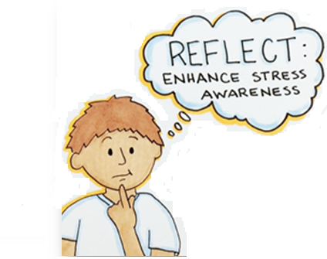
How do we help develop self-awareness in others and ourselves?
The first step is to turn the stress response off
To do this we need to become aware of what it feels like when our own stress response and that of our Autistic adult child, is starting to gear up
We need to support our child to experience what it feels like to turn off their stress response; what calm feels like

Slide 19
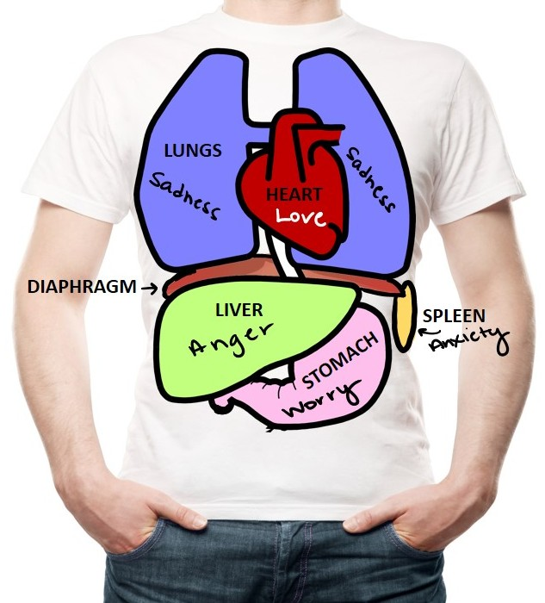
Connecting the dots. . .
Interoception: The felt experience or sense of internal physiological states and what is going on inside your body
Identify where in your body you experienced sensation/s during the body scan activity.
Difficulty with the interoceptive sense can mean trouble “feeling” one’s emotions.

Slide 20
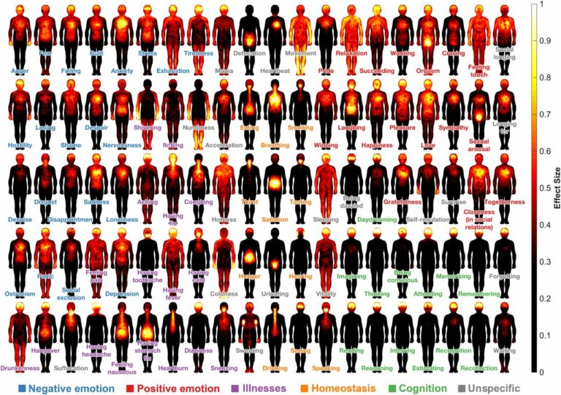
‘Listen to your body’
Interoceptive awareness: the ability to perceive physical sensations within the body
Awareness of our body sensations enables the cultivation of the mind-body connection
Attunement to our physical selves is like saying, ‘Hello’ to our bodies and to makes it possible to answer: ‘How do I feel?’
Being self-aware is arguably central to what it means to be human.
The Bodily Sensations Map: identifies where in our physical bodies we experience core feelings and emotions

Slide 21
“If you think of your body as a musical instrument, the body scan is a way of tuning it. If you think of it as a universe, the body scan is a way to come to know it. If you think of your body as a house, the body scan is a way to throw open all the windows and doors and let the fresh air of awareness sweep it clean.”
Jon Kabat-Zinn
https://insighttimer.com/petekirchmer/guided-meditations/body-scan-mpeak

Slide 22
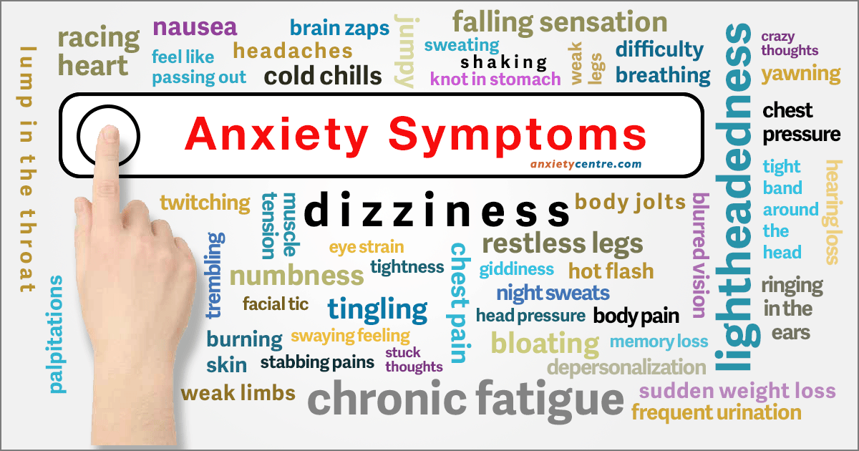
Keeping the dots connected. . .
Connecting bodily sensations to the appropriate emotions

Slide 23
Labelling Emotions
This requires the need to learn to label feelings and develop the verbal skills for generating rational responses
An explanation; not an excuse!
Feelings can be confusing
Feelings can hide other feelings: ‘Hard’ emotions tend to cover up our ‘soft’ emotions
For Autistic adults aggression and anger can often be the response to feeling fear, anxiety and/or overwhelmed

Slide 24
The development of personalized strategies to promote resilience and restoration
Parent-carers respond by:
Trial-and-error
Empowering their children whenever possible, to become their own agents of self-regulation
Discussing and collaboratively exploring problem-solving strategies

Slide 25
Responding
The challenge is how to do so in constructive ways?
Focus on the emotions driving the behaviour rather than the behaviour itself
The goal is to de-escalate, not to punish or teach a lesson i.e. reduce the stressor
It requires tuning in, and making insightful comments about your Autistic adult child’s mental state

Slide 27
Surviving Intense Emotions
STOP, DROP, STAY
STOPPING
By stopping—recognizing and naming when you’ve been triggered—you’ve already begun to slow your process down.
https://blog.sivanaspirit.com/mf-gn-stay-abiding-intense-emotions/

Slide 28
DROPPING
Dropping - shifting your attention inward to a deeper place inside yourself - letting go of the story line, getting out of the chatter in your heads and connecting with what’s going on in your body.

Slide 29
STAYING
By staying with your emotional experience, by abiding with it and giving it room to breathe, it’s able to move through you and come to a resolution. When you stay with your emotional experience and see it through, you grow your capacity to be present with yourself and with others.

Slide 30
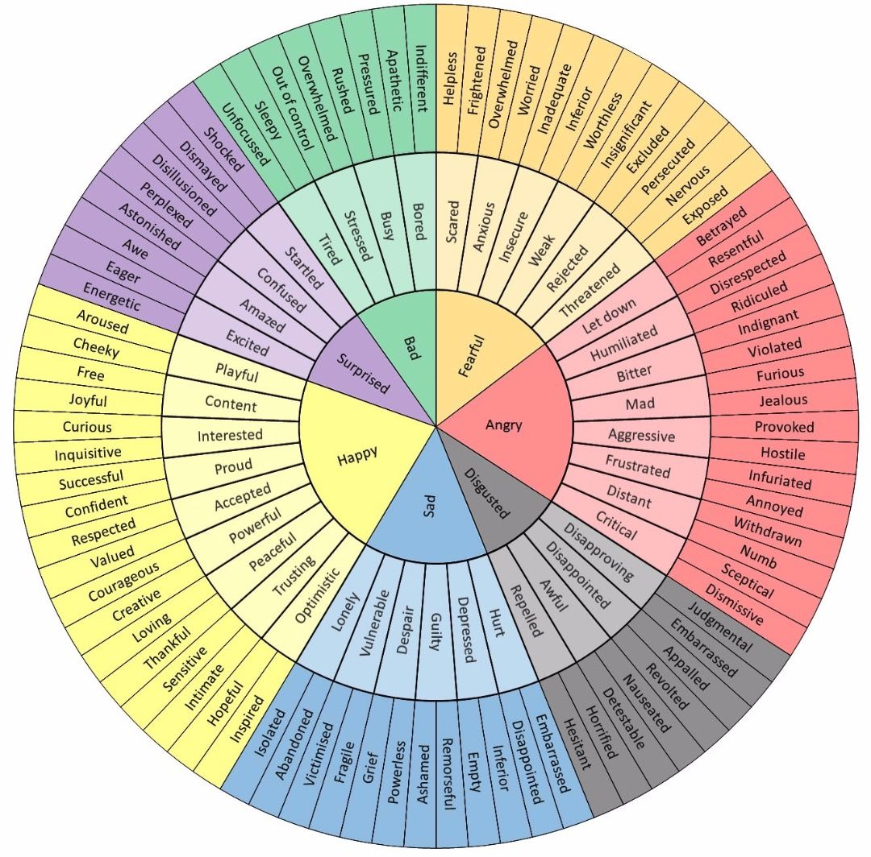
Wheel of Emotions
Support to identify feelings
Can you guess how many emotions a human can experience?
How can one navigate the turbulent waters of feelings, without getting lost?
http://feelingswheel.com/

Slide 31
The Zones of Regulation
An approach to support the development of self-regulation skills by:
https://www.zonesofregulation.com/learn-more-about-the-zones.html
Categorization of feelings and states of alertness
Development of emotional vocabulary and a shared language for talking about feelings and arousal states
Teaches awareness and growing independence in controlling emotions and impulses, managing sensory needs, and improving the ability to problem solve
Supports difficulties with emotional and sensory regulation, executive functioning and and social cognition
The ZONES of Regulation
The brain controls the Zone we are in
The body’s response change depending on the Zone we are in

Slide 32
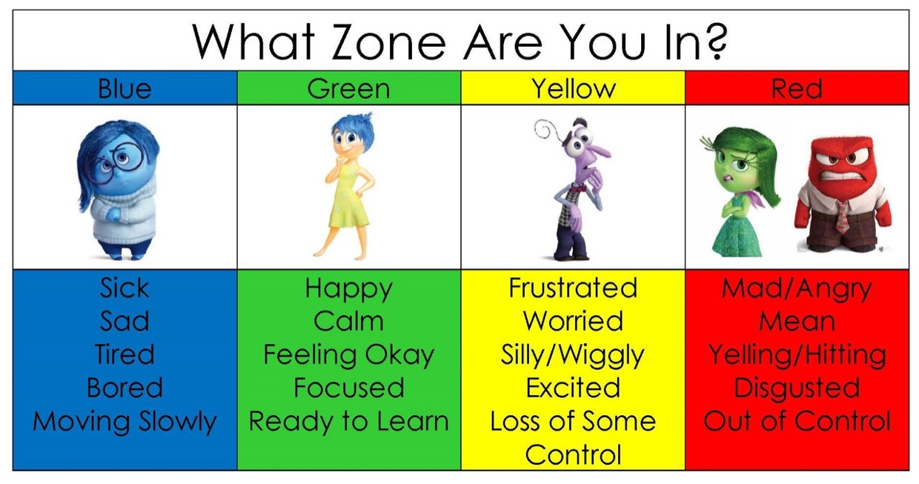
Leah Kuypers

Slide 33
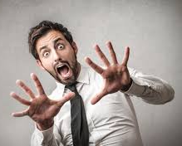
Practice using the Zones
Think about a recent experience that put you into the Red Zone
How would you describe the bodily sensations you experienced?
What emotion would you attach to these feelings?

Slide 34
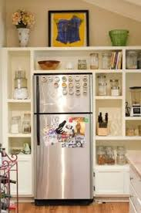
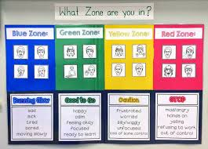
The Zones at Home
Introduce the poster
Display it somewhere that is easily accessible
Highlight that there are no ‘good’ and ‘bad’
Zones, but being in the Green Zone means
you are ‘good to go’ and ‘ready to learn’
Sorting emotions activity
Daily ‘Check in’ and ‘Check out’
https://www.socialthinking.com/Articles?name=all-the-zones-are-ok#:~:text=It%20is%20vital%20to%20understand,low%20or%20high%3F%E2%80%9D).

Slide 35
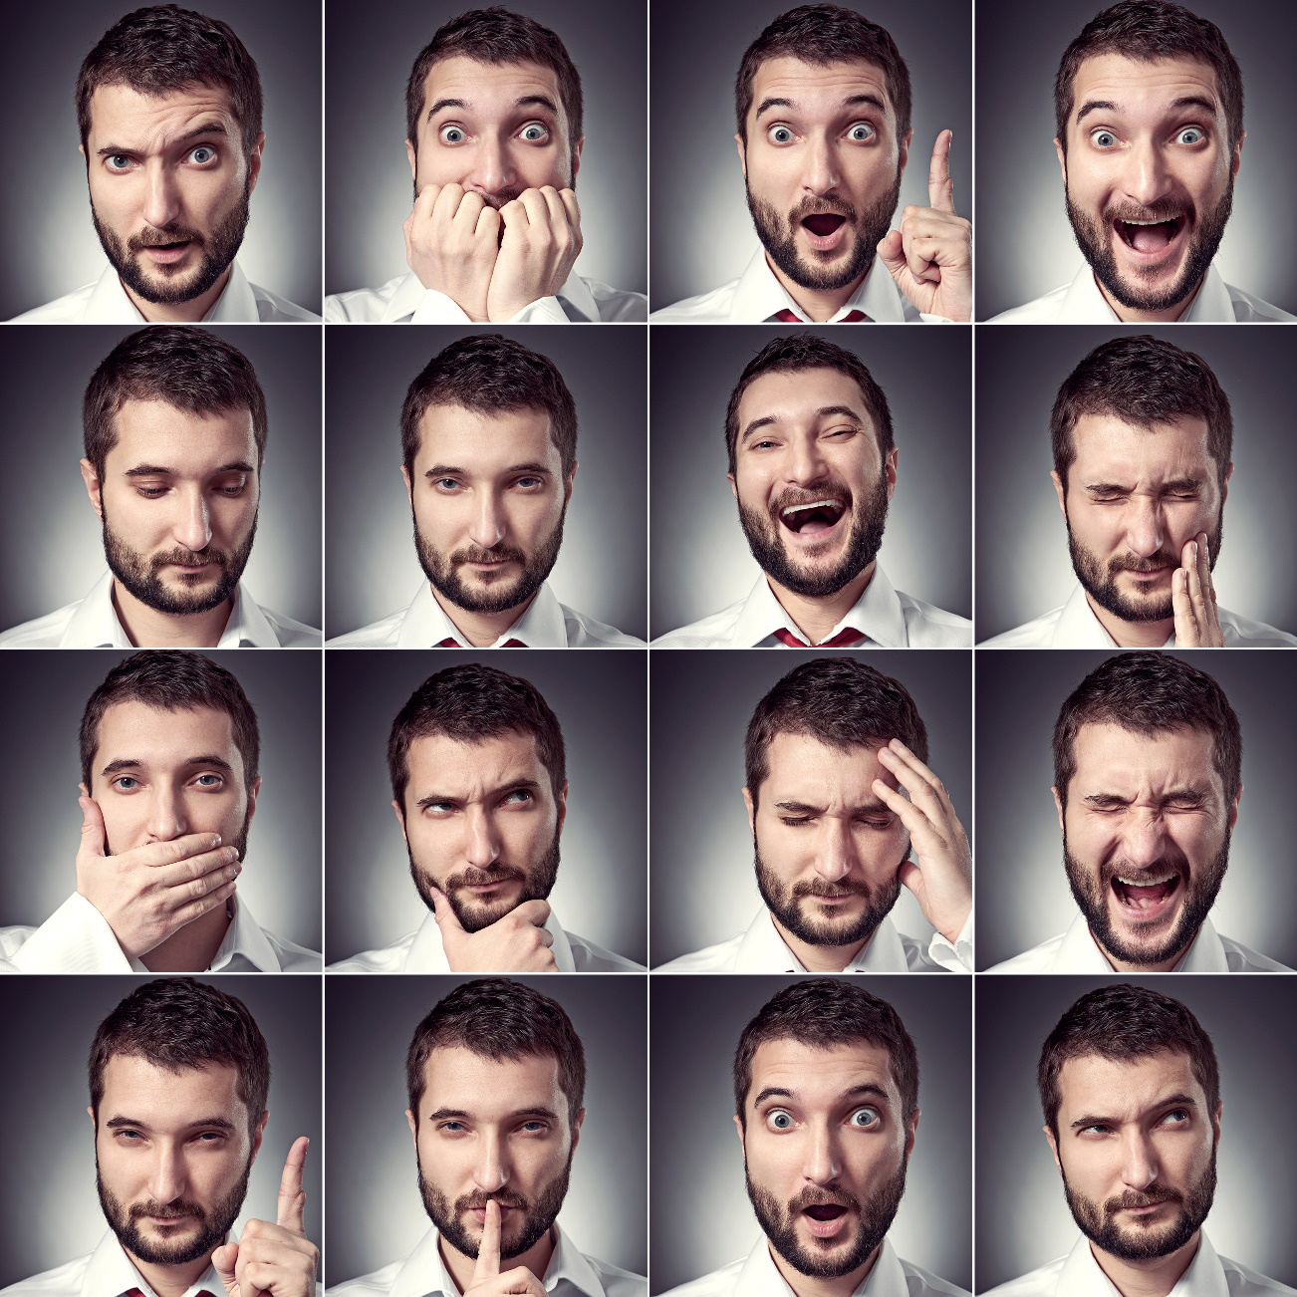
Label each of the emotions below
2. Match the emotions to the appropriate Zone opposite

Slide 36
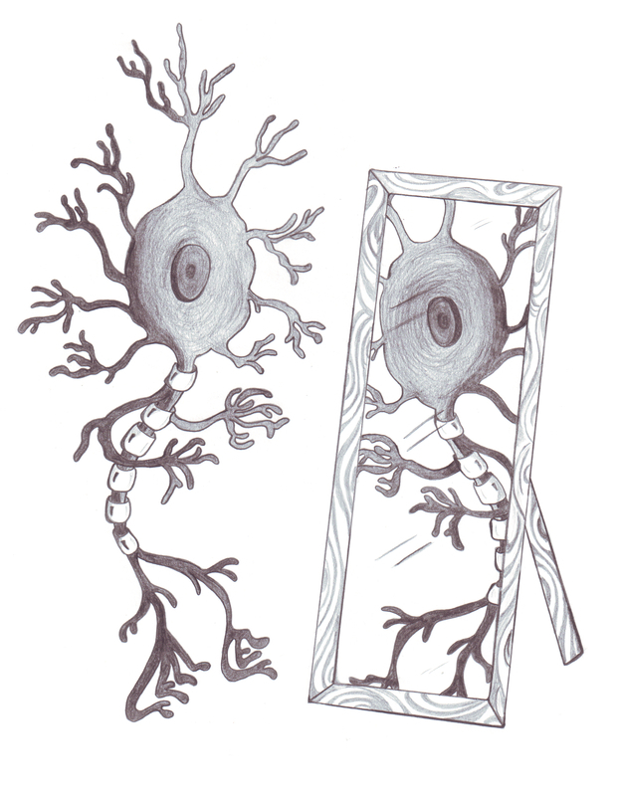
Mirror Neurons
This is the way we all unconsciously send our emotions or feelings into a room
This affect other people in the room — for good or for bad
When we’re under stress, our family members can pick up our negativity and anxiety through the “mirror-neuron-emotions” which can then impact their actions
The opposite can also happen – parent-carers can pick up on their child’s negative energy
https://www.youtube.com/watch?v=Jcc0L9v1q-8

Slide 37
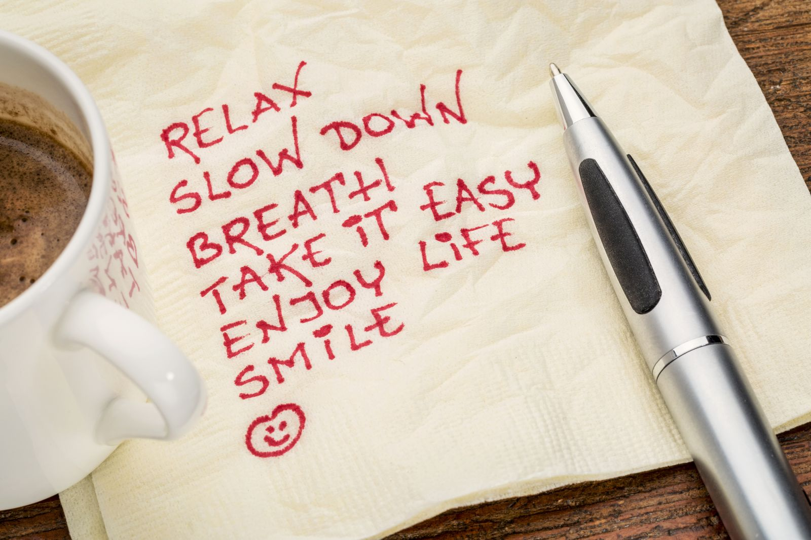
De-stressing Techniques
Walk Your Cares Away
- Exercise is important to both our body and mind
Laugh Out Loud!
Laughter is a whole-body experience which positively affects every organ of your body
Wake Up to Morning Pages
Each morning put a pen to paper and continuously write whatever comes into your mind
Breathe Away Stress
A quick way to defuse anxiety is through simple controlled breathing exercises
https://goodparentingbrighterchildren.com/relaxation-techniques/

Slide 38
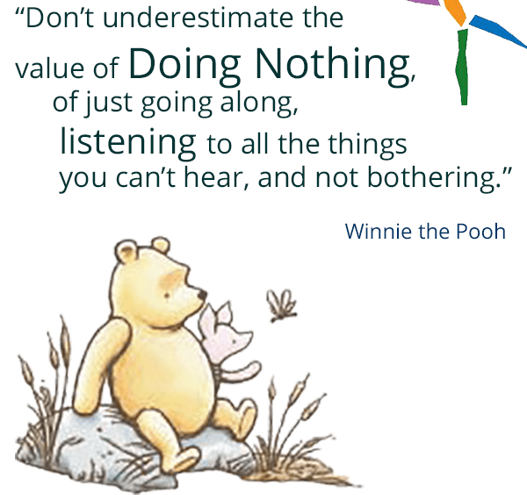
De-stressing Techniques
Continued . . .
Pet Your Pet
People who own pets suffer far less stress and work more efficiently at home and work
Art: Colouring
Helps to energize, clarify and calm your thought processes and fill your body with peace
Bathe Your Cares Away
Reduce aches and pains, allowing for relaxation, triggers mindfulness and helps you to sleep
Music
Background music can motivate, relax, tap into your creative
juices and help build your brain
https://goodparentingbrighterchildren.com/ways-to-relax/
https://positivepsychology.com/wp-content/uploads/Skills-for-Regulating-Emotions.pdf

Slide 39
The Lazy 8 Breathing Technique
https://jefferson.mpls.k12.mn.us/uploads/bw_reproducible_t.pdf

Slide 40
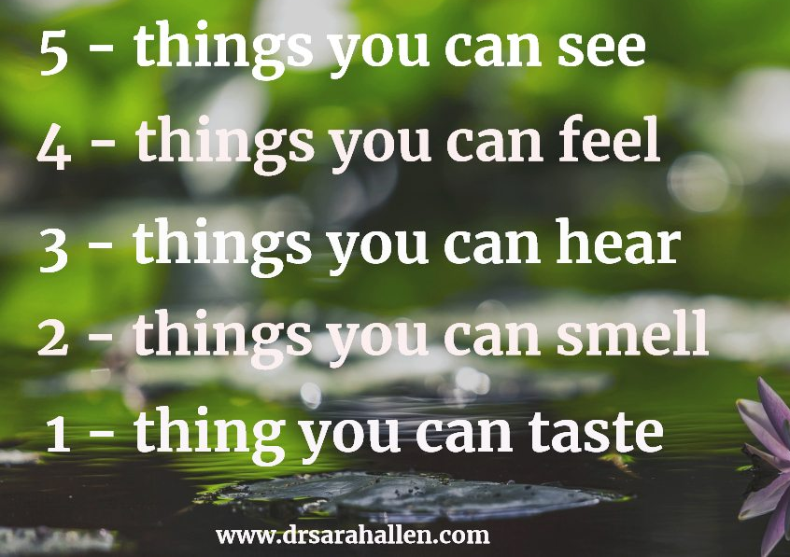
Grounding Techniques
Shift your focus from your:
Anxiety provoking thoughts in your mind
to
What is happening physically in your body or your surroundings right now
The 5-4-3-2-1 Grounding Techniques
https://drsarahallen.com/7-ways-to-calm/

Slide 41
Which Zone are you in now?
Have a chat to your partner and/or family members; share with each other which Zones you are in just now.

Slide 42
Visualize a Safe Place
Visualizing a Safe place is a useful technique for grounding the body and mind
By bringing to mind your safe space, your favourite environment, or your comfort zone you can actually reverse the stress response
This can become an essential coping skill for managing anxiety, panic
https://www.youtube.com/watch?v=Isw37iCwMCg

Slide 43
57 Albion Road, Edinburgh EH7 5QY Tel: 0131 475 2416 Email: info@pasda.org.uk Website: www.pasda.org.uk Scottish Charity Number: SC042678
MAKE A DONATION TO SUPPORT Pasda’s WORK
If you have benefitted from this presentation, please consider supporting Pasda's work.
You can do this in one of four ways:
Donate via JustGiving on the Pasda website at: https://www.pasda.org.uk , at the top right of the Home Page.
Donate via JustGiving at: https://www.justgiving.com/pasdauk
Make a bank transfer. To do this, please contact us by phone or email for the account details.
Make out a cheque payable to Pasda, and mail it to our office at the address above.
Thank you very much.

