Slide 1
Sensory processing
and Autism
PART 1
Sarah Barratt
Educational Psychologist, PASDA
sarahs_karma@yahoo.co.uk
Sensory Overload, watercolour and ink on paper

Slide 2
Sensory Processing and Autism
Our Sensory systems
Sensory processing
Is it sensory or behaviour?
Sensory processing difficulties
Synaesthesia: Mixed signals
Sensory processing and Autism
Sensory Overload
Sensory Meltdown
Responding to sensory processing difficulties
MODULE
outline

Slide 3
one day . . .
Driving a car that isn't working well.
When you step on the accelerator the car sometimes lurches forward and sometimes doesn't respond.
When you press the hooter it sounds blaring.
The brakes sometimes slow the car, but not always.
The indicators work occasionally, the steering is erratic, and the speedometer is inaccurate.
You are engaged in a constant struggle to keep the car on the road, and it is difficult to concentrate on anything else.

Slide 4
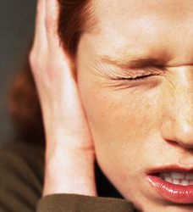
SENSORY OVERLOAD
‘Cover my ears and block out the world Rock it so gently away Shut my eyes and pretend I’m elsewhere Hum so there’s nothing left Bang my head so the confusion is gone Curl up so I feel safe and warm Hide under blankets so I can feel hugged Be without words so alone and lost Have my body not do what I want Cry loudly so I can let it all out Be overloaded, scared and afraid Be frustrated that no one understands me That no one understands my pain.’
Matty Angel, 2010
http://www.mattyangel.com/

Slide 5
Our senses
Our senses give us the information we need to function in the world
They help ensure we:
- survive
- learn how to become active and sociable beings
They receive information from stimuli both outside and inside our bodies
Any activity engages several of our senses simultaneously
To do their job well, so that we respond appropriately, the senses need to work together

Slide 6
Our Eight Senses
4. Auditory
1. Visual
7. Vestibular sense
(Inner ear: balance & movement)
5. Olfactory
8. Interoception
(Internal organs)
2. Gustatory
3.Tactile
6. Proprioception (muscles & joints)

Slide 7
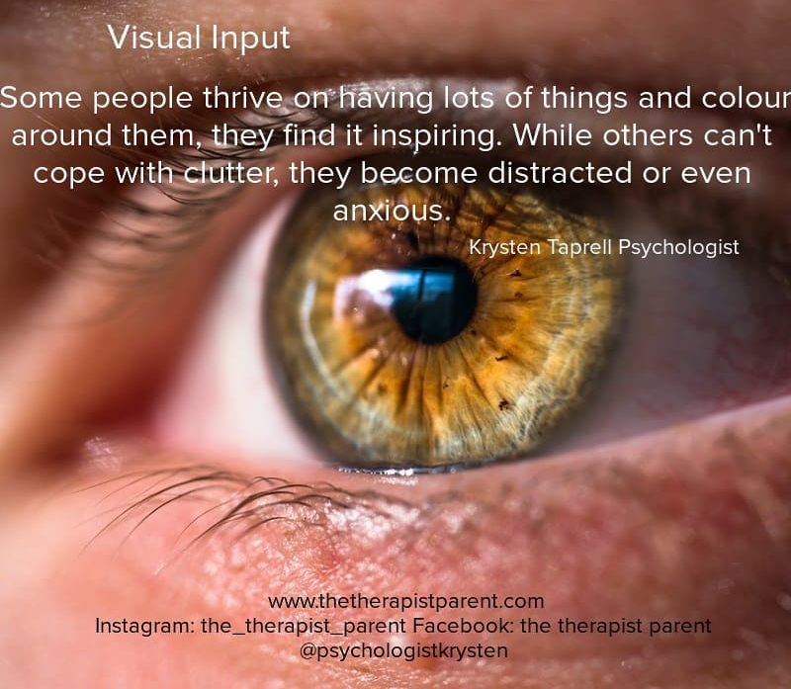

Slide 8
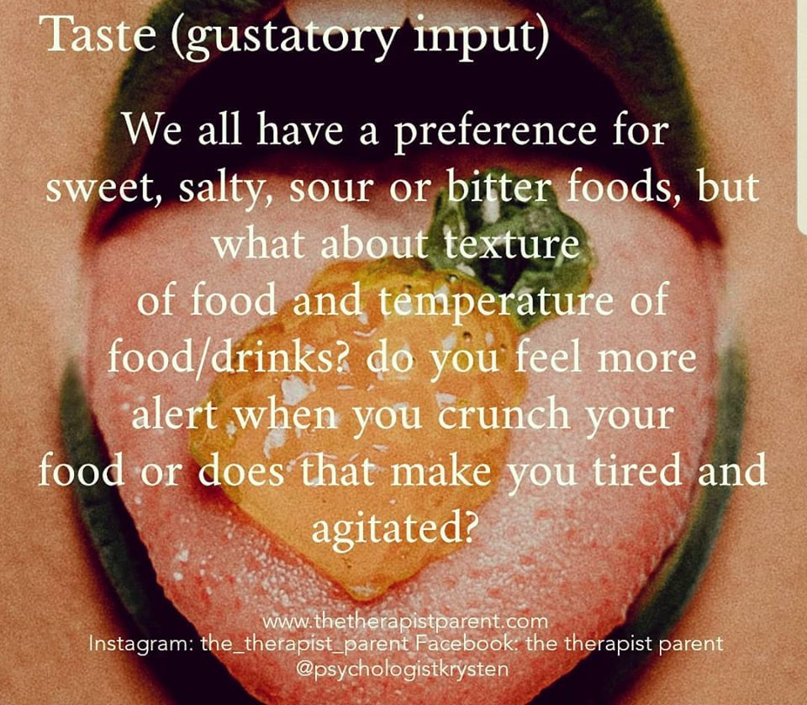

Slide 9
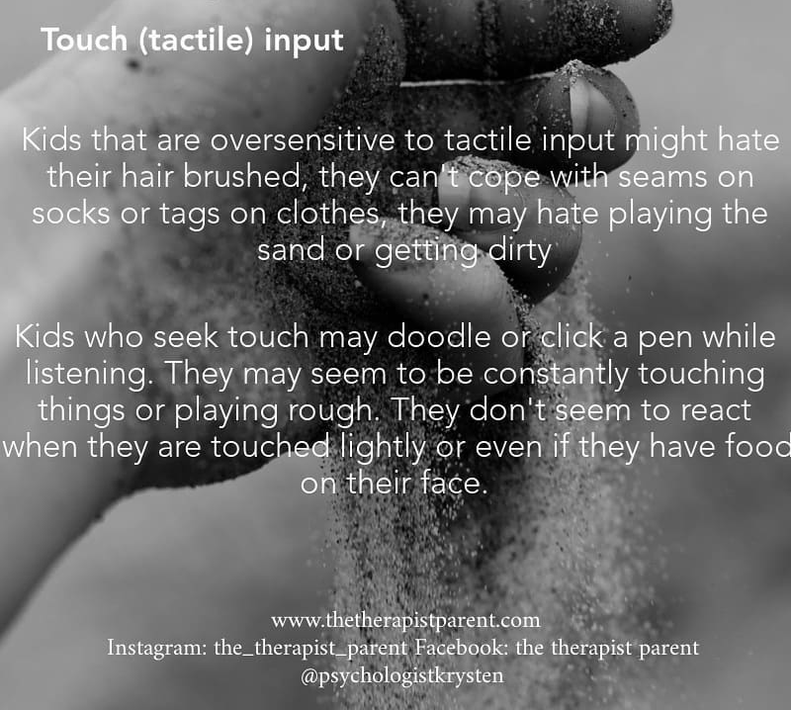

Slide 10
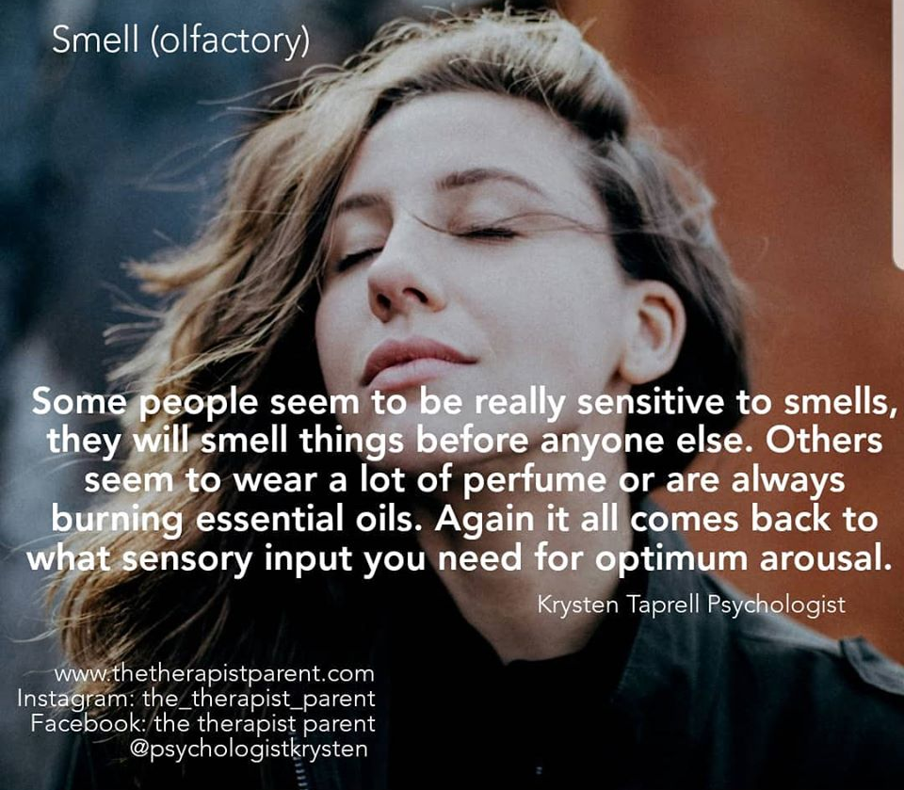

Slide 11
Sound (Auditory) input
Some individuals struggle to filter out sounds. They can’t distinguish between hearing your voice and hearing the background noise of the air-conditioner.
Others will have the TV turned up really loudly or when it is quiet make their own noises like tapping, humming, singing or anything to break the silence.
https://www.playitforwardtherapy.net/the-8-sensory-systems

Slide 12
of
https://www.playitforwardtherapy.net/the-8-sensory-systems

Slide 13
The Vestibular Sense
Located in the inner ear
Helps to detect changes in relation to gravity i.e. are you sitting, standing, lying down, upside down, spinning or standing still
Often referred to as the internal
GPS system of your body

Slide 14
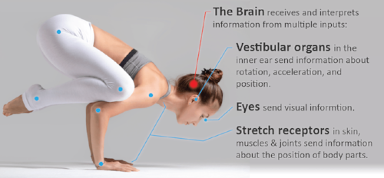
Importance of the vestibular sense
The Vestibular Sense is a crucial part of human development
A well developed vestibular system enables an individual to feel secure and confident in their body
This makes it possible to move confidently, optimally attend to learn and rest peacefully

Slide 15
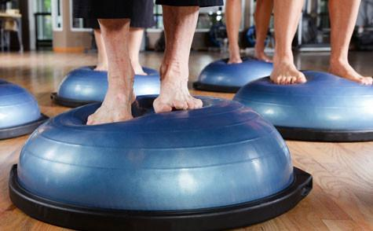
A well-developed vestibular sense
More specifically the vestibular system:
Means good balance
Improves visual tracking (maintaining a steady visual image while watching a
moving object) & hand (fine motor) skills
Develops and maintains normal muscle ‘tone’, (our muscles’ ‘state-of-readiness’)
Supports language development
Helps with an individual’s self-care and independence
Encourages self-regulation
https://childreninspiredbyyoga.com/blog/2018/01/vestibular-sense-child-development/

Slide 16
Vestibular Sense & Self-regulation
The vestibular system can also be likened to the ‘volume control button’ for the body
Quick up and down or spinning head movements tend to ‘wake us up’
Slower rocking head movements, or keeping the head still, helps us to calm down
https://www.youtube.com/watch?v=pEbILhUc1Pc&feature=youtu.be

Slide 17
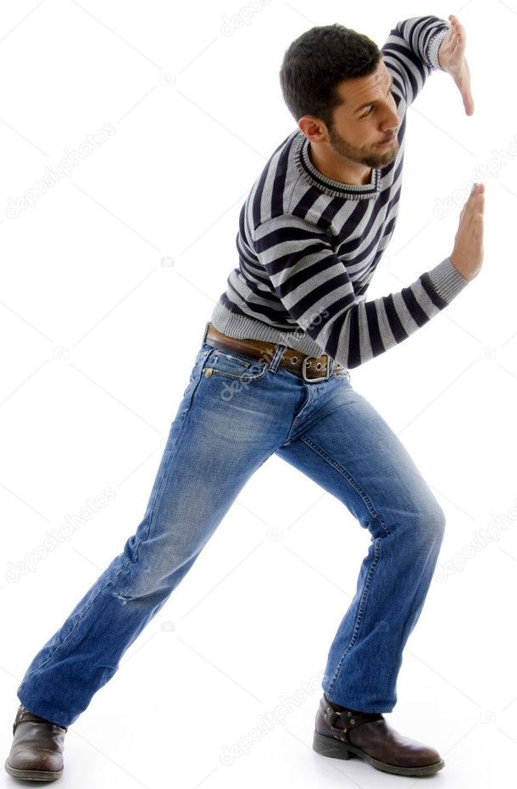
The Proprioceptive Sense
An internal senses of the body
that comes from the joints, muscles, ligaments, and other connective tissue
Allows you to know where your body parts are and what they are doing without necessarily having to look at them
Examples of proprioception include being able to:
- move in a coordinated way
- hold a pencil with just the right amount of force
- judge how hard to throw a ball
https://www.youtube.com/watch?v=WZ9NJsiz6lo

Slide 18
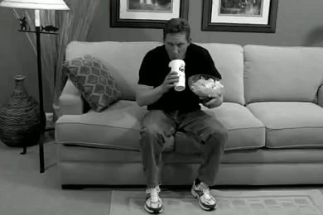
Proprioceptive Dysfunction
The proprioceptive sense is not receiving or interpreting input correctly within your muscles and joints
It can manifest itself as:
Clumsiness
Lack of coordination
Difficulty performing basic,
everyday activities
https://www.youtube.com/watch?v=b2iOliN3fAE

Slide 19
https://www.youtube.com/watch?v=pMEROPOK6v8

Slide 20
Proprioception & Alertness
Proprioceptive activities can be used to manage our levels of alertness:
Weight bearing activities e.g. crawling, push-ups
Resistance activities e.g. pushing/pulling
Heavy lifting e.g. carrying grocery bags
Cardiovascular activities e.g. running, jumping on a trampoline
Oral activities e.g. chewing, blowing bubbles
Deep pressure e.g. tight hugs
Proprioceptive input can be regulating, calming, soothing, organising and/or alerting, depending on the current state of one’s nervous system
https://mft.nhs.uk/app/uploads/2019/09/sensory-processing-pre-referral-advice-oct18.pdf

Slide 21
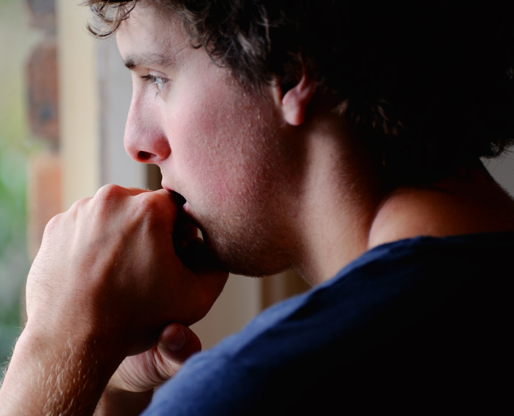
Difficulty concentrating
Enables you to answer: How you feel
Helps you control the way you feel
Prompts you to take action based on the signals you receive from within your body
Shallow breathing
Sweaty palms
Racing heart
Fluttering in my stomach
Anxious
https://www.youtube.com/watch?v=A0zbCiakjaA

Slide 22
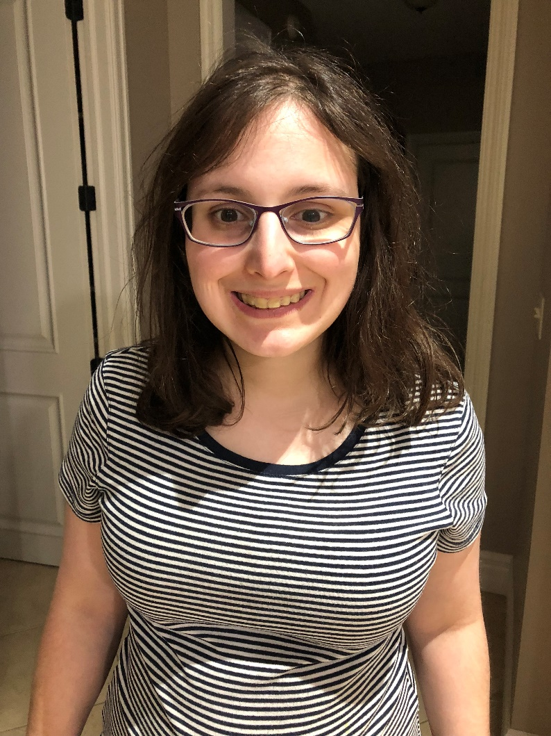
Interoception and Autism
‘I did not realize I had trouble feeling my internal body signals, as I had never heard of interoception before November 2014, but when I did, everything started to make sense.
That is, difficulties with interception help to clarify why I have such a hard time pinpointing my symptoms when I am not feeling well, why sometimes I seem to eat snack after snack without feeling full and why I get upset, anxious and overwhelmed so quickly, because I don’t feel it until I’m already far into the storm of the discomfort and frustration.’
Chloe Rothschild, a young 22-year old Autistic adult

Slide 23
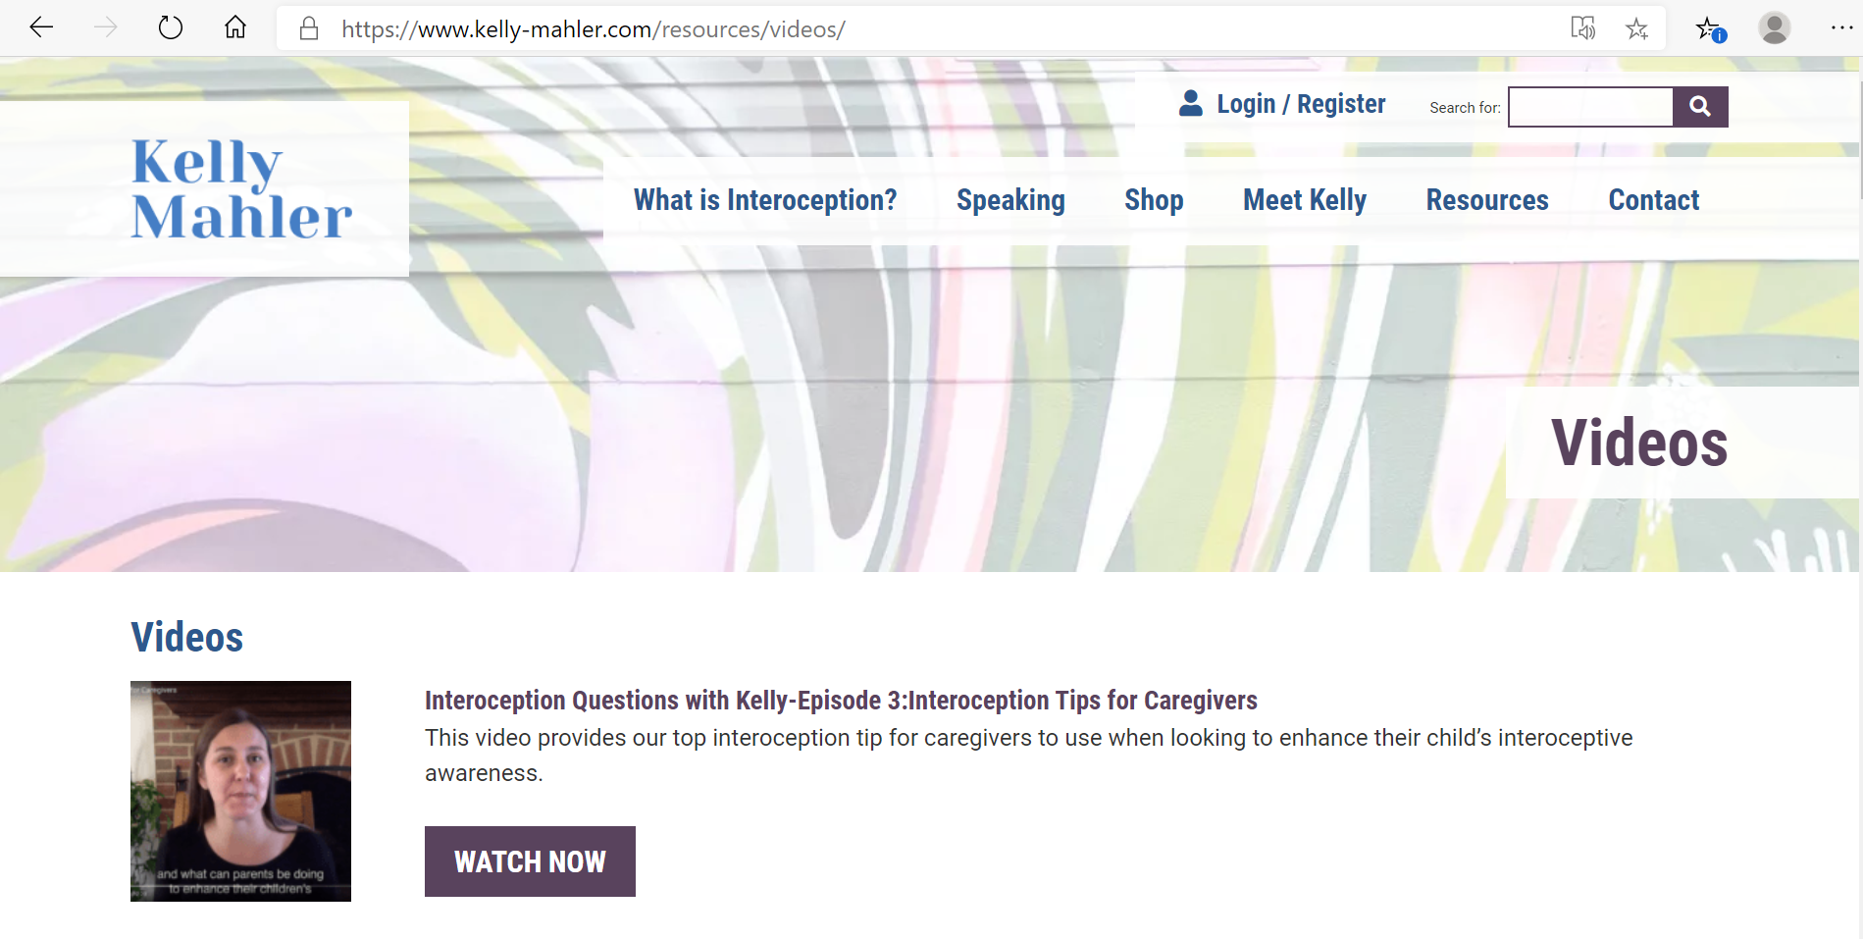
Research states that interoception can be improved
https://www.kelly-mahler.com/resources/videos/

Slide 24
What is sensory processing?
Sensory processing is foundational to our ability to engage with the world and function in it
Well developed sensory processing positively influences:
Cognitive Development
Communication
Self-regulation
Motor Skills
Interactions with the environment

Slide 25
Components of sensory processing
Sensory Input
Motor Output
Neurological Organisation

Slide 26
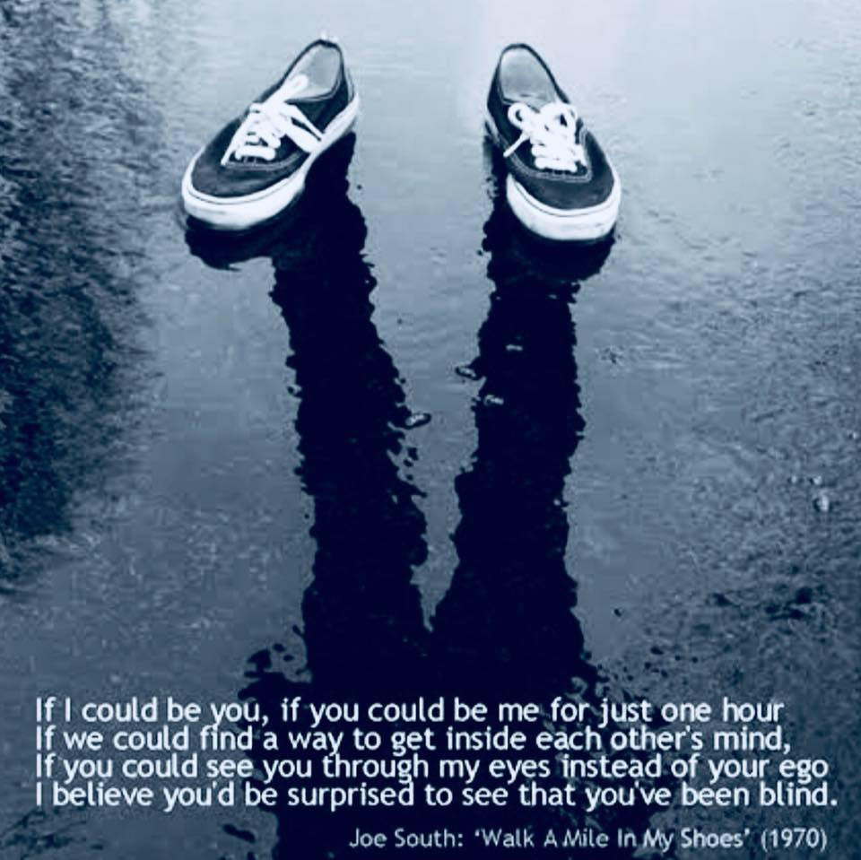
An Insider’s View
for the Neurotypical into the world of sensory processing difficulties
Many Autistic adults have difficulty processing sensory information in at least one of their eight senses
One or more of an Autistic adult’s senses are either over or under sensitive to specific stimuli
The response to the same sensory input can also vary from over to under sensitive from one day to the next
https://www.youtube.com/watch?v=QMpyDF0Pvf8

Slide 27
57 Albion Road, Edinburgh EH7 5QY Tel: 0131 475 2416 Email: info@pasda.org.uk Website: www.pasda.org.uk Scottish Charity Number: SC042678
MAKE A DONATION TO SUPPORT Pasda’s WORK
If you have benefitted from this presentation, please consider supporting Pasda's work.
You can do this in one of four ways:
Donate via JustGiving on the Pasda website at: https://www.pasda.org.uk , at the top right of the Home Page.
Donate via JustGiving at: https://www.justgiving.com/pasdauk
Make a bank transfer. To do this, please contact us by phone or email for the account details.
Make out a cheque payable to Pasda, and mail it to our office at the address above.
Thank you very much.

