Slide 1
Sensory processing
and Autism
PART 2
Sarah Barratt
Educational Psychologist, PASDA
sarahs_karma@yahoo.co.uk
Sensory Overload, watercolour and ink on paper

Slide 2
Is it Sensory or Behaviour?
Difficulties interpreting sensory information can have an impact on:
how we feel
how we think
how we behave or respond
Each of us are constantly having to respond to sensory input from within our bodies as well as from the environment around us
https://www.autism.org.uk/about/behaviour/sensory-world.aspx

Slide 3
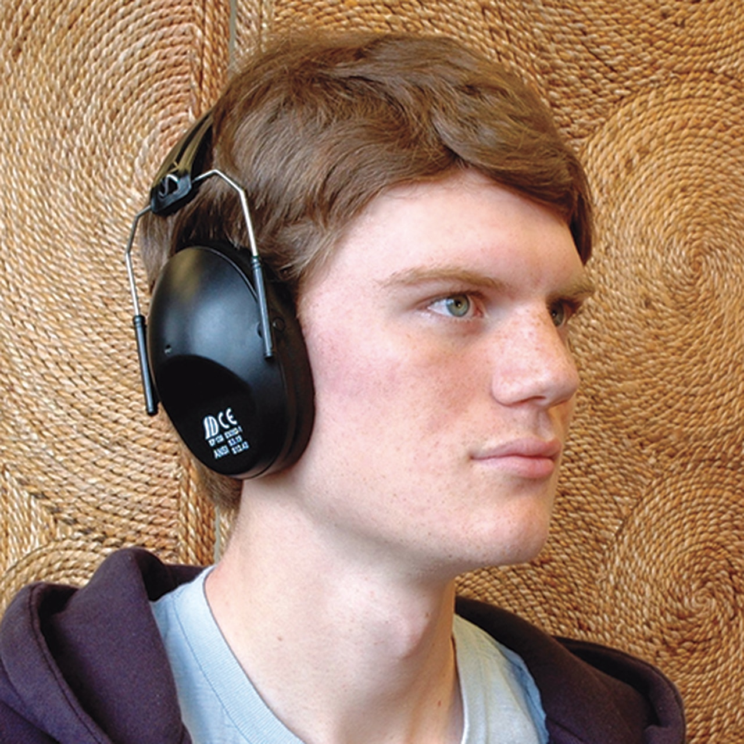
Behaviour is Communication
As parent-carers we all need a basic understanding of sensory processing if we are to make sense of observable behaviours we are not able to understand!
An individual’s behaviour may very well be addressing unique sensory needs.

Slide 4
Sensory Processing:
A key to understanding behaviour
Meeting our individual arousal needs depends on how we process
sensory information
Some of us need a lot of sensory input; others of us need less to reach and maintain an optimal state of arousal
Self-regulation enables us to reach our optimal arousal level even when the environment changes
Self-regulating all of the sensory information received, can be very difficult for Autistic individuals
Understanding an Autistic individual’s sensory needs, we can better provide support to help them meet and maintain their optimal arousal

Slide 5
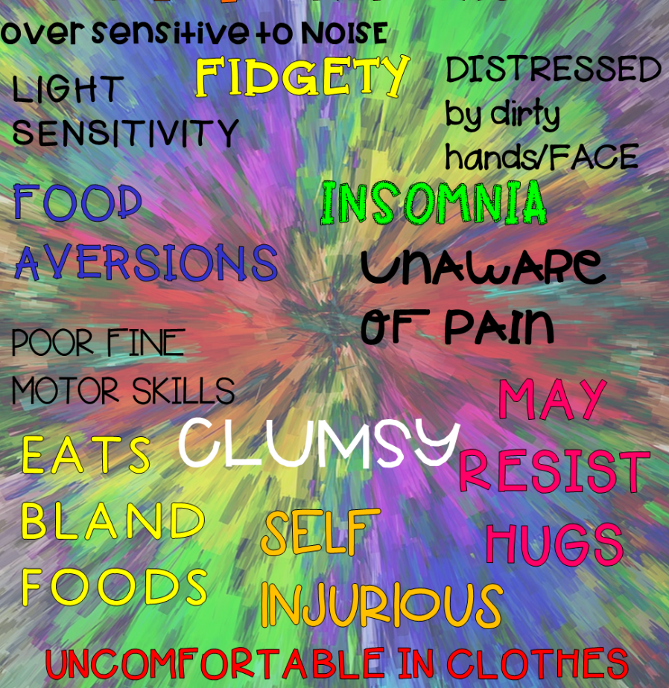
Sensory Processing Difficulties
This occurs when sensory signals are not organized and processed into appropriate motor & behavioural responses
Difficulties in sensory processing affect
every aspect of a person's functioning:
from posture
to catching a ball
focusing on a task
engaging in social relationships
Certain sensory input can be at best disturbing and at
worst, physically painful
https://www.bbc.com/future/article/20160617-the-daily-pain-of-having-extreme-perception

Slide 6
Synaesthesia
Synaesthesia is a condition in which a sensation in one of the senses triggers a sensation in another
For example seeing colour when listening to music or tasting numbers or shapes
Studies from the University of Edinburgh suggest 4% of the UK population could be affected by synaesthesia
Mixed signals
Autistic people are more likely to have synaesthesia than the general population
https://network.autism.org.uk/good-practice/evidence-base/synaesthesia-autism

Slide 7
Tasting words or sensing letters as colours
Lexical-gustatory synaesthesia is a rare form of synaesthesia
The individual senses words (both spoken and written) as distinct tastes, smells, and textures in the mouth or senses the tastes in their head
Grapheme-colour synaesthesia is one of the most prevalent and most studied
The individual naturally associates written letters and numerals with colours
https://synesthesia.me/see-your-name#
https://www.bbc.co.uk/news/health-21060207

Slide 8
A Neurological Traffic Jam
Sensory processing difficulties
The brain may not receive or detect sensory information
Or be able to efficiently organise the incoming sensory input
May not even send out accurate messages to direct the individual’s actions

Slide 9
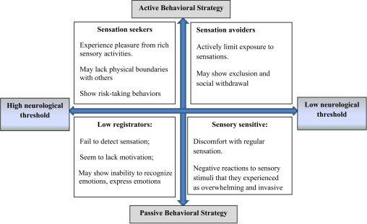
What is your Sensory Profile?
https://www.griffinot.com/wp-content/uploads/Checklist-Signs-and-Symptoms-of-Sensory-Processing-Disorder-2019.pdf

Slide 10
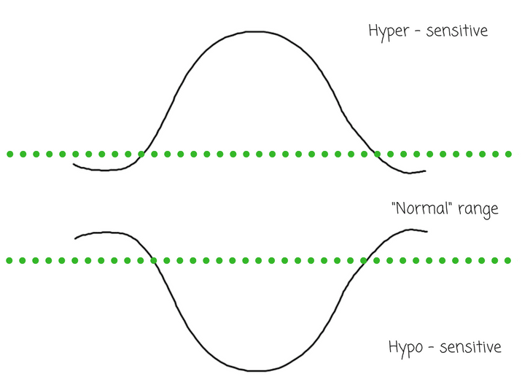
The Sensory Spectrum
describes the array of sensory differences that exist from one individual to another
Highly sensitive individuals:
Very sensitive to sensory input
Behave in ways that tend to avoid certain sensory input
Autistic individuals
Most neurotypical individuals
Hyposensitive individuals:
Less responsive to sensory input
Tend to exhibit certain sensory seeking behaviours
Autistic individuals
https://www.youtube.com/watch?v=Rsw-cBs74q0

Slide 11
The Autistic
nervous system
MELTDOWN – the brain’s ‘panic’ button has been set off!
is fragile and vulnerable to stress and overload
Point of no return
SHUTDOWN - brains attempt to minimize stimulation in order to avoid overload!
Critical point
Sensory receptors give inadequate feedback. Individual unaware of the rapid build up of stress chemicals.
Easily overwhelmed!
Nervous system running on high idle, anxious and insecure
https://www.facebook.com/autismdiscussionpage/posts/shutdowns-and-meltdownsthere-are-many-aspects-of-autism-that-make-the-world-chao/812793155466853/

Slide 12
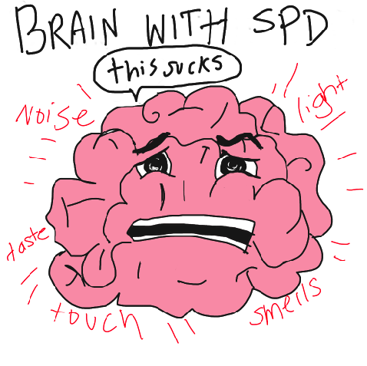
Sensory Processing & Autism
ASD
ASD and sensory processing difficulties often occur together
Certain behaviours, activities and/or interests may be due to over or under reactivity to sensory input or particular interest in sensory aspects of the environment
This can contribute significantly to increasing levels of stress
“IMAGINE BEING BORN into a world of bewildering, inescapable sensory overload, like a visitor from a much darker, calmer, quieter planet.”
Kaila and Henry Markram, neuroscientists
An out-of-sync nervous system influences the way the world is experienced and engaged with
https://time.com/3905841/autism-hyperfunctional/#:~:text=In%202007%2C%20researchers%20Kamila%20Markram,is%20actually%20supercharged%20and%20hyperfunctional.

Slide 13
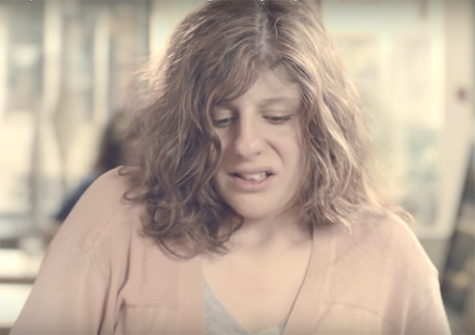
Autism Spectrum Condition
and sensory processing difficulties
Research has shown there is no clear pattern of responses in Autism to sensory information
Some brains are:
more sensitive
others could be slower to respond to sensory inputs
while others might seek out increased sensory inputs
One common finding is increased auditory sensitivity and the frequency of touch sensitivity for Autistic individuals
Carly Fleischmann: Autistic and non-verbal
https://www.youtube.com/watch?v=KmDGvquzn2k
‘If you've met one individual with Autism, you've met one individual with Autism.’
Stephen Shore

Slide 14
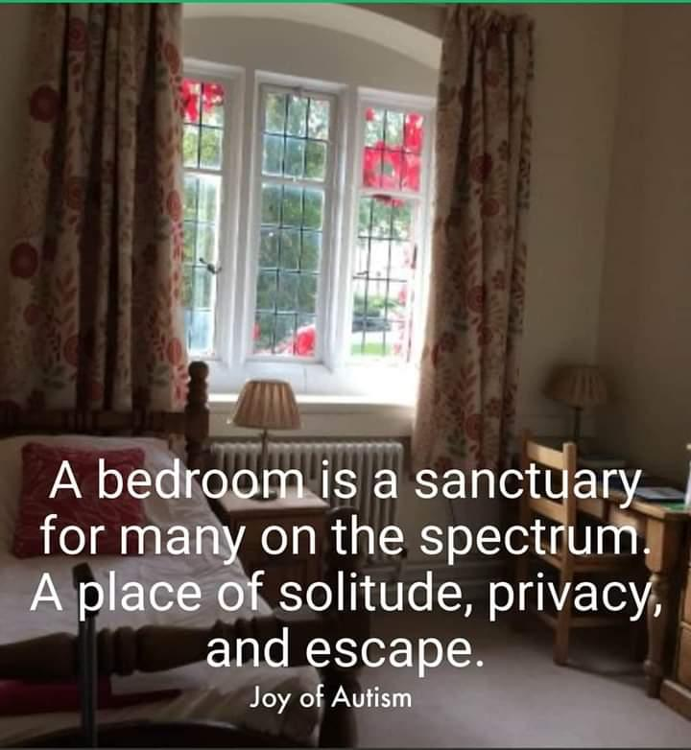
Autism Spectrum Condition
and the impact of sensory processing difficulties on daily living
Autistic neurology pays attention and processes every sensory input encountered
- Neurotypical brains can filter out unimportant sensory information
Sensory inputs will change depending on the environment:
- home: predictable; sensory inputs easier to manage; able to
retreat to a safe space
- the supermarket: unpredictable; huge amounts of sensory inputs
Responses to sensory inputs can fluctuate and change depending on:
- Time of day
- Health
- Anxiety and stress

Slide 15
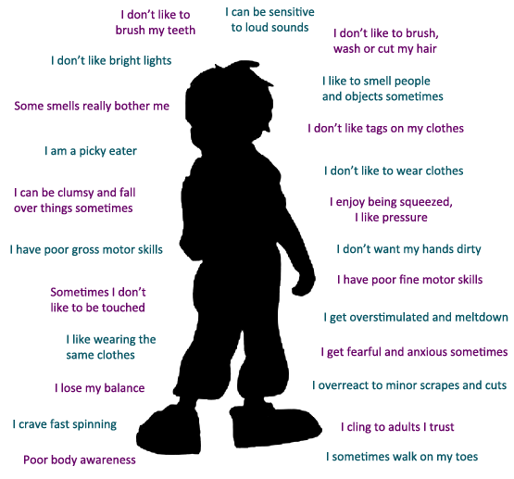
I cling to others I trust
Difficulties processing sensory input could mean . . .

Slide 16
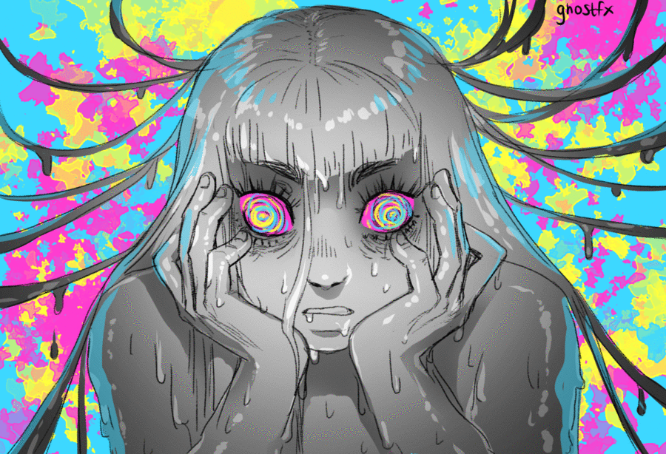
Sensory Overload
Imagine walking into a room filled with 25 72-inch flat-screen TVs that all have super-high definition and surround sound, but they’re all playing different movies. On full blast. At the same time!
Jenalyn Cloward Barton
https://tbirehabilitation.wordpress.com/2020/07/18/blog-post-21-people-explain-what-sensory-overload-feels-like-the-mighty/

Slide 17
https://www.youtube.com/watch?v=K2P4Ed6G3gw

Slide 18
Sensory Meltdown
A fight, flight or freeze response to sensory overload
Often mistaken for bad behaviour
A reaction to stimuli within the body or something in the environment which is usually beyond the individual’s control
https://themighty.com/2018/04/sensory-meltdowns-in-adults/

Slide 19
An insider view
Joe James; diagnosed with Autism in adulthood
‘Meltdowns are like heart attacks, you can have a snap one or a gradual one.
They build up slowly and can affect me for hours and sometimes even days.
Like a storm building up inside of me.
I feel myself tensing up, losing my patience, stimming uncontrollably and feeling very sick.
My anxiety levels go way up and I find myself being even more hyper sensitive to the things around me.
I may even have several snap meltdowns in the middle of a gradual one.
Sometimes I don't even realise they are happening, which is scary for me.
As I get older I'm getting better at recognizing the signs and have put measures into place to relax me.’
https://www.facebook.com/JoeJamesNeurodiversityawareness/

Slide 20
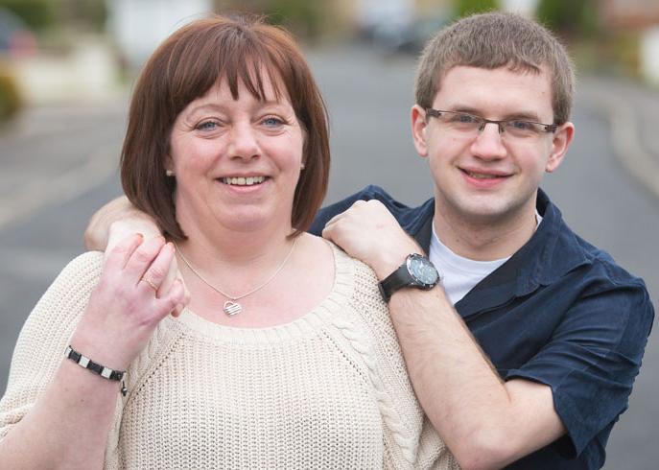
Responding to Sensory Meltdowns
Support to reduce the intensity and frequency of meltdowns:
Good hydration and access to regular, healthy snacks
Identify potential sensory triggers; keep a sensory triggers’ log
Avoid potential sensory triggers e.g. make use of noise cancelling headphones, a weighted blanket
Look at ways to improve sleep hygiene
Model and provide direct coaching on how to use calming and self-regulation techniques

Slide 21
Autism and Eating Disorders
Eating difficulties and sensory sensitivities; rigid and repetitive patterns around eating are often very much part of Autism
Avoidant and Restrictive Food Intake Disorder (AFRID) first introduced into DSM-5
To date very little research exists about the relationship between Autism and ARFID
https://pathologicaldemandavoidanceaprofileofautism.com/2019/03/18/45/

Slide 22
Autism and Eating Disorders
Three separate studies (2015 and 2017) suggest that 15% of women with anorexia are also Autistic
Dr James Cusack, Autistica's director of science
https://www.autistica.org.uk/
Women and girls are much less likely than men to be recognised as Autistic.
The accompanying ‘high levels of stress and anxiety’ contribute to the experience of severe mental health conditions e.g. eating disorders
Will Mandy, Autism Researcher, University College London
Sophie McInnes, a young Autistic adult was obsessed with counting calories
https://www.bbc.co.uk/news/health-47359416

Slide 23
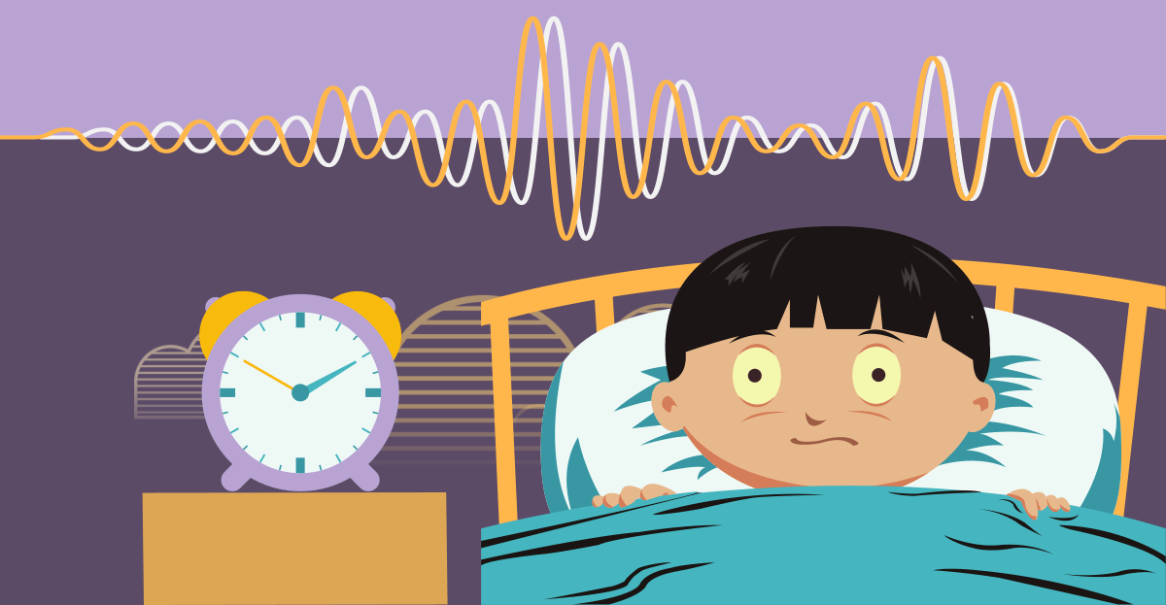
Autism and Sleep Difficulties
‘Not getting enough sleep, as I’m sure is true for many, causes me to struggle the next day.
I’m unable to think clearly and my processing worsens.
My mind obsesses.
I can’t handle even the slightest change.
I have a difficult time making decisions.
My senses are even more heightened.
I hear and smell everything causing me to be constantly overstimulated.
Touch is more difficult for me to receive than it normally is.
I’m clumsier.
I have an even more difficult time speaking to others and digesting my food.
I’m more likely to snap and to have meltdowns.’
By an Autistic adult with significant sleep difficulties
https://network.autism.org.uk/sites/default/files/ckfinder/files/Sleep%20issues%20in%20autistic%20adults%20PDF(1).pdf

Slide 24
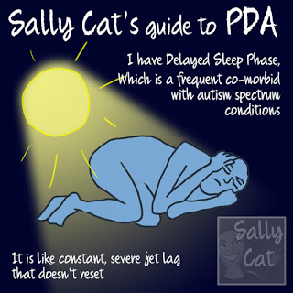
Delayed Sleep Phase Disorder
A circadian rhythm sleep disorder
Caused by the body's internal clock
An individual's sleep-wake cycle is significantly later than the societal norm e.g. sleeping from 5am to 1pm
Generally need more than eight hours sleep per ‘night’; natural wake times then tend to be even later than might be expected
Commonly experience extended sleep inertia (brain is slow to fully wake)
http://www.sallycatpda.co.uk/2019/02/delayed-sleep-phase-syndrome-and-pda.html

Slide 25
Responding to Sensory Meltdowns
Continued
Support to reduce the intensity and frequency of meltdowns:
Visual prompts and cues to identify and communicate emotions
Encourage and build up an appropriate emotional vocabulary
Get support to design an appropriate sensory diet
Teach breathing and mindfulness techniques
Use developmentally appropriate Social Stories and/or Comic Conversations
Keep to a daily routine as much as possible
Carefully prepare for transitions

Slide 26
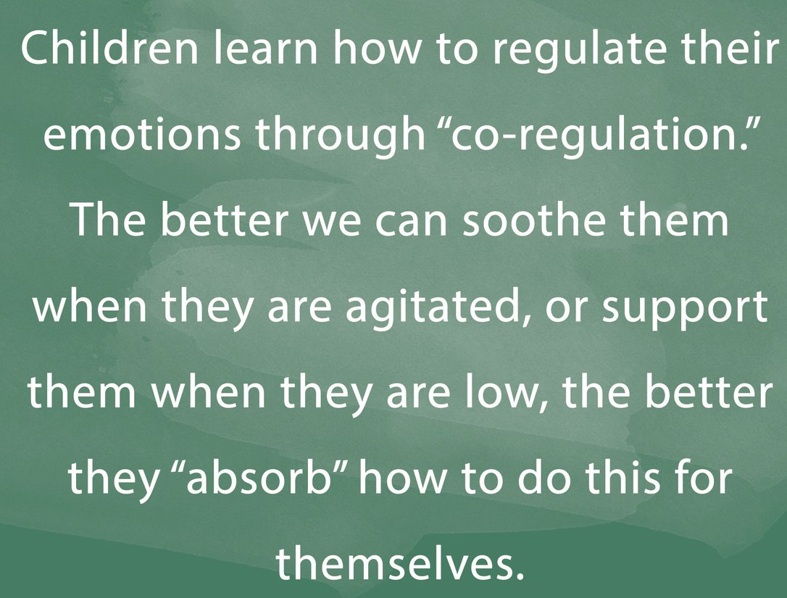
It takes two to tango (and self-regulate).
Dr. Stuart Shanker

Slide 27
57 Albion Road, Edinburgh EH7 5QY Tel: 0131 475 2416 Email: info@pasda.org.uk Website: www.pasda.org.uk Scottish Charity Number: SC042678
MAKE A DONATION TO SUPPORT Pasda’s WORK
If you have benefitted from this presentation, please consider supporting Pasda's work.
You can do this in one of four ways:
Donate via JustGiving on the Pasda website at: https://www.pasda.org.uk , at the top right of the Home Page.
Donate via JustGiving at: https://www.justgiving.com/pasdauk
Make a bank transfer. To do this, please contact us by phone or email for the account details.
Make out a cheque payable to Pasda, and mail it to our office at the address above.
Thank you very much.

